Slide 1
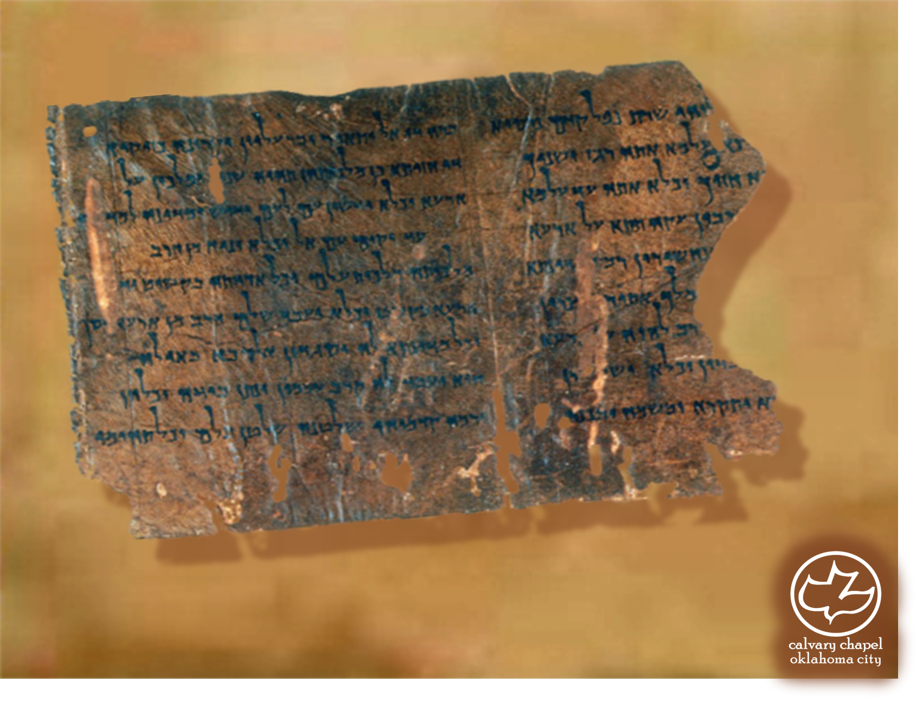

Minor Prophets … Major Message:
Zechariah 13:8-14:21
A CD of this message will be available (free of charge) immediately following today's message
This message will be available via podcast later this week at calvaryokc.com

Slide 2
Zechariah 13:8-14:21
Ezekiel War?
Rapture
Abomination of Desolation
Return of Christ
Rise of Antichrist
Time of Jacob’s Troubles
Church Age
Millennium
7 year Tribulation

Slide 3
Zechariah 13:8-14:21
Rom. 11:26-27 ~ ²⁶ And so all Israel will be saved, as it is written: "The Deliverer will come out of Zion, And He will turn away ungodliness from Jacob; ²⁷ For this is My covenant with them, When I take away their sins." (Is. 59:20-21)

Slide 4
Zechariah 13:8-14:21
Is. 63:1-4 ~ ¹ Who is this who comes from Edom, With dyed garments from Bozrah, This One who is glorious in His apparel, Traveling in the greatness of His strength? —"I who speak in righteousness, mighty to save." ² Why is Your apparel red, And Your garments like one who treads in the winepress?
³ "I have trodden the winepress alone, And from the peoples no one was with Me. For I have trodden them in My anger, And trampled them in My fury; Their blood is sprinkled upon My garments, And I have stained all My robes. ⁴ For the day of vengeance is in My heart, And the year of My redeemed has come."

Slide 5
Zechariah 13:8-14:21
Rapture
Wedding Feast of the Lamb
Return of Christ
Rise of Antichrist
Time of Jacob’s Troubles
Church Age
Millennium
7 year Tribulation

Slide 6
Zechariah 13:8-14:21
One ~ NIV, NASB – unique

Slide 7
Zechariah 13:8-14:21
Ezekiel 47:8-10 ~ ⁸ Then he said to me: "This water flows toward the eastern region, goes down into the valley, and enters the sea. When it reaches the sea, its waters are healed. ⁹ And it shall be that every living thing that moves, wherever the rivers go, will live. There will be a very great multitude of fish, because these
waters go there; for they will be healed, and everything will live wherever the river goes. ¹⁰ It shall be that fishermen will stand by it from En Gedi to En Eglaim; they will be places for spreading their nets. Their fish will be of the same kinds as the fish of the Great Sea, exceedingly many."

Slide 8
Zechariah 13:8-14:21
Jerusalem ~ Yawrah – to lay out or to instruct; Shalom – peace
Teaching of peace

Slide 9
Zechariah 13:8-14:21
Who is left ~ NIV, survivors – possibly the sheep of Matt. 25

Slide 10
Zechariah 13:8-14:21
Leviticus 23 ~ The 7 Feasts of Israel
1) Sabbath (v. 3) ~ Rest – the finished work of the Lord
2) Passover and Unleavened Bread (vv. 4-8) ~ Remission – being washed by the Blood of the Lamb
3) Firstfruits (vv. 9-14) ~ Resurrection – Christ was the firstfruits from the dead
4) Pentecost (vv. 15-22) ~ Regeneration – Institution of the Church and outpouring of the Holy Spirit

Slide 11
Zechariah 13:8-14:21
Leviticus 23 ~ The 7 Feasts of Israel
5) Trumpets (vv. 23-25) ~ Rapture – Rosh Hashanah
6) Day of Atonement – Redemption (We have been bought with a price)
7) Tabernacles ~ Residing – Our ruling with Him during the Millennium
Rev. 21:3 ~ And I heard a loud voice from heaven saying, "Behold, the tabernacle of God is with men, and He will dwell with them, and they shall be His people.

