Slide 1
TITUS 2:11-3:3

Slide 2
TITUS 2:11-3:3
Titus 2:11-3:3 ~ ¹¹ For the grace of God that brings salvation has appeared to all men, ¹² teaching us that, denying ungodliness and worldly lusts, we should live soberly, righteously, and godly in the present age, ¹³ looking for the blessed hope and glorious appearing of our great God and Savior Jesus Christ, ¹⁴ who gave Himself for us, that He might redeem us from every lawless deed and purify for Himself His own special people, zealous for good works.
¹⁵ Speak these things, exhort, and rebuke with all authority. Let no one despise you.

Slide 3
TITUS 2:11-3:3
Titus 2:11-3:3 ~ ^{3:1} Remind them to be subject to rulers and authorities, to obey, to be ready for every good work, ² to speak evil of no one, to be peaceable, gentle, showing all humility to all men. ³ For we ourselves were also once foolish, disobedient, deceived, serving various lusts and pleasures, living in malice and envy, hateful and hating one another.

Slide 4
TITUS 2:11-3:3

Slide 5
TITUS 2:11-3:3
all men (v. 11) ~ anthrōpos – i.e. humanity, mankind

Slide 6
TITUS 2:11-3:3

Slide 7
TITUS 2:11-3:3
Ps. 2:7 ~ I will declare the decree:
The Lord has said to Me,
“You are My Son,
Today I have begotten You.”

Slide 8
TITUS 2:11-3:3
Ps. 22:1, 6-8, 15-18 ~ ¹ My God, My God, why have You forsaken Me?
Why are You so far from helping Me,
And from the words of My groaning?
⁶ But I am a worm, and no man;
A reproach of men, and despised by the people.
⁷ All those who see Me ridicule Me;
They shoot out the lip, they shake the head, saying,
⁸ “He trusted in the Lord, let Him rescue Him;
Let Him deliver Him, since He delights in Him!"

Slide 9
TITUS 2:11-3:3
Ps. 22:1, 6-8, 15-18 ~ ¹⁵ My strength is dried up like a potsherd,
And My tongue clings to My jaws;
You have brought Me to the dust of death.
¹⁶ For dogs have surrounded Me;
The congregation of the wicked has enclosed Me.
They pierced My hands and My feet;
¹⁷ I can count all My bones.
They look and stare at Me.
¹⁸ They divide My garments among them,
And for My clothing they cast lots.

Slide 10
TITUS 2:11-3:3
Is. 53: 3-10 ~ ³ He is despised and rejected by men,
A Man of sorrows and acquainted with grief.
And we hid, as it were, our faces from Him;
He was despised, and we did not esteem Him.
⁴ Surely He has borne our griefs
And carried our sorrows;
Yet we esteemed Him stricken,
Smitten by God, and afflicted.
⁵ But He was wounded for our transgressions,
He was bruised for our iniquities;
The chastisement for our peace was upon Him,
And by His stripes we are healed.

Slide 11
TITUS 2:11-3:3
Is. 53: 3-10 ~ ⁶ All we like sheep have gone astray;
We have turned, every one, to his own way;
And the Lord has laid on Him the iniquity of us all.
⁷ He was oppressed and He was afflicted,
Yet He opened not His mouth;
He was led as a lamb to the slaughter,
And as a sheep before its shearers is silent,
So He opened not His mouth.
⁸ He was taken from prison and from judgment,
And who will declare His generation?
For He was cut off from the land of the living;

Slide 12
TITUS 2:11-3:3
Is. 53: 3-10 ~ For the transgressions of My people He was stricken.
⁹ And they made His grave with the wicked—
But with the rich at His death,
Because He had done no violence,
Nor was any deceit in His mouth.
^{10a} Yet it pleased the Lord to bruise Him …

Slide 13
TITUS 2:11-3:3

Slide 14
TITUS 2:11-3:3
Gal. 3:24 ~ Therefore the law was our tutor to bring us to Christ,
tutor ~ paidagōgos (n.) – instructor
teaching ~ paideuō (v.)– instructing

Slide 15
TITUS 2:11-3:3

Slide 16
TITUS 2:11-3:3
denying ungodliness ~ double negative = “pursue godliness”

Slide 17
TITUS 2:11-3:3

Slide 18
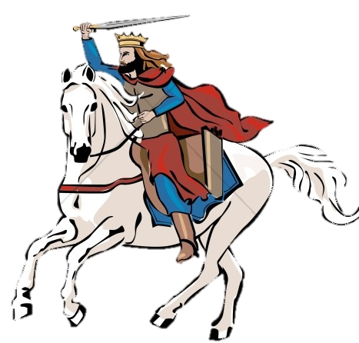
TITUS 2:11-3:3
appeared (v. 11) ~ epiphainō – (v.) epiphany
appearing (v. 13) ~ epiphaneia – (n.)
Jonathan Edwards (1703-1758) ~ “Grace is but Glory begun … and Glory is but Grace perfected.”
This Photo by Unknown uthor is licensed under CC BY-NC

Slide 19
TITUS 2:11-3:3

Slide 20
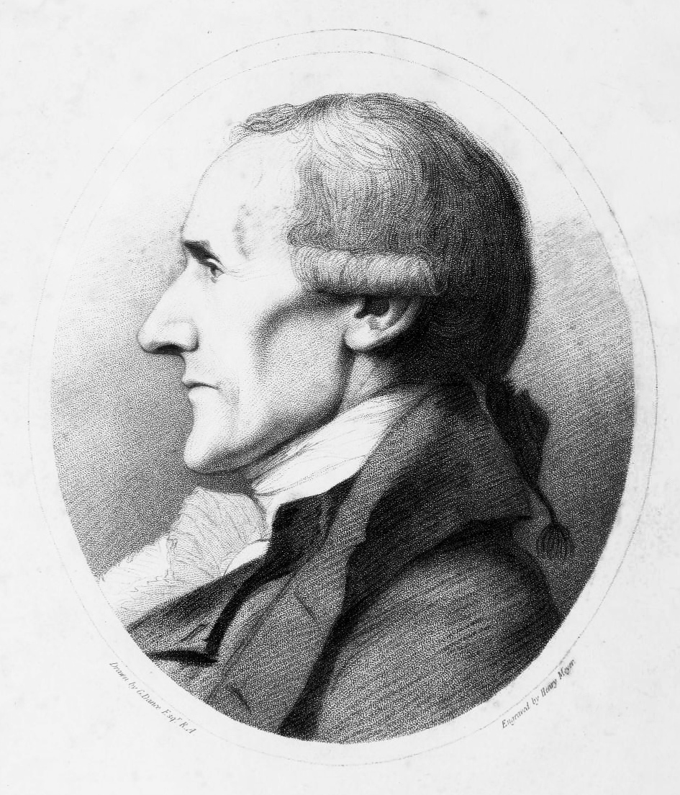
TITUS 2:11-3:3
Sharp’s rule:
We met the janitor and pastor of the church,
John Jones.
the
Granville Sharp (1735–1813)
This Photo by Unknown uthor is licensed under CC BY-NC

Slide 21
TITUS 2:11-3:3

Slide 22
TITUS 2:11-3:3
special ~ KJV, peculiar

Slide 23
TITUS 2:11-3:3

Slide 24
TITUS 2:11-3:3
rebuke ~ elegchō – to convince of, or provide evidence of a fault
authority ~ epitagē – noun form of verb “to command”

Slide 25
TITUS 2:11-3:3

Slide 26
TITUS 2:11-3:3
also once ~ KJV, sometimes
foolish ~ literally “without understanding”
lusts ~ epithumia – to burn upon
pleasures ~ hēdonē – the Greek goddess of pleasure
serving ~ douleuō – present participle of doulos
John Newton (1725-1807) ~ “If ever I reach heaven I expect to find three wonders there: first, to meet some I had not thought to see there; second, to miss some I had expected to see there; and third – the greatest
wonder of all – to find myself there.”

Slide 27
TITUS 2:11-3:3

