Slide 1
TITUS 1:10-2:10

Slide 2
TITUS 1:10-2:10
Titus 1:10-2:10 ~ ¹⁰ For there are many insubordinate, both idle talkers and deceivers, especially those of the circumcision, ¹¹ whose mouths must be stopped, who subvert whole households, teaching things which they ought not, for the sake of dishonest gain. ¹² One of them, a prophet of their own, said, “Cretans are always liars, evil beasts, lazy gluttons.” ¹³ This testimony is true. Therefore rebuke them sharply, that they may be sound in the faith, ¹⁴ not giving heed to Jewish fables and commandments of men who turn from the truth. ¹⁵ To the pure all things are pure, but to those who are defiled and unbelieving nothing is pure; but even their mind and
conscience are defiled.

Slide 3
TITUS 1:10-2:10
Titus 1:10-2:10 ~ ¹⁶ They profess to know God, but in works they deny Him, being abominable, disobedient, and disqualified for every good work.
^{2:1} But as for you, speak the things which are proper for sound doctrine: ² that the older men be sober, reverent, temperate, sound in faith, in love, in patience; ³ the older women likewise, that they be reverent in behavior, not slanderers, not given to much wine, teachers of good things — ⁴ that they admonish the young women to love their husbands, to love their children, ⁵ to be discreet, chaste, homemakers, good, obedient to their own husbands, that the word of God may not be
blasphemed.

Slide 4
TITUS 1:10-2:10
Titus 1:10-2:10 ~ ⁶ Likewise, exhort the young men to be sober-minded, ⁷ in all things showing yourself to be a pattern of good works; in doctrine showing integrity, reverence, incorruptibility, ⁸ sound speech that cannot be condemned, that one who is an opponent may be ashamed, having nothing evil to say of you.
⁹ Exhort bondservants to be obedient to their own masters, to be well pleasing in all things, not answering back, ¹⁰ not pilfering, but showing all good fidelity, that they may adorn the doctrine of God our Savior in all things.

Slide 5
TITUS 1:10-2:10

Slide 6
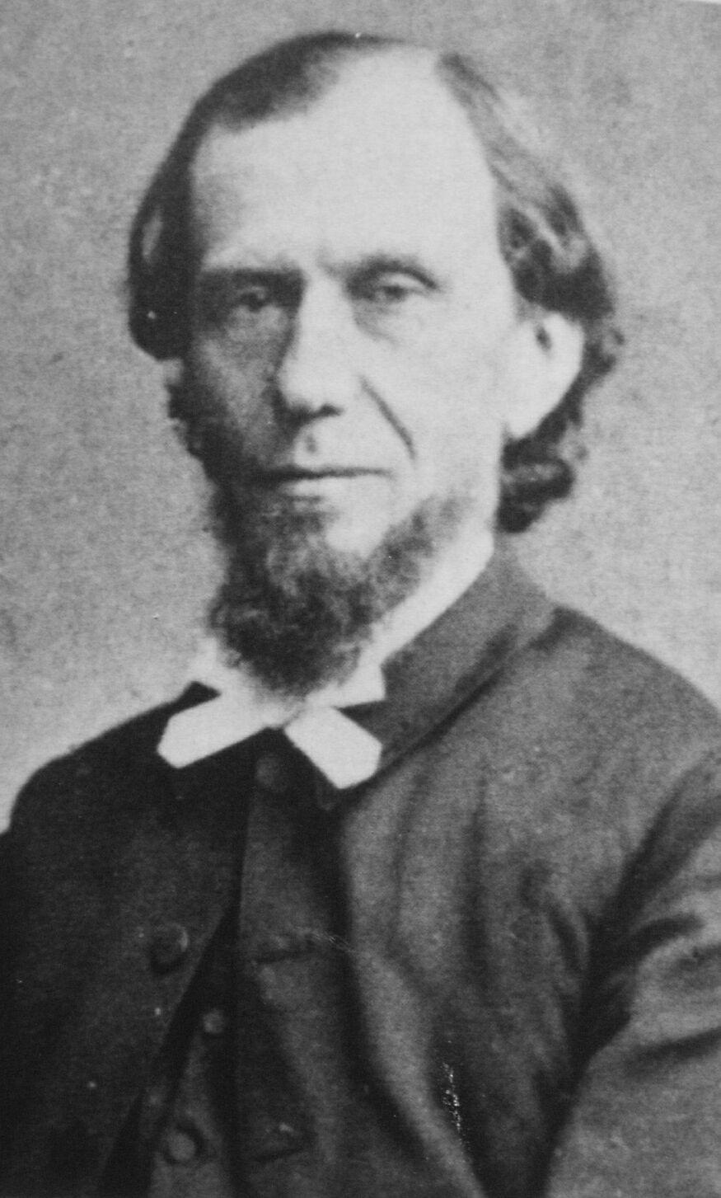
TITUS 1:10-2:10
insubordinate ~ literally, “non-submissive”
“unaccountable”
Andrew Murray (1828-1917) ~ “The chief mark of counterfeit holiness is its lack of humility. Every seeker after holiness needs to be on his guard, lest unconsciously what was begun in the spirit be perfected in the flesh, and pride creep in where its presence is least expected.”

Slide 7
TITUS 1:10-2:10

Slide 8
TITUS 1:10-2:10
dishonest gain (also NIV)
KJV, filthy lucre
NASB, sordid gain
Literally, “shameful gain”

Slide 9
TITUS 1:10-2:10

Slide 10
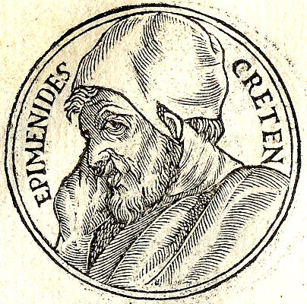
TITUS 1:10-2:10
Epimenides
krētizō – to lie, or deceive
lazy gluttons ~ Marvin Vincent: “They are so given to gluttony that they are mere bellies.”

Slide 11
TITUS 1:10-2:10

Slide 12
TITUS 1:10-2:10
2 greatest hindrances to being sound in the faith:
Jewish fables ~ legalism
commandments of men ~ traditionalism

Slide 13
TITUS 1:10-2:10

Slide 14
TITUS 1:10-2:10
How can I walk in holiness without being a legalist?
How can I walk in grace without being licentious?
Soren Kierkegaard ~ “purity of heart is ‘willing one thing’”

Slide 15
TITUS 1:10-2:10
Phil. 4:8 ~ Finally, brethren, whatever things are true, whatever things are noble, whatever things are just, whatever things are pure, whatever things are lovely, whatever things are of good report, if there is any virtue and if there is anything praiseworthy — meditate on these things.

Slide 16
TITUS 1:10-2:10

Slide 17
TITUS 1:10-2:10
sound ~ hugiainō – 12x
Luke (2x)
3 John (1x)
Titus (5x)
1&2 Timothy (4x)

Slide 18
TITUS 1:10-2:10

Slide 19
TITUS 1:10-2:10
older ~ KJV, aged – presbutēs
sober ~ “free from outside influences: alcohol, money, anger, lust or greed”
Matthew Henry ~ “… not thinking that the decays of nature will justify any excess; but seeking comfort from nearer communion with God, not from any undue indulgence”

Slide 20
TITUS 1:10-2:10
reverent ~ KJV, grave – semnos
NASB ~ dignified
NIV ~ worthy of respect
temperate ~ sōphrōn – literally saved midriff

Slide 21
TITUS 1:10-2:10

Slide 22
TITUS 1:10-2:10
older ~ KJV, aged
reverent ~ heiroprepōs – literally, “becoming holy”
KJV, as becometh holiness

Slide 23
TITUS 1:10-2:10
Rom. 12:1 ~ I beseech you therefore, brethren, by the mercies of God, that you present your bodies a living sacrifice, holy, acceptable to God, which is your reasonable service.
Merrihew Standard Version ~ Therefore, in light of all that He has done for us, the only logical and sensible response would be for us to surrender ourselves willingly, wholly and without reservation to God’s purposes and will.

Slide 24
TITUS 1:10-2:10
slanderers – also, NIV
KJV, false accusers
diabolos
diabolos – devil
NASB, malicious gossips
This Photo by Unknown Author is licensed under CC BY-SA-NC

Slide 25
TITUS 1:10-2:10

Slide 26
TITUS 1:10-2:10
obedient ~ NASB, NIV – better, subject

Slide 27
TITUS 1:10-2:10

Slide 28
TITUS 1:10-2:10
sober-minded ~ sōphrōn – form occurs in all 4 groups
older men ~ temperate (v. 2)
older women ~ admonish (v. 4)
young women ~ be discreet (v. 5)
young men ~ sober-minded (v. 6)

Slide 29
TITUS 1:10-2:10

Slide 30
TITUS 1:10-2:10
answering back ~ antilegō – same as 1:9 (contradict)

Slide 31
TITUS 1:10-2:10

Slide 32
TITUS 1:10-2:10
adorn ~ kosmeō – cosmetics
Merrihew Standard Version (vv. 9-10) ~ Encour-age employees to show their Christianity in word and deed before their employers so that they to might be attracted to a belief in our God and Savior.

Slide 33
TITUS 1:10-2:10

