Slide 1
Romans 9:1-21
A CD of this message will be available (free of charge) immediately following today’s Bible study.
This message will be available via podcast later this week at calvaryokc.com

Slide 2
Romans 9:1-21
Chapter 9 ~ Israel's past
Chapter 10 ~ Israel's present
Chapter 11 ~ Israel's future

Slide 3
Romans 9:1-21
Wiersbe ~ "Try to explain God's sovereign election and you may lost your mind.
But try to explain it away and you may lose your soul."

Slide 4
Romans 9:1-21

Slide 5
Romans 9:1-21
Albert Einstein ~ "God casts the die, not the dice."

Slide 6
Romans 9:1-21

Slide 7
Romans 9:1-21
Accursed ~ anathema
Exodus 32:31–32 ~ ³¹ Then Moses returned to the Lord and said, "Oh, these people have committed a great sin, and have made for themselves a god of gold! ³² Yet now, if You will forgive their sin—but if not, I pray, blot me out of Your book which You have written."

Slide 8
Romans 9:1-21
Johann Bengel ~ "It is not easy to estimate the measure of love in a Moses and a Paul. For our limited reason does not grasp it, as the child cannot comprehend the courage of warriors!"

Slide 9
Romans 9:1-21

Slide 10
Romans 9:1-21
Glory ~ dōxa
Heb. ~ kabowd (not shekinah) – from a root meaning to make heavy

Slide 11
Romans 9:1-21

Slide 12
Romans 9:1-21
NIV ~ Theirs are the patriarchs, and from them is traced the human ancestry of Christ, who is God over all, forever praised! Amen.

Slide 13
Romans 9:1-21

Slide 14
Romans 9:1-21
Israel ~ ruled by God or God rules
Seed ~ sperma

Slide 15
Romans 9:1-21

Slide 16
Romans 9:1-21
Luke 14:26 ~ If anyone comes to Me and does not hate his father and mother, wife and children, brothers and sisters, yes, and his own life also, he cannot be My disciple.

Slide 17
Romans 9:1-21

Slide 18
Romans 9:1-21
Ex. 9:34-35 ~ ³⁴ And when Pharaoh saw that the rain, the hail, and the thunder had ceased, he sinned yet more; and he hardened his heart, he and his servants.
Harden - kabed (heavy)
Also 7:14; 8:15, 32; 9:7
³⁵ So the heart of Pharaoh was hard; neither would he let the children of Israel go, as the Lord had spoken by Moses.
Hard – chazaq (to strengthen)

Slide 19
Romans 9:1-21

Slide 20
Romans 9:1-21
Hardens ~ sclērunō – sclerosis

Slide 21
Romans 9:1-21

Slide 22
Romans 9:1-21
Jer. 12:5 ~ If you have run with the footmen, and they have wearied you,
Then how can you contend with horses?

Slide 23
Romans 9:1-21

Slide 24
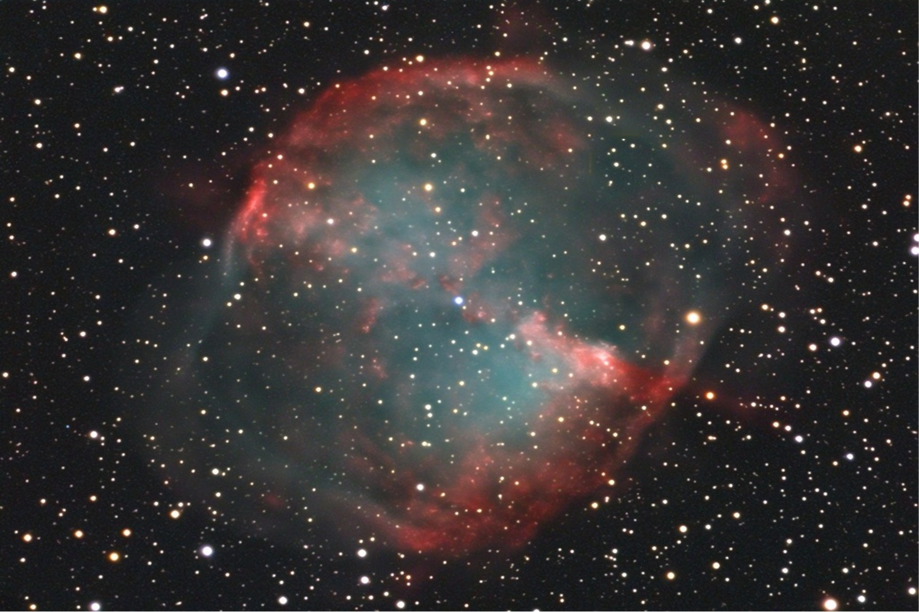
Romans 9:1-21
GOD

Slide 25
Romans 9:1-21

Slide 26
Romans 9:1-21
4 New Spiritual Laws
1. There is a God
2. You are not Him
3. You are confused about this
4. You need to repent

Slide 27
Romans 9:1-21

