Slide 1
Romans 6:11-23
A CD of this message will be available (free of charge) immediately following today’s Bible study.
This message will be available via podcast later this week at calvaryokc.com

Slide 2
Romans 6:11-23
A. W. Pink ~ "An ineffably holy God, who has the utmost abhorrence of sin, was never invented by any of Adam's descendants."

Slide 3
Romans 6:11-23

Slide 4
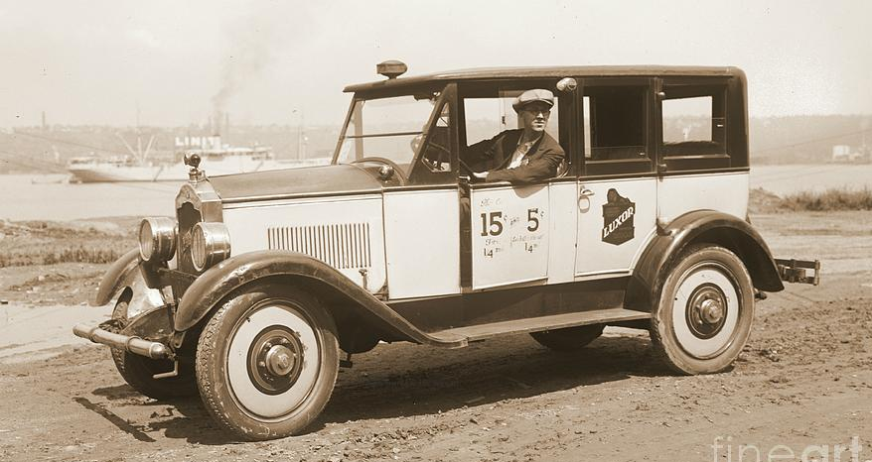
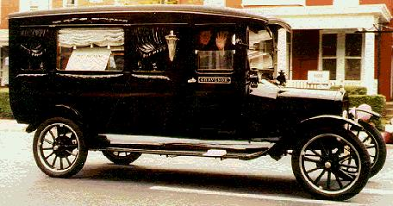
Romans 6:11-23

Slide 5
Romans 6:11-23

Slide 6
Romans 6:11-23
RECOGNIZE THE DATA (vv. 3-10)
RECKON THE DEATH (vv. 11-12)
REMIT OUR DEVICES (vv. 13-23)

Slide 7
Romans 6:11-23

Slide 8
Romans 6:11-23
Chap. 5 ~ dia (through Christ, by faith, etc.)
Chap. 6 ~ en (in Christ)
Reckon ~ logizomai – to take an inventory, conclude, compute

Slide 9
Romans 6:11-23
1st fact: We are identified into Jesus death
2nd fact: This identification allows me to be "grafted" into Him
3rd fact: This engrafting is past tense
4th fact: This past tense death renders my "old man" "inactive"
5th fact: My inactive old man is free from sin
6th fact: My identification with Jesus brings me life

Slide 10
Romans 6:11-23

Slide 11
Romans 6:11-23
Instruments ~ hoplon – tool, usually associated with warfare (weapon, armor)
Phillips ~ ¹² Do not, then, allow sin to establish any power over your mortal bodies in making you give way to its lusts. ¹³ Nor hand over your bodily parts to be, as it were, weapons of evil for the devil’s purposes. But, like men rescued from certain death, put yourselves in God’s hands as weapons of good for his own purposes.

Slide 12
Romans 6:11-23

Slide 13
Romans 6:11-23
Dominion ~ kurieuō – same word as v. 9 (verb form of kurios)

Slide 14
Romans 6:11-23

Slide 15
Romans 6:11-23
Jude 1:4 ~ For certain men have crept in unnoticed, who long ago were marked out for this condemnation, ungodly men, who turn the grace of our God into lewdness and deny the only Lord God and our Lord Jesus Christ.

Slide 16
Romans 6:11-23

Slide 17
Romans 6:11-23
F. F. Bruce ~ "To treat being under grace as an excuse for sinning is a sign that one is not really under grace at all."

Slide 18
Romans 6:11-23

Slide 19
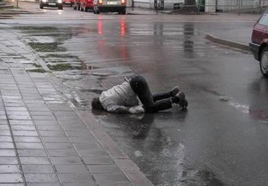
Romans 6:11-23
FOR ALL YOU DO …
THIS BUD'S FOR YOU

Slide 20
Romans 6:11-23

Slide 21
Romans 6:11-23
Feeling Faith and Fact
Three men were walking on a wall,
Feeling, Faith, and Fact,
When Feeling got an awful fall,
And Faith was taken back
So close was Faith to Feeling,
He stumbled and fell too,
But Fact remained,
And pulled Faith back,
And Faith brought Feeling too.

Slide 22
Romans 6:11-23

Slide 23
Romans 6:11-23
13th Amendment
Section 1. Neither slavery nor involuntary servitude, except as a punishment for crime whereof the party shall have been duly convicted, shall exist within the United States, or any place subject to their jurisdiction.
Section 2. Congress shall have power to enforce this article by appropriate legislation.

Slide 24
Romans 6:11-23

