Slide 1
Romans 4:1-12
A CD of this message will be available (free of charge) immediately following today’s Bible study.
This message will be available via podcast later this week at calvaryokc.com

Slide 2
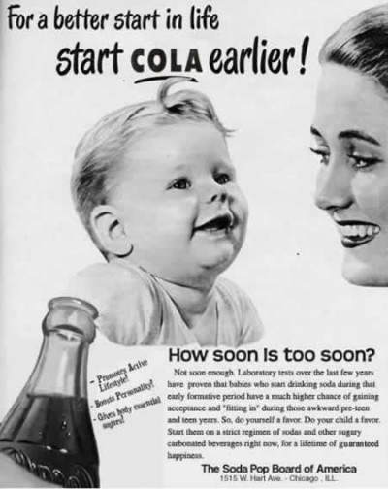
Romans 4:1-12

Slide 3
Romans 4:1-12

Slide 4
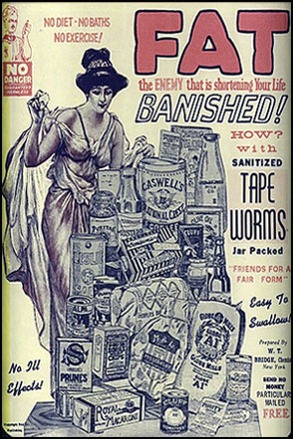
Romans 4:1-12

Slide 5
Romans 4:1-12

Slide 6
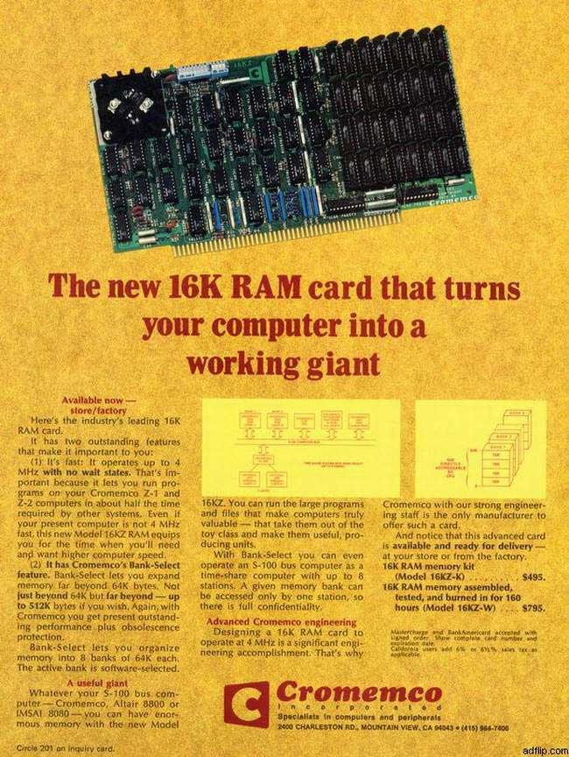
Romans 4:1-12

Slide 7
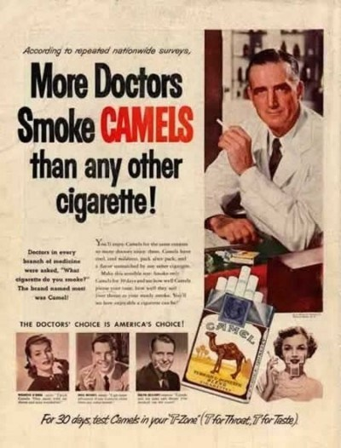
Romans 4:1-12

Slide 8
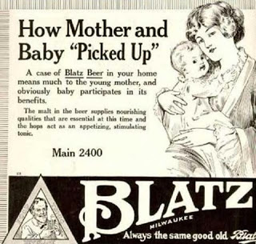
Romans 4:1-12

Slide 9
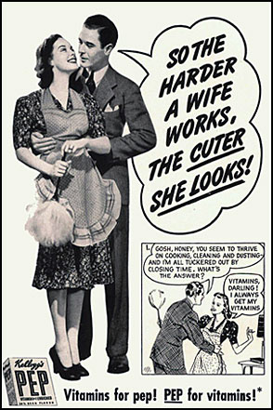
Romans 4:1-12

Slide 10
Romans 4:1-12

Slide 11
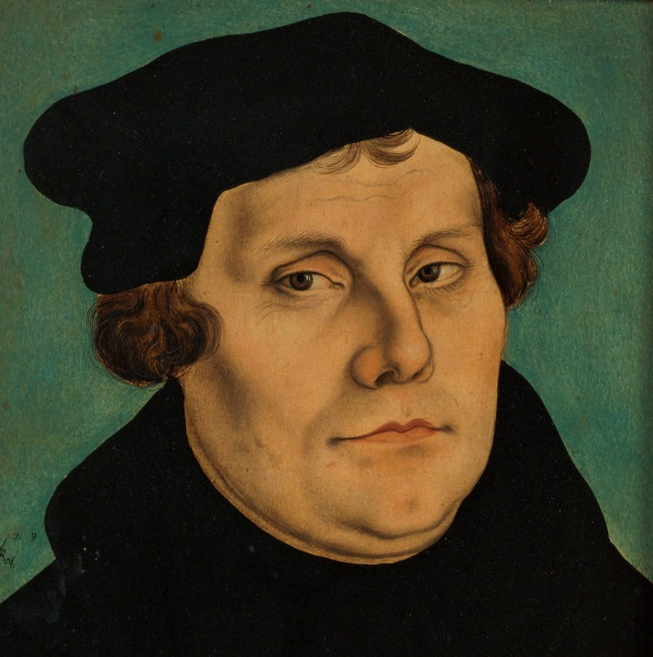
Romans 4:1-12
Martin Luther
Sola scriptura ~ by the Word alone
Sola gratia ~ by grace alone
Sola fide ~ by faith alone

Slide 12
Romans 4:1-12

Slide 13
Romans 4:1-12
Father ~ literally, forefather - as in NIV, NASB

Slide 14
Romans 4:1-12

Slide 15
Romans 4:1-12
Accounted ~ logizomai
40x in New Testament
34x by Paul (35x with Hebrews)
18x in Romans
11x in Romans 4
James 2:23 ~ And the Scripture was fulfilled which says, "Abraham believed God, and it was accounted to him for righteousness." And he was called the friend of God.

Slide 16
Romans 4:1-12

Slide 17
Romans 4:1-12
Deut. 25:1 ~ If there is a dispute between men, and they come to court, that the judges may judge them, and they justify the righteous and condemn the wicked,
1 Kings 8:31-32 ~ ³¹ When anyone sins against his neighbor, and is forced to take an oath, and comes and takes an oath before Your altar in this temple, ³² then hear in heaven, and act, and judge Your servants, condemning the wicked, bringing his way on his head, and justifying the righteous by giving him according to his righteousness.

Slide 18
Romans 4:1-12
Ex. 23:7 ~ Keep yourself far from a false matter; do not kill the innocent and righteous. For I will not justify the wicked.

Slide 19
Romans 4:1-12

Slide 20
Romans 4:1-12
Abraham's call (13)
Ishmael born (16)
Isaac born (21)
Death of Sarah (23)
James 2:20-24
14 years
35 years
75
85
95
105
115
125
135
145
155
165
175
Abraham be-lieved God (15)
Circumcision (17)
Offering of Isaac (22)
Death of Abraham (25)
Abraham's timeline

Slide 21
Romans 4:1-12
A. W. Tozer ~ "The Bible recognizes no faith that does not lead to obedience, nor does it recognize any obedience that does not spring from faith. The two are at opposite sides of the same coin.”
Gen. 15:6 ~ Then he believed in the Lord; and He reckoned it to him as righteousness.
Believed ~ aman – root of amen

Slide 22
Romans 4:1-12

Slide 23
Romans 4:1-12
Rom. 3:24 ~ being justified freely by His grace through the redemption that is in Christ Jesus,

Slide 24
Romans 4:1-12

