Slide 1
A free CD of this message will be available following the service
6 . 5 – 1 7
This message will also be available for podcast later in the week a calvaryokc.com

Slide 2
6 . 5 – 1 7
Matt. 24.7a ~ For nation will rise against nation, and kingdom against kingdom. And there will be famines,
Rats ~ 35 diseases, 200 million people

Slide 3
6 . 5 – 1 7

Slide 4
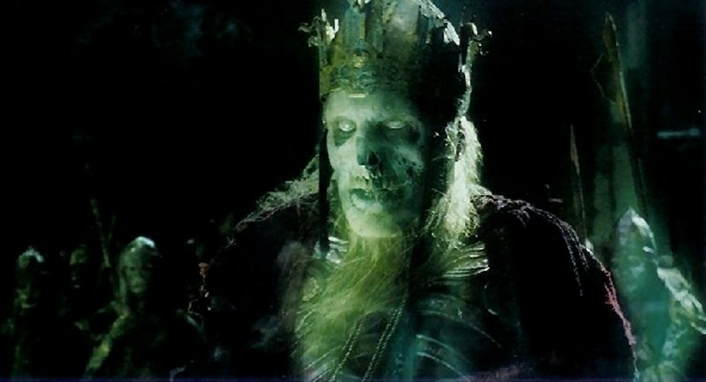
6 . 5 – 1 7
Pale horse ~ NASB, ashen; NLT, whose color was pale green like a corpse
chloros ~ chlorine, chlorophyll, etc.

Slide 5
6 . 5 – 1 7
, but thērion – always a wild beast
Beasts ~ not, zōon
30x in Revelation
Used of Antichrist and False Prophet
Matt. 24.7b ~ And there will be pestilences, and earthquakes in various places.

Slide 6
6 . 5 – 1 7
1918 flu epidemic:
Affected 500,000,000 people worldwide
Killed possibly 25,000,000 in the first 25 weeks
Between 50-100 million worldwide total
Killed more people in 6 months than the Black Plague in 100 years

Slide 7
6 . 5 – 1 7

Slide 8
6 . 5 – 1 7
Matt. 24.8 ~ All these are the beginning of sorrows.
Sorrows ~ hōdin – birth pang

Slide 9
6 . 5 – 1 7

Slide 10
6 . 5 – 1 7
1 Thess. 4.16-17 ~ ¹⁶ For the Lord Himself will descend from heaven with a shout, with the voice of an archangel, and with the trumpet of God. And the dead in Christ will rise first. ¹⁷ Then we who are alive and remain shall be caught up together with them in the clouds to meet the Lord in the air. And thus we shall always be with the Lord.

Slide 11
6 . 5 – 1 7

Slide 12
6 . 5 – 1 7
Lord ~ not kurios but despotēs

Slide 13
6 . 5 – 1 7

Slide 14
6 . 5 – 1 7
Matt. 24.9 ~ Then they will deliver you up to tribulation and kill you, and you will be hated by all nations for My name's sake.

Slide 15
6 . 5 – 1 7

Slide 16
6 . 5 – 1 7
Matt. 4.8c ~ And there will be … earthquakes in various places.

Slide 17
6 . 5 – 1 7

Slide 18
6 . 5 – 1 7
USGS ~ magnitude of 6.0 or greater
1890-99
= 1
1900-09
= 3
1910-19
= 2
1920-29
= 2
1930-39
= 5
1940-49
= 4
1950-59
= 9
1960-69
= 13
1970-79
= 51
1980-89
= 86
1990-99
= 1365
2000-09
= 1591

Slide 19
6 . 5 – 1 7

Slide 20
6 . 5 – 1 7
Babylonians used a base 6 system
A B C D E F G H I
6 9 18 24 30 36 42 48 54
J K L M N O P Q R
60 66 72 78 84 90 96 102 108
S T U V W X Y Z
114 120 126 132 138 144 150 154
K I S S I N G E R
66 54 114 114 54 84 42 30 108
= 666

Slide 21
6 . 5 – 1 7

