Slide 1
A free CD of this message will be available following the service
3 . 1 4 – 2 2
This message will also be available for podcast later in the week a calvaryokc.com

Slide 2
3 . 1 4 – 2 2
Laodicea 1800 – Present
Philadelphia 1800 - Present
Sardis 1517 - Present
Thyatira 590 - Present
Pergamos 314 - 590
Smyrna 100 - 314
Ephesus 32 - 100
200
400
600
800
1000
1200
1400
1600
1800
2000

Slide 3
3 . 1 4 – 2 2
Revelation 1:19 ~
Things which you have seen ~ chapter 1
Things which are ~ chapters 2-3
Things which will take place after this ~ chapters 4-22

Slide 4
3 . 1 4 – 2 2

Slide 5
3 . 1 4 – 2 2
Laodicea ~ laos – people; dikē ; to rule
Hence, rule of the people

Slide 6
3 . 1 4 – 2 2

Slide 7
3 . 1 4 – 2 2
William Barclay ~ “Laodicea was too rich to accept help from anyone. Tacitus, the Roman historian, tells us: ‘Laodicea arose from the ruins by the strength of her own resources, and with no help from us.’”

Slide 8
3 . 1 4 – 2 2

Slide 9
3 . 1 4 – 2 2
archē ~ origin, the person or thing that commences
Wuest ~ the originating source of the creation of God.

Slide 10
3 . 1 4 – 2 2

Slide 11
3 . 1 4 – 2 2
Donald G. Barnhouse ~ “So the Lord is saying, ‘If instead of being lukewarm, you were so cold that should feel that coldness, then the very feeling of your need might drive you to the true warmth, but now in your lukewarmness, you have just enough to protect yourselves against a feeling of need.’”

Slide 12
3 . 1 4 – 2 2
G. Campbell Morgan ~ "All the wrath of my heart could not equal the words of Christ to such as are lukewarm, 'I am about to spew thee out of My mouth.' He loathes the unimpassioned regularity of the man who professes to believe the facts which constitute evangelical faith, and does not yield himself to the great claims lying within these truths. Lukewarmness is the worst form of blasphemy.
Let the tepid churches call themselves clubs, and we shall know how to deal with them. Let tepid men leave the churches. Let them say they do not believe in Christ, for that is the true statement."

Slide 13
3 . 1 4 – 2 2
1 Kg. 18:21 ~ And Elijah came to all the people, and said, "How long will you falter between two opinions? If the LORD is God, follow Him; but if Baal, follow him."

Slide 14
3 . 1 4 – 2 2

Slide 15
3 . 1 4 – 2 2
Vomit ~ emeō
NASB, NIV ~ spit
Message ~ You’re stale. You’re stagnant. You make me want to vomit.

Slide 16
3 . 1 4 – 2 2

Slide 17
3 . 1 4 – 2 2
Rev. 2:9 ~ I know your works, tribulation, and poverty (but you are rich);

Slide 18
3 . 1 4 – 2 2

Slide 19
3 . 1 4 – 2 2
Vance Havner ~ "The cause of Christ has been hurt more by Sunday-morning bench-warmers who pretend to love Christ, who call Him Lord but do not His commands, than by all the publicans and sinners."

Slide 20
3 . 1 4 – 2 2

Slide 21
3 . 1 4 – 2 2
Isaiah 55:1–2 ~ ¹ Ho! Everyone who thirsts,
Come to the waters;
And you who have no money,
Come, buy and eat.
Yes, come, buy wine and milk
Without money and without price.
² Why do you spend money for what is not bread,
And your wages for what does not satisfy?
Listen carefully to Me, and eat what is good,
And let your soul delight itself in abundance.

Slide 22
3 . 1 4 – 2 2

Slide 23
3 . 1 4 – 2 2
Love ~ not agapaō (unconditional love), but phileō (strong affection)

Slide 24
3 . 1 4 – 2 2

Slide 25
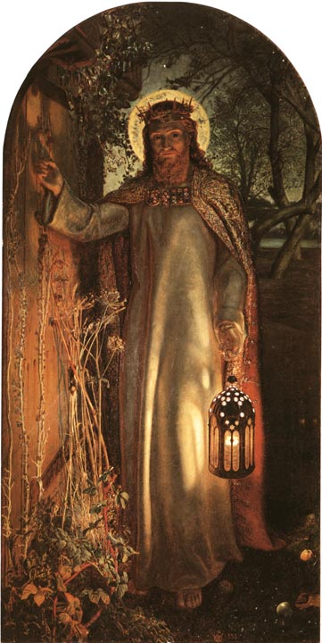
3 . 1 4 – 2 2

Slide 26
3 . 1 4 – 2 2
William Barclay ~ "Supper (deipnon) was the main meal of the day. This was the meal at which a man sat and talked for long, for now there was time, for work was ended . . . it is not a mere courtesy visit, paid in the passing, which Jesus Christ offers to us. He desires to come in and to sit long with us, and to wait as long as we wish him to wait.”

Slide 27
3 . 1 4 – 2 2

