Slide 1
Psalms
the book of
142-145

Slide 2
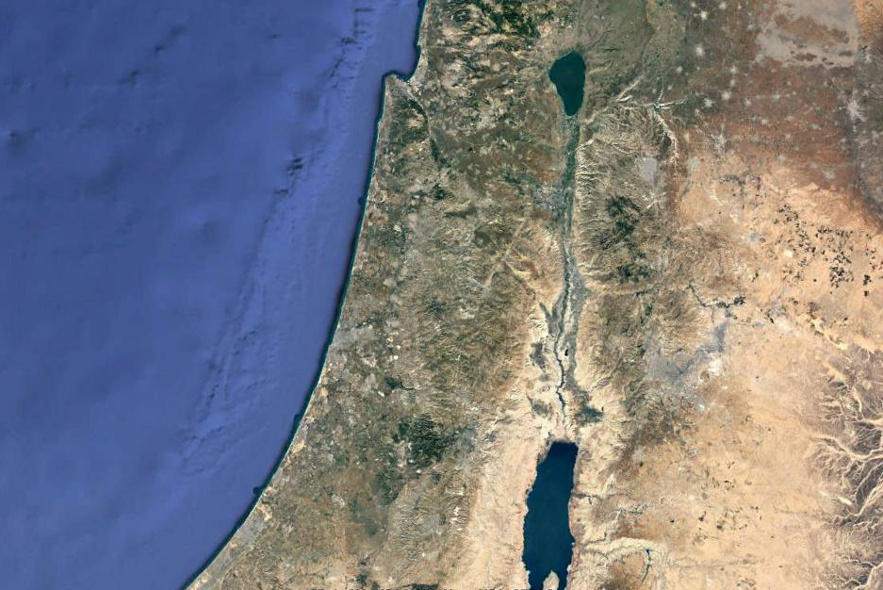
the book of
Psalms
142-145
Contemplation ~ last of the 13 Maskil Psalms
Jerusalem
Adullam
En Gedi
Judean Wilderness

Slide 3
the book of
Psalms
142-145

Slide 4
the book of
Psalms
142-145
As You Like It (Act II, Scene VII) ~ “All the world’s a stage,
And all the men and women merely players;
They have their exits and their entrances;
And one man in his time plays many parts,”
Edwin Markham (1852-1940) ~ “Whoever falls from God's right hand is caught in his left.”
This Photo by Unknown Author is licensed under CC BY-SA
This Photo by Unknown Author is licensed under CC BY-NC-ND

Slide 5
the book of
Psalms
142-145

Slide 6
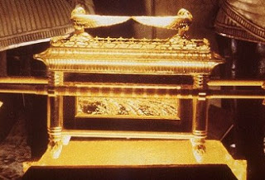
the book of
Psalms
142-145
Thomas Watson (1620-1686) ~ “Mercy is not for them that sin and fear not, but for them that fear and sin not.”
William Shakespeare (1564-1616) ~ “We do pray for mercy;
And that same prayer doth teach us all to render
The deeds of mercy.”
Mercy Seat
Judgment Seat

Slide 7
the book of
Psalms
142-145

Slide 8
the book of
Psalms
142-145
sin
Satan’s condemnation
God’s conviction
sin-o-meter

Slide 9
the book of
Psalms
142-145

Slide 10
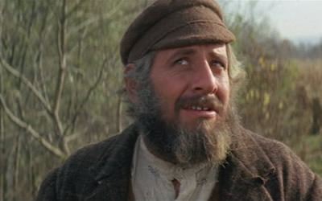
the book of
Psalms
142-145
meditate ~ from a root meaning to moan
muse ~ from a root meaning to converse with one’s self
Tevye ~ “Fiddler on the Roof”

Slide 11
the book of
Psalms
142-145

Slide 12
the book of
Psalms
142-145
Matt. 5:6 ~ Blessed are those who hunger and thirst for righteousness, for they shall be filled.

Slide 13
the book of
Psalms
142-145

Slide 14
the book of
Psalms
142-145
Rock ~ tsur – KJV, strength
Deut. 32:31 ~ For their rock is not like our Rock,
Even our enemies themselves being judges.

Slide 15
the book of
Psalms
142-145

Slide 16
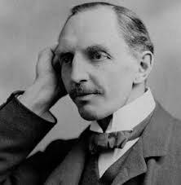
the book of
Psalms
142-145
Only One Life – C. T. Studd
Two little lines I heard one day,
Traveling along life’s busy way;
Bringing conviction to my heart,
And from my mind would not depart;
Only one life, ‘twill soon be past,
Only what’s done for Christ will last.
C. T. Studd
(1860-1931)

Slide 17
the book of
Psalms
142-145
Only One Life – C. T. Studd
Only one life, yes only one,
Soon will its fleeting hours be done;
Then, in ‘that day’ my Lord to meet,
And stand before His Judgement seat;
Only one life, ‘twill soon be past,
Only what’s done for Christ will last.
C. T. Studd
(1860-1931)

Slide 18
the book of
Psalms
142-145
Only One Life – C. T. Studd
Only one life, the still small voice,
Gently pleads for a better choice
Bidding me selfish aims to leave,
And to God’s holy will to cleave;
Only one life, ‘twill soon be past,
Only what’s done for Christ will last.
C. T. Studd
(1860-1931)

Slide 19
the book of
Psalms
142-145
Only One Life – C. T. Studd
Only one life, a few brief years,
Each with its burdens, hopes, and fears;
Each with its clays I must fulfill,
Living for self or in His will;
Only one life, ‘twill soon be past,
Only what’s done for Christ will last.
C. T. Studd
(1860-1931)

Slide 20
the book of
Psalms
142-145
Only One Life – C. T. Studd
When this bright world would tempt me sore,
When Satan would a victory score;
When self would seek to have its way,
Then help me Lord with joy to say;
Only one life, ‘twill soon be past,
Only what’s done for Christ will last.
C. T. Studd
(1860-1931)

Slide 21
the book of
Psalms
142-145
Only One Life – C. T. Studd
Give me Father, a purpose deep,
In joy or sorrow Thy word to keep;
Faithful and true what e’er the strife,
Pleasing Thee in my daily life;
Only one life, ‘twill soon be past,
Only what’s done for Christ will last.
C. T. Studd
(1860-1931)

Slide 22
the book of
Psalms
142-145
Only One Life – C. T. Studd
Oh, let my love with fervor burn,
And from the world now let me turn;
Living for Thee, and Thee alone,
Bringing Thee pleasure on Thy throne;
Only one life, ‘twill soon be past,
Only what’s done for Christ will last.
C. T. Studd
(1860-1931)

Slide 23
the book of
Psalms
142-145
Only One Life – C. T. Studd
Only one life, yes only one,
Now let me say, “Thy will be done”;
And when at last I’ll hear the call,
I know I’ll say ‘twas worth it all”;
Only one life, ‘twill soon be past,
Only what’s done for Christ will last.”
C. T. Studd
(1860-1931)

Slide 24
the book of
Psalms
142-145

Slide 25
the book of
Psalms
142-145
foreigners ~ KJV, strange children
NASB, aliens

Slide 26
the book of
Psalms
142-145

Slide 27
the book of
Psalms
142-145
“The problem with quotes on the Internet is that it is hard to verify their authenticity.” ~ Abraham Lincoln (source: the Internet)
truth
Lie

Slide 28
the book of
Psalms
142-145

Slide 29
the book of
Psalms
142-145
FOR AGE 10 AND UP

Slide 30
the book of
Psalms
142-145

Slide 31
the book of
Psalms
142-145
such a state ~ external peace
whose God is the Lord ~ internal peace

Slide 32
the book of
Psalms
142-145

Slide 33
the book of
Psalms
142-145
Ps. 127:3 ~ Behold, children are a heritage from the Lord,
The fruit of the womb is a reward.

Slide 34
the book of
Psalms
142-145

Slide 35
the book of
Psalms
142-145
awesome ~ KJV, terrible

Slide 36
the book of
Psalms
142-145

Slide 37
the book of
Psalms
142-145
Ps. 37:4 ~ Delight yourself also in the Lord,
And He shall give you the desires of your heart.

Slide 38
the book of
Psalms
142-145

