Slide 1
Psalms
the book of
120-127

Slide 2
the book of
Psalms
120-127
15 Songs of Ascents (Ps. 120-134) ~ KJV, degrees
Three required “Pilgrim Feasts”:
Passover (14 Nisan)
Pentecost (50 days after 1st Sabbath after Passover)
Tabernacles (15 Tishri)
Mar
Apr
May
Jun
Jul
Aug
Sep
Oct
Nov
Dec
Jan
Feb
Mar
Nisan
Iyar
Sivan
Tammuz
Av
Elul
Tishri
Heshvan
Chislev
Tevet
Shevat
Adar

Slide 3
the book of
Psalms
120-127
Deut. 16:16 ~ Three times a year all your males shall appear before the Lord your God in the place which He chooses: at the Feast of Unleavened Bread (Passover), at the Feast of Weeks (Pentecost), and at the Feast of Tabernacles; and they shall not appear before the Lord empty-handed.

Slide 4
the book of
Psalms
120-127

Slide 5
the book of
Psalms
120-127
C. H. Spurgeon ~ “Lips are soft; but when they are lying lips they suck away the life of character and are as murderous as razors. Lips should never be red with the blood of honest men’s reputes, nor salved with malicious falsehoods.”

Slide 6
the book of
Psalms
120-127

Slide 7
the book of
Psalms
120-127
Prov. 6:16-19 ~ ¹⁶ These six things the Lord hates,
Yes, seven are an abomination to Him:
¹⁷ A proud look,
A lying tongue,
Hands that shed innocent blood,
¹⁸ A heart that devises wicked plans,
Feet that are swift in running to evil,
¹⁹ A false witness who speaks lies,
And one who sows discord among brethren.

Slide 8
the book of
Psalms
120-127

Slide 9
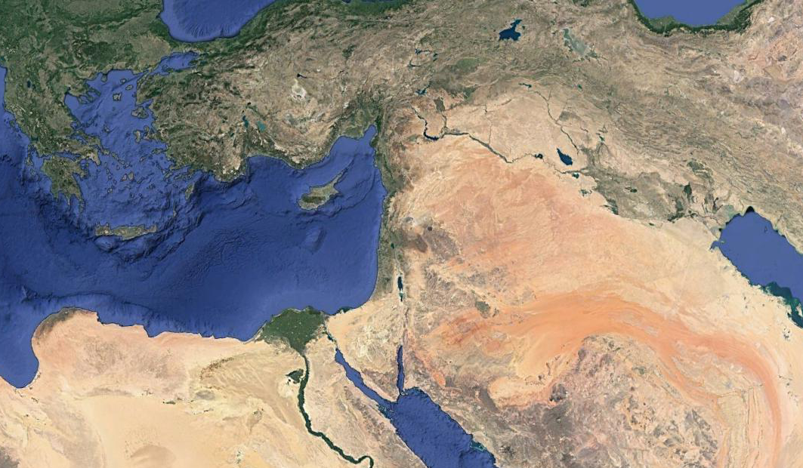
the book of
Psalms
120-127
Meshech
Kedar

Slide 10
the book of
Psalms
120-127

Slide 11
the book of
Psalms
120-127
KJV ~ I will lift up mine eyes unto the hills, from whence cometh my help.

Slide 12
the book of
Psalms
120-127

Slide 13
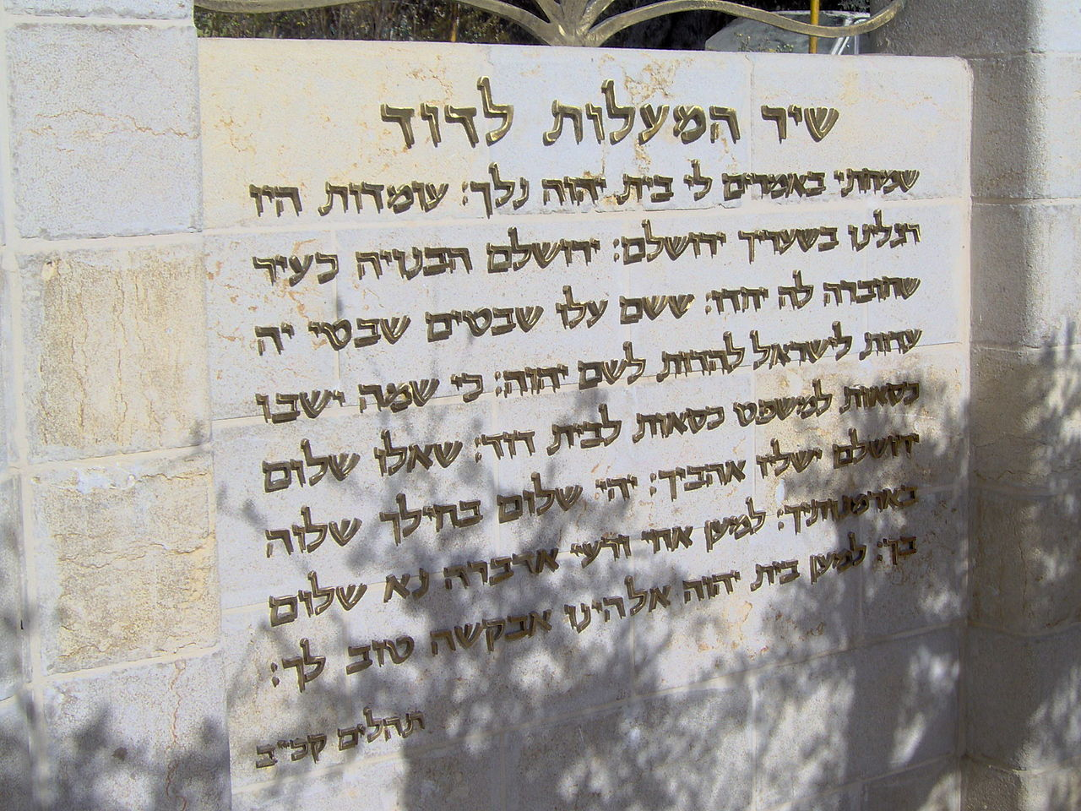
the book of
Psalms
120-127
Ps. 122 ~ entrance to the City of David

Slide 14
the book of
Psalms
120-127

Slide 15
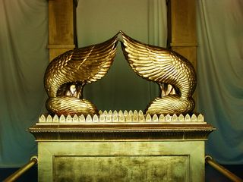
the book of
Psalms
120-127
Glad ~ samach – rejoice
YHWH

Slide 16
the book of
Psalms
120-127

Slide 17
the book of
Psalms
120-127
C. H. Spurgeon ~ “Escaped from our natural slavery; escaped from the guilt, the degradation, the habit, the dominion of sin; escaped from the vain deceits and fascinations of Satan; escaped from all that can destroy; we do indeed experience delight. What a wonder of grace it is! What a miraculous escape that we who are so easily misled should not have been permitted to die by the dread fowler’s hand.”

Slide 18
the book of
Psalms
120-127

Slide 19
the book of
Psalms
120-127
GOD CAN’T DO WHAT?
YOU WANT IT WHEN?

Slide 20
the book of
Psalms
120-127

Slide 21
the book of
Psalms
120-127
YHWH
Me

Slide 22
the book of
Psalms
120-127

Slide 23
the book of
Psalms
120-127
C. H. Spurgeon ~ “Men to be good at all must be good at heart. Those who trust in the Lord are good; for faith is the root of righteousness, and the evidence of uprightness. Faith in God is a good and upright thing, and its influence makes the rest of the man good and upright.”

Slide 24
the book of
Psalms
120-127

Slide 25
the book of
Psalms
120-127
C. H. Spurgeon ~ “How sad that men who once walked in the right way should turn aside from it! Observe the course of the false-hearted—first, they look out for crooked ways; next, they choose them and make them ‘their crooked ways’; and then they turn aside into them. They never intend to go back unto perdition, but only to make a curve and drop into the right road again. The straight way becomes a little difficult, and so they make a circumbendibus, which all along aims at coming out right, though it may a little deviate from precision. These
people are neither upright in heart, nor good,

Slide 26
the book of
Psalms
120-127
C. H. Spurgeon ~ nor trusters in Jehovah, and therefore the Lord will deal otherwise with them than with his own people: when execution day comes these hypocrites and time-servers shall be led out to the same gallows as the openly wicked.”

Slide 27
the book of
Psalms
120-127

Slide 28
the book of
Psalms
120-127

Slide 29
the book of
Psalms
120-127

Slide 30
the book of
Psalms
120-127

