Slide 1
Psalms
the book of
119:73-176

Slide 2
the book of
Psalms
119:73-176
Ps 119
Hebrew
English
Ps 119
Hebrew
English
1-8
א aleph
(silent)
89-96
ל lamed
L
9-16
ב beth
B
97-104
מ mem
M
17-24
ג gimel
G
105-112
נ‍ nun
N
25-32
ד daleth
D
113-120
ס samek
S
33-40
ה he
H
121-218
ע ayin
(silent)
41-48
ו waw
V
129-136
פ‍ pe
P
49-56
ז zayin
Z
137-144
צ‍ tsadde
Z/TZ
57-64
ח heth
Kh
145-152
ק qoph
K
65-72
ט teth
T
153-160
ר resh
R
73-80
י yod
Y
161-168
ש shin
S
81-88
כ kaph
K
169-176
ת tau
T

Slide 3
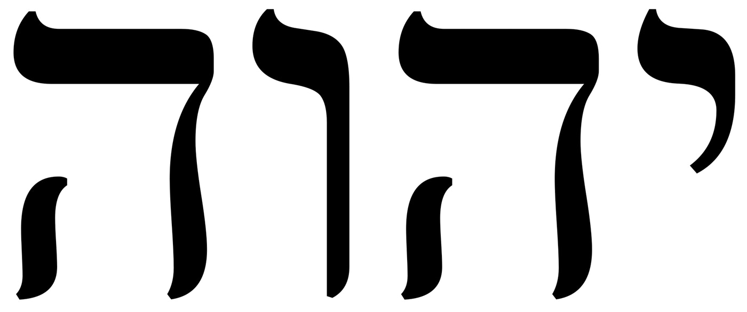
the book of
Psalms
119:73-176
yod: Theme ~ Teach me the Word so I can be a witness
Matthew 5:18 ~ For assuredly, I say to you, till heaven and earth pass away, one jot or one tittle will by no means pass from the law till all is fulfilled.
Jot ~ iōta (yod) – smallest Hebrew letter
Tittle ~ keraia – a pen stroke
Tittle
Jot

Slide 4
the book of
Psalms
119:73-176

Slide 5
the book of
Psalms
119:73-176
kaph: Theme ~ The Word teaches me how to trust

Slide 6
the book of
Psalms
119:73-176

Slide 7
the book of
Psalms
119:73-176
lamed: Theme ~ The Word gives permanence

Slide 8
the book of
Psalms
119:73-176

Slide 9
the book of
Psalms
119:73-176
C. H. Spurgeon ~ “The strain is more joyful, for experience has given the sweet singer a comfortable knowledge of the word of the Lord, and this makes a glad theme. After tossing about on a sea of trouble the Psalmist here leaps to shore and stands upon a rock. Jehovah's word is not fickle nor uncertain; it is settled, determined, fixed, sure, immovable.”

Slide 10
the book of
Psalms
119:73-176

Slide 11
the book of
Psalms
119:73-176
C. H. Spurgeon ~ “If we are conscious that we are the Lord's we may be confident that he will save us. We are the Lord's by creation, election, redemption, surrender, and acceptance; and hence our firm hope and assured belief that he will save us.”

Slide 12
the book of
Psalms
119:73-176

Slide 13
the book of
Psalms
119:73-176
NLT ~ Even perfection has its limits, but your commands have no limit.

Slide 14
the book of
Psalms
119:73-176
mem: Theme ~ The Word brings clarity of perspective

Slide 15
the book of
Psalms
119:73-176

Slide 16
the book of
Psalms
119:73-176
KJV ~ O how love I thy law!
His Word
Leads us to love Him
Desire to know Him

Slide 17
the book of
Psalms
119:73-176

Slide 18
the book of
Psalms
119:73-176
C. H. Spurgeon ~ “He who is careful not to go an inch aside will not leave the road. He who never touches the intoxicating cup will never be drunk. He who never utters an idle word will never be profane. If we begin to depart a little we can never tell where we shall end.”

Slide 19
the book of
Psalms
119:73-176

Slide 20
the book of
Psalms
119:73-176
nun: Theme ~ A commitment to follow God's Word

Slide 21
the book of
Psalms
119:73-176

Slide 22
the book of
Psalms
119:73-176
2 Cor. 3:6 ~ who also made us sufficient as ministers of the new covenant, not of the letter but of the Spirit; for the letter kills, but the Spirit gives life.
Not
But
the letter the Law
of
is

Slide 23
the book of
Psalms
119:73-176

Slide 24
the book of
Psalms
119:73-176
samek: Theme ~ The opposers of God’s Word

Slide 25
the book of
Psalms
119:73-176

Slide 26
the book of
Psalms
119:73-176
ayin: Theme ~ Preserve me through Your Word

Slide 27
the book of
Psalms
119:73-176

Slide 28
the book of
Psalms
119:73-176
Surety ~ guaranty

Slide 29
the book of
Psalms
119:73-176

Slide 30
the book of
Psalms
119:73-176
pe: Theme ~ I love Your Word

Slide 31
the book of
Psalms
119:73-176

Slide 32
the book of
Psalms
119:73-176
KJV ~ as thou usest to do unto those that love thy name.

Slide 33
the book of
Psalms
119:73-176

Slide 34
the book of
Psalms
119:73-176
tsadde: Theme ~ The perfect righteousness of the Lord and His Word

Slide 35
the book of
Psalms
119:73-176

Slide 36
the book of
Psalms
119:73-176
qoph: Theme ~ A commitment to keep God's Word

Slide 37
the book of
Psalms
119:73-176

Slide 38
the book of
Psalms
119:73-176
qoph: Theme ~ A commitment to keep God's Word

Slide 39
the book of
Psalms
119:73-176

Slide 40
the book of
Psalms
119:73-176
Rise ~ KJV, prevented

Slide 41
the book of
Psalms
119:73-176

Slide 42
the book of
Psalms
119:73-176
resh: Theme ~ He will trust the Word even in trials and affliction

Slide 43
the book of
Psalms
119:73-176

Slide 44
the book of
Psalms
119:73-176
shin: Theme ~ His Word reveals His will

Slide 45
the book of
Psalms
119:73-176

Slide 46
the book of
Psalms
119:73-176
tau: Theme ~ The Psalm is closed with the psalmist's face on the ground

Slide 47
the book of
Psalms
119:73-176
C. H. Spurgeon ~ “The Psalmist is approaching the end of the Psalm, and his petitions gather force and fervency; he seems to break into the inner circle of divine fellowship, and to come even to the feet of the great God whose help he is imploring.”

Slide 48
the book of
Psalms
119:73-176

Slide 49
the book of
Psalms
119:73-176
C. H. Spurgeon ~ “That man cannot be utterly lost whose heart is still with God. If he be gone astray in many respects, yet still, if he be true in his soul's inmost desires, he will be found again, and fully restored. Yet let the reader remember Ps. 119:1 (Blessed are the undefiled in the way, who walk in the law of the Lord.) while he reads Ps. 119:176, the major blessedness lies not in being restored from wandering, but in being upheld in a blameless way even to the end.”

Slide 50
the book of
Psalms
119:73-176

