Slide 1
Psalms
the book of
110-112

Slide 2
the book of
Psalms
110-112
Most quoted Psalm in the New Testament
Quoted by Jesus in all 3 synoptic gospels (Matt. 22:44, Mark 12:36, Luke 20:43)
Peter on the Day of Pentecost (Acts 2:35)
3x in Hebrews (1:13, 7:17, 10:13)

Slide 3
the book of
Psalms
110-112

Slide 4
the book of
Psalms
110-112
The Lord said to my Lord,
YHWH said to my Adonai,
“Sit at My right hand,
Till I make Your enemies Your footstool.”
Rev. 22:16 ~ I, Jesus, have sent My angel to testify to you these things in the churches. I am the Root and the Offspring of David, the Bright and Morning Star.
Jesus
David
Jesus

Slide 5
the book of
Psalms
110-112
C. H. Spurgeon ~ “How condescending on Jehovah’s part to permit a mortal ear to hear, and a human pen to record his secret converse with his co-equal Son!”

Slide 6
the book of
Psalms
110-112
Mark 12:35–37 ~ ³⁵ Then Jesus answered and said, while He taught in the temple, “How is it that the scribes say that the Christ is the Son of David? ³⁶ For David himself said by the Holy Spirit:
‘The Lord said to my Lord,
“Sit at My right hand,
Till I make Your enemies Your footstool.”’
³⁷ Therefore David himself calls Him ‘Lord’; how is He then his Son?”
And the common people heard Him gladly.

Slide 7
the book of
Psalms
110-112

Slide 8
the book of
Psalms
110-112
Merrihew Standard Version ~ When You come in Your power, the people will gladly follow You;
It will be the beautiful dawning of a New Day
With all the excitement and vigor of a youth movement.

Slide 9
the book of
Psalms
110-112

Slide 10
the book of
Psalms
110-112
Jacob
Judah
Levi
Aaron
Tabernacle/Temple Stewards
David
Aaronic Priests
David’s “greater” Son

Slide 11
the book of
Psalms
110-112
Genesis 14
Psalm 110
Hebrews 7
1500 BC
1000 BC
500 BC

Slide 12
the book of
Psalms
110-112
melek ~ king
tsedek ~ righteous
Salem (shalom) ~ peace
Genesis 14:18 ~ Then Melchizedek king of Salem brought out bread and wine; he was the priest of God Most High.
Lord’s table

Slide 13
the book of
Psalms
110-112
Heb. 7:1-3 ~ ¹ For this Melchizedek, king of Salem, priest of the Most High God, who met Abraham returning from the slaughter of the kings and blessed him, ² to whom also Abraham gave a tenth part of all, first being translated “king of righteousness,” and then also king of Salem, meaning “king of peace,” ³ without father, without mother, without genealogy, having neither beginning of days nor end of life, but made like the Son of God, remains a priest continually.

Slide 14
the book of
Psalms
110-112
Zech. 6:12-13 ~ ¹² Then speak to him, saying, “Thus says the Lord of hosts, saying:
‘Behold, the Man whose name is the BRANCH!
From His place He shall branch out,
And He shall build the temple of the Lord;
¹³ Yes, He shall build the temple of the Lord.
He shall bear the glory,
And shall sit and rule on His throne;
So He shall be a priest on His throne,
And the counsel of peace shall be between them both.’”

Slide 15
the book of
Psalms
110-112
Prophet
Priest
King

Slide 16
the book of
Psalms
110-112

Slide 17
the book of
Psalms
110-112
Acrostic
22 lines in Hebrews, corresponding to the 22 letters in Hebrew alphabet
Aleph (A) ~ 1st word of the 1st line
Bet (B) ~ 1st word of the 2nd line
Gimmel (G) ~ 1st word of the 3rd line
Dalet (D) ~ 1st word of the 4th line, etc.

Slide 18
the book of
Psalms
110-112

Slide 19
the book of
Psalms
110-112
C. H. Spurgeon ~ “Those who love their Maker delight in his handiworks, they perceive that there is more in them than appears upon the surface, and therefore they bend their minds to study and understand them. The devout naturalist ransacks nature, the earnest student of history pries into hidden facts and dark stories, and the man of God digs into the mines of Scripture, and hoards up each grain of its golden truth.”

Slide 20
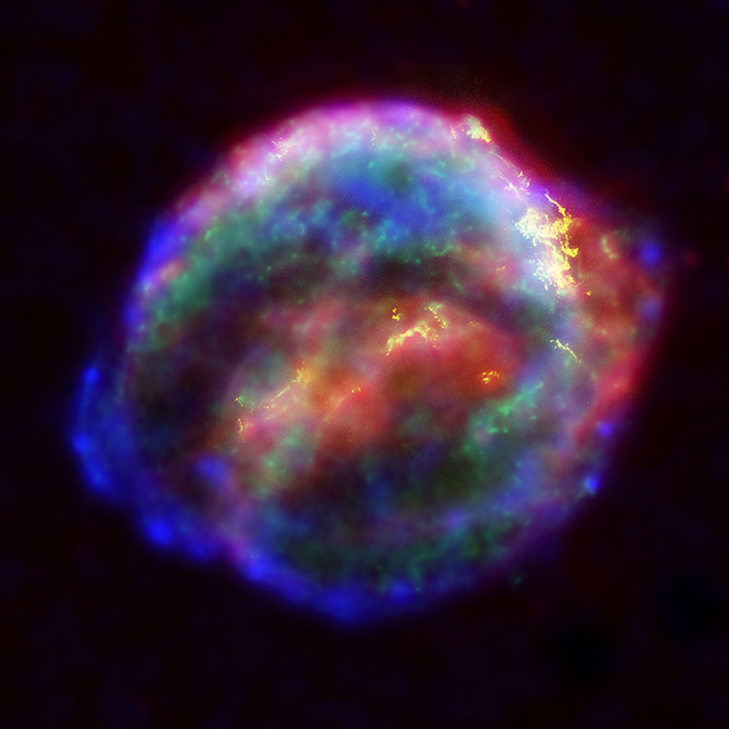
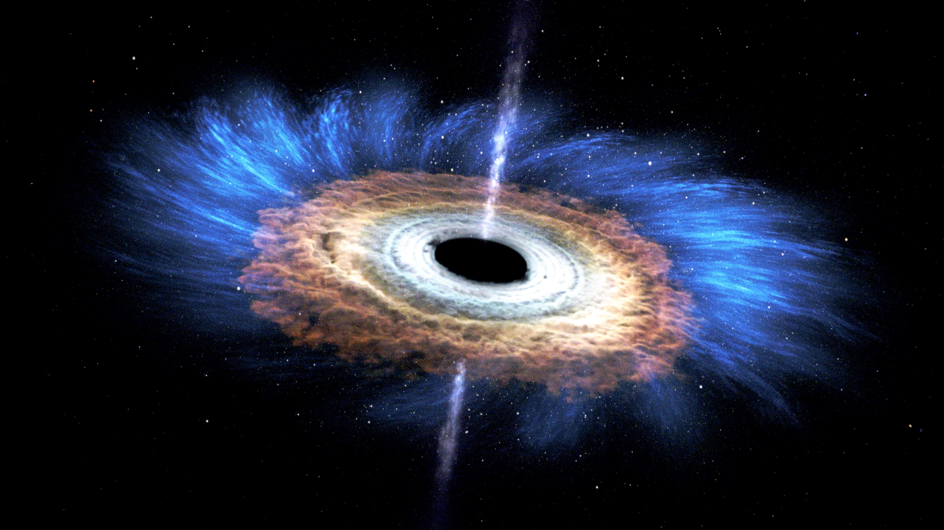
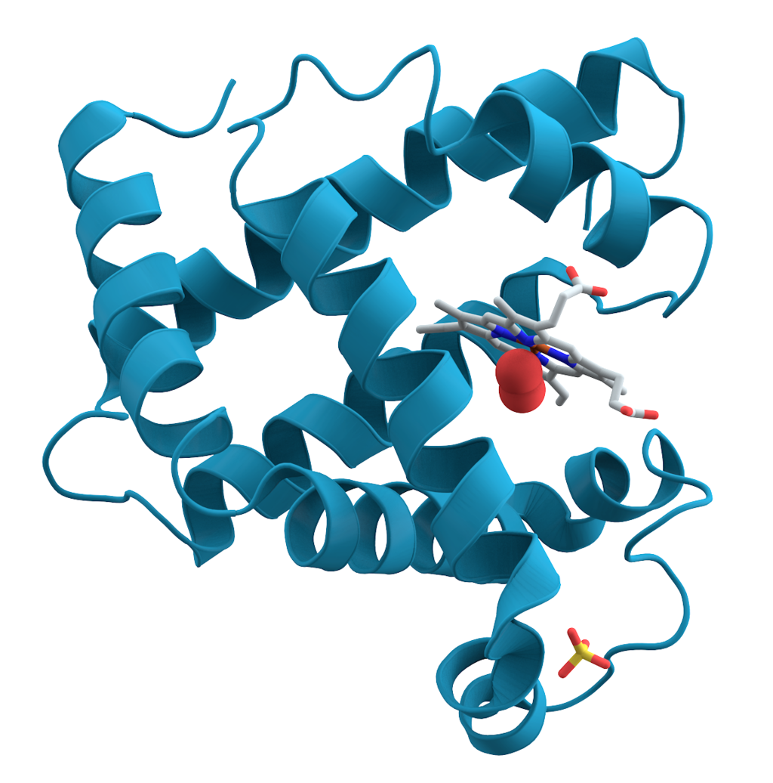
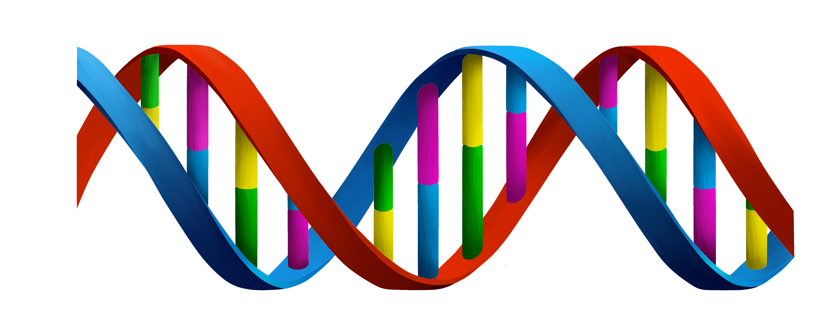
the book of
Psalms
110-112
Black holes
Plan of Redemption
Supernovas
My problems
Proteins
DNA

Slide 21
the book of
Psalms
110-112

Slide 22
the book of
Psalms
110-112
NLT ~ He has shown his great power to his people
by giving them the lands of other nations.

Slide 23
the book of
Psalms
110-112

Slide 24
the book of
Psalms
110-112
Awesome ~ KJV, reverend

Slide 25
the book of
Psalms
110-112

Slide 26
the book of
Psalms
110-112
Prov. 9:10 ~ “The fear of the Lord is the beginning of wisdom,
And the knowledge of the Holy One is understanding.

Slide 27
the book of
Psalms
110-112

Slide 28
the book of
Psalms
110-112
C. H. Spurgeon ~ “Jehovah is so great that he is to be feared and had in reverence of all them that are round about him, and he is at the same time so infinitely good that the fear is sweetened into filial love, and becomes a delightful emotion, by no means engendering bondage. There is a slavish fear which is accursed; but that godly fear which leads to delight in the service of God is infinitely blessed.”

Slide 29
the book of
Psalms
110-112

Slide 30
the book of
Psalms
110-112
Horn ~ symbol of power or strength

Slide 31
the book of
Psalms
110-112

