Slide 1
Psalms
the book of
84-87

Slide 2
the book of
Psalms
84-87
C. H. Spurgeon ~ “He does not tell us how lovely they were, because he could not. His expressions show us that his feelings were inexpressible. Lovely to the memory, to the mind, to the heart, to the eye, to the whole soul, are the assemblies of the saints. Earth contains no sight so refreshing to us as the gathering of believers for worship. Those are sorry saints who see nothing amiable in the services of the Lord's house.”

Slide 3
the book of
Psalms
84-87

Slide 4
the book of
Psalms
84-87
Matt. 5:6 ~ Blessed are those who hunger and thirst for righteousness,
For they shall be filled.

Slide 5
the book of
Psalms
84-87

Slide 6
the book of
Psalms
84-87
Pilgrimage ~ KJV, ways
Literally ~ highways, public thoroughfares
NASB ~ highways to Zion!

Slide 7
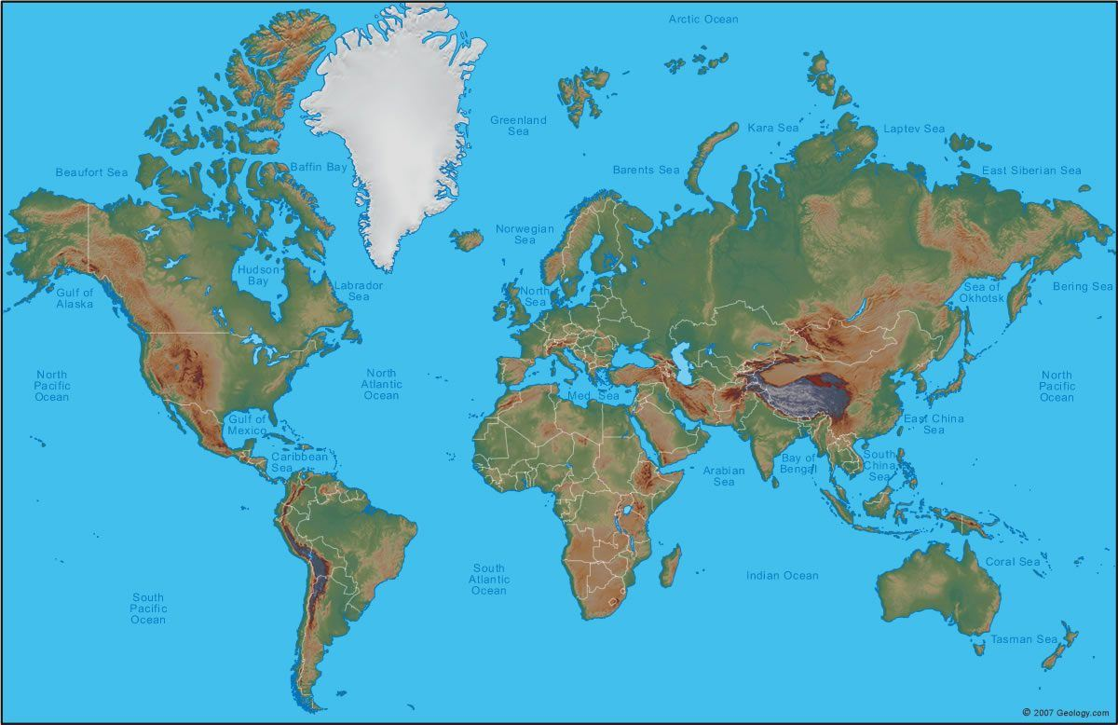
the book of
Psalms
84-87
Holy Land
OKC
His strength
My strength

Slide 8
the book of
Psalms
84-87

Slide 9
the book of
Psalms
84-87
Valley of Baca ~ Valley of Weeping
Prov. 18:1 ~ A man who isolates himself seeks his own desire;
He rages against all wise judgment.
C. H. Spurgeon ~ “As around a well men meet and converse cheerfully, being refreshed after their journey, so even in the vale of tears, or any other dreary glen, the pilgrims to the skies find sweet solace in brotherly communion and in anticipation of the general assembly above, with its joys unspeakable.”

Slide 10
the book of
Psalms
84-87

Slide 11
the book of
Psalms
84-87
Anointed ~ Meshiach

Slide 12
the book of
Psalms
84-87

Slide 13
the book of
Psalms
84-87
Mercy
Truth
and are mutually exclusive
Rom. 3:23-26 ~ ²³ … for all have sinned and fall short of the glory of God, ²⁴ being justified freely by His grace through the redemption that is in Christ Jesus, ²⁵ whom God set forth as a propitiation by His blood, through faith, to demonstrate His righteousness, because in His forbearance God had passed over the sins that were previously committed, ²⁶ to demonstrate at the present time His righteousness, that He might be just and the justifier of the one who has faith in Jesus.

Slide 14
the book of
Psalms
84-87

Slide 15
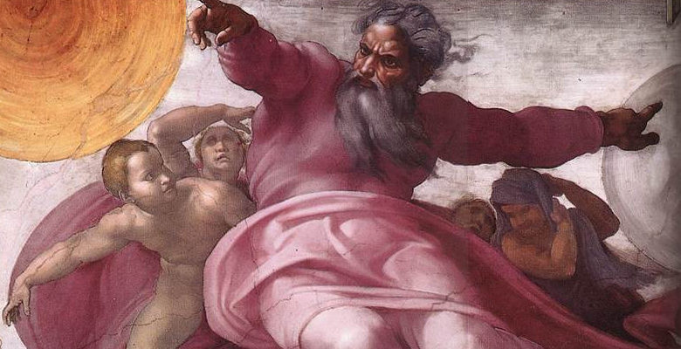
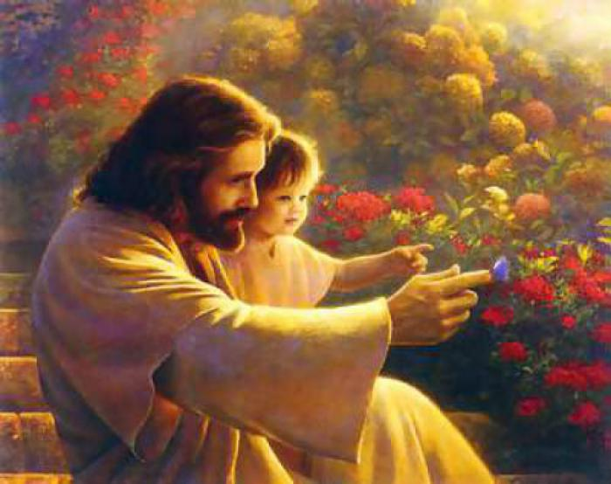
the book of
Psalms
84-87
Old Testament God of Wrath
New Testament God of Love

Slide 16
the book of
Psalms
84-87

Slide 17
the book of
Psalms
84-87
C. H. Spurgeon ~ “This is yet more true of the church: she is founded in grace, but her pinnacles glow with glory. Men may glory in her without being braggarts, she has a luster about her brow which none can rival. Whatever glorious things the saints may say of the church in their eulogies, they cannot exceed what prophets have foretold, what angels have sung, or what God himself has declared.”

Slide 18
the book of
Psalms
84-87

Slide 19
the book of
Psalms
84-87
Rahab ~ NLT, Egypt

Slide 20
the book of
Psalms
84-87

Slide 21
the book of
Psalms
84-87
Record ~ the Book of Life

Slide 22
the book of
Psalms
84-87

