Slide 1
Psalms
the book of
81-83

Slide 2
the book of
Psalms
81-83
Feast of Trumpets (Rosh Hashanah) Tishri 1
Day of Atonement (Yom Kippur) Tishri 10
Feast of Tabernales (Kukkot) Tishri 15
Mar
Apr
May
Jun
Jul
Aug
Sep
Oct
Nov
Dec
Jan
Feb
Mar
Nisan
Iyar
Sivan
Tammuz
Av
Elul
Tishri
Heshvan
Chislev
Tevet
Shevat
Adar

Slide 3
the book of
Psalms
81-83

Slide 4
the book of
Psalms
81-83
Gath ~ winepress
KJV, NASB, NIV, ESV ~ Gittith

Slide 5
the book of
Psalms
81-83

Slide 6
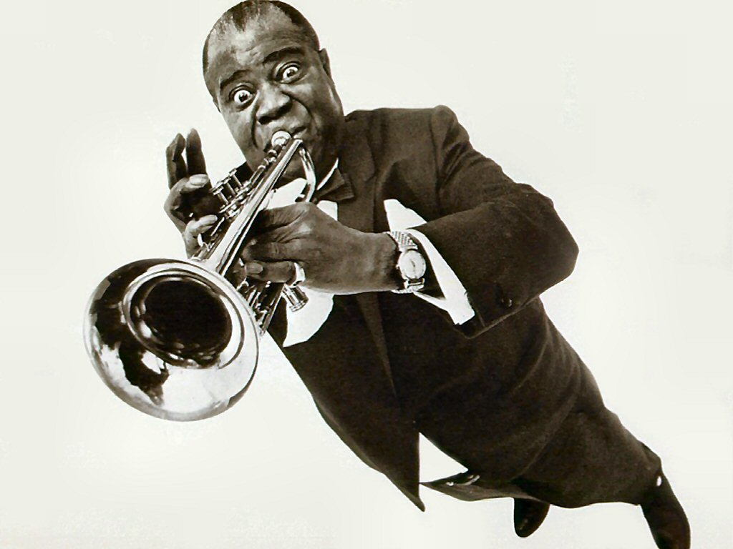
the book of
Psalms
81-83
Blow ~ KJV, blow up

Slide 7
the book of
Psalms
81-83

Slide 8
the book of
Psalms
81-83
C. H. Spurgeon ~ “Hurried reading is of little benefit; to sit down a while and meditate is very profitable.”

Slide 9
the book of
Psalms
81-83

Slide 10
the book of
Psalms
81-83
KJV ~ So I gave them up unto their own hearts’ lust
Rom. 1:24, 26, 28

Slide 11
the book of
Psalms
81-83
80%
97.7%
97.8%
60%
Women
www.statista.com
40%
Men
20%
1.5%
1.8%
.9%
.4%
Lesbian/Gay
Bisexual
Straight

Slide 12
the book of
Psalms
81-83
1,800,000
1,600,000
1,400,000
1,200,000
1,000,000
60,000,000+
800,000
600,000
400,000
200,000
Guttmacher Institute
1975
1980
1985
1990
1995
2000
2005
2010
2015
Abortions by years since Roe v. Wade (1972)

Slide 13
the book of
Psalms
81-83

Slide 14
the book of
Psalms
81-83
C. H. Spurgeon ~ “If we depart from God, our inward corruptions are sure to make a rebellion. Satan will assail us, the world will worry us, doubts will annoy us, and all through our own fault. Solomon’s departure from God raised up enemies against him, and it will be so with us, but if our ways please the Lord he will make even our enemies to be at peace with us.”

Slide 15
the book of
Psalms
81-83

Slide 16
the book of
Psalms
81-83
NIV ~ Those who hate the Lord would cringe before him, and their punishment would last forever.

Slide 17
the book of
Psalms
81-83

Slide 18
the book of
Psalms
81-83
Would (vv. 14-16) 5x
(express desire or intent)
KJV ~ should
(express duty or obligation)

Slide 19
the book of
Psalms
81-83

Slide 20
the book of
Psalms
81-83
Gods ~ elohim
Ex. 22:8-9 ~ ⁸ If the thief is not found, then the master of the house shall be brought to the judges to see whether he has put his hand into his neighbor’s goods.
⁹ For any kind of trespass, whether it concerns an ox, a donkey, a sheep, or clothing, or for any kind of lost thing which another claims to be his, the cause of both parties shall come before the judges; and whomever the judges condemn shall pay double to his neighbor.

Slide 21
the book of
Psalms
81-83

Slide 22
the book of
Psalms
81-83
Is. 33:22 ~ (For the Lord is our Judge,
The Lord is our Lawgiver,
The Lord is our King;
He will save us);
Legislative
Judicial
Executive
The 3 Branches of Gummint

Slide 23
the book of
Psalms
81-83

Slide 24
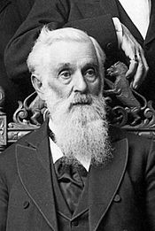
the book of
Psalms
81-83
“As man now is, God once was: As God now is, man may be.”
Lorenzo Snow
(5th president of the LDS)

Slide 25
the book of
Psalms
81-83

Slide 26
the book of
Psalms
81-83
The last psalm of Asaph

Slide 27
the book of
Psalms
81-83

Slide 28
the book of
Psalms
81-83
Children of Lot ~ Ammon and Moab
Midian ~ Gideon
Sisera ~ Deborah
Jabin ~ king of Hazor

Slide 29
the book of
Psalms
81-83

Slide 30
the book of
Psalms
81-83
C. H. Spurgeon ~ “Shame has often weaned men from their idols, and set them upon seeking the Lord.”
Available for free in E-sword
(www.e-sword.net)

Slide 31
the book of
Psalms
81-83

