Slide 1
Psalms
the book of
72-74

Slide 2
the book of
Psalms
72-74
KJV ~ A Psalm for Solomon

Slide 3
the book of
Psalms
72-74

Slide 4
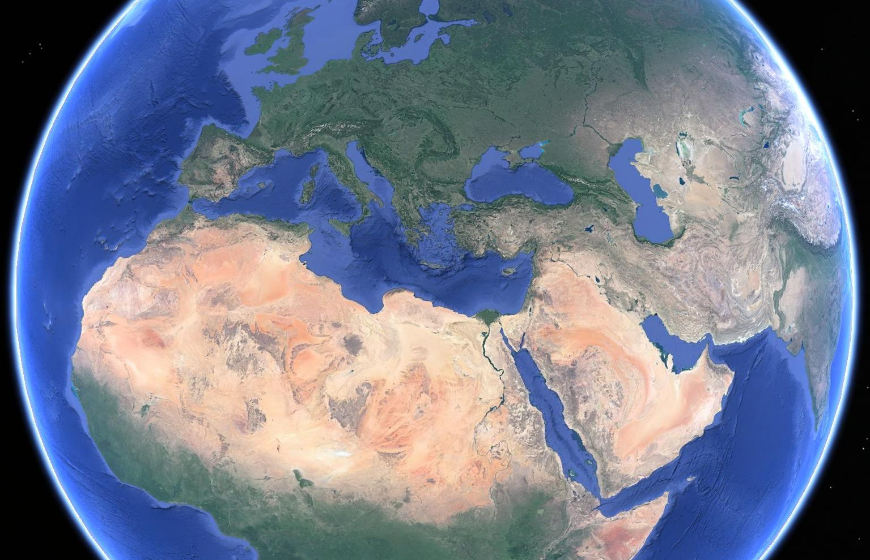
the book of
Psalms
72-74
Isles?
Israel
Tarshish
Seba
Sheba

Slide 5
the book of
Psalms
72-74

Slide 6
the book of
Psalms
72-74
Divided into 5 books
Book 1
Book 2
Book 3
Book 4
Book 5
1-41
Genesis
Foundations
42-72
Exodus
Redemption
73-89
Leviticus
Worship
90-106
Numbers
Wanderings
107-150
Deuteronomy
Promised Life

Slide 7
the book of
Psalms
72-74

Slide 8
the book of
Psalms
72-74
Asaph ~ authored Psalm 50, 73-83

Slide 9
the book of
Psalms
72-74

Slide 10
the book of
Psalms
72-74
Truly ~ could be translated only
C. H. Spurgeon ~ “He is only good, nothing else but good to his own covenanted ones. He cannot act unjustly or unkindly to them; his goodness to them is beyond dispute, and without mixture.”
C. H. Spurgeon ~ “Here begins the narrative of a great soul-battle, a spiritual Marathon, a hard and well-fought field, in which the half-defeated became in the end wholly victorious.”

Slide 11
the book of
Psalms
72-74

Slide 12
the book of
Psalms
72-74
KJV ~ my feet were almost gone

Slide 13
the book of
Psalms
72-74

Slide 14
the book of
Psalms
72-74
Marilyn Manson ~ “I’m sick and tired of people calling me a devil worshiper. If there really was a devil, he would worship me.”

Slide 15
the book of
Psalms
72-74

Slide 16
the book of
Psalms
72-74
KJV ~ I was pricked in my reins.

Slide 17
the book of
Psalms
72-74

Slide 18
the book of
Psalms
72-74
Prov. 14:12 ~ There is a way that seems right to a man,
But its end is the way of death.

Slide 19
the book of
Psalms
72-74

Slide 20
the book of
Psalms
72-74
Meeting places ~ KJV, synagogues
Literally, festival places

Slide 21
the book of
Psalms
72-74

Slide 22
the book of
Psalms
72-74
USA
Judah
N. Korea
Babylon
GOOD
BAD
Bad-o-meter

Slide 23
the book of
Psalms
72-74

Slide 24
the book of
Psalms
72-74
sea serpents ~ tannin – any water dwelling predator

Slide 25
the book of
Psalms
72-74

