Slide 1
Psalms
the book of
62-65

Slide 2
the book of
Psalms
62-65
Acts 20:24 ~ But most of these things do not move me.

Slide 3
the book of
Psalms
62-65

Slide 4
the book of
Psalms
62-65
Moved ~ cf. v. 2 – greatly moved

Slide 5
the book of
Psalms
62-65

Slide 6
the book of
Psalms
62-65
Pour ~ literally, to spill out
Figuratively, to expend

Slide 7
the book of
Psalms
62-65

Slide 8
the book of
Psalms
62-65
MSV ~ Common people, within themselves,
Are lacking any substance.
The blue bloods are less than that.
If you put them together, you’ve still got nothing.

Slide 9
the book of
Psalms
62-65

Slide 10
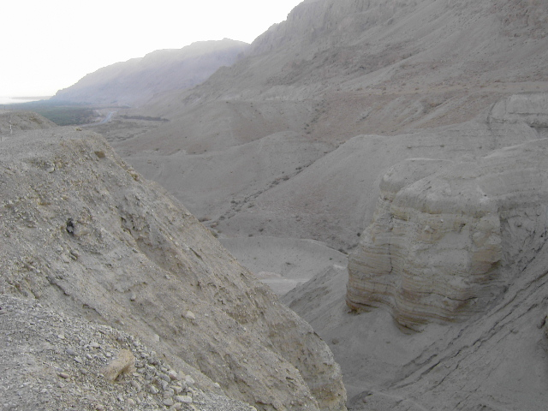
the book of
Psalms
62-65
Judean Wilderness

Slide 11
the book of
Psalms
62-65

Slide 12
the book of
Psalms
62-65
C. H. Spurgeon ~ “Communion with God is so sweet that the chill of the morning is forgotten, and the luxury of the couch is despised. The morning is the time for dew and freshness, and the Psalmist consecrates it to prayer and devout fellowship.”
Henry Drummond (1851-1897) ~ “There is within the very protoplasm of man those little tentacles that are reaching out for God.”

Slide 13
the book of
Psalms
62-65

Slide 14
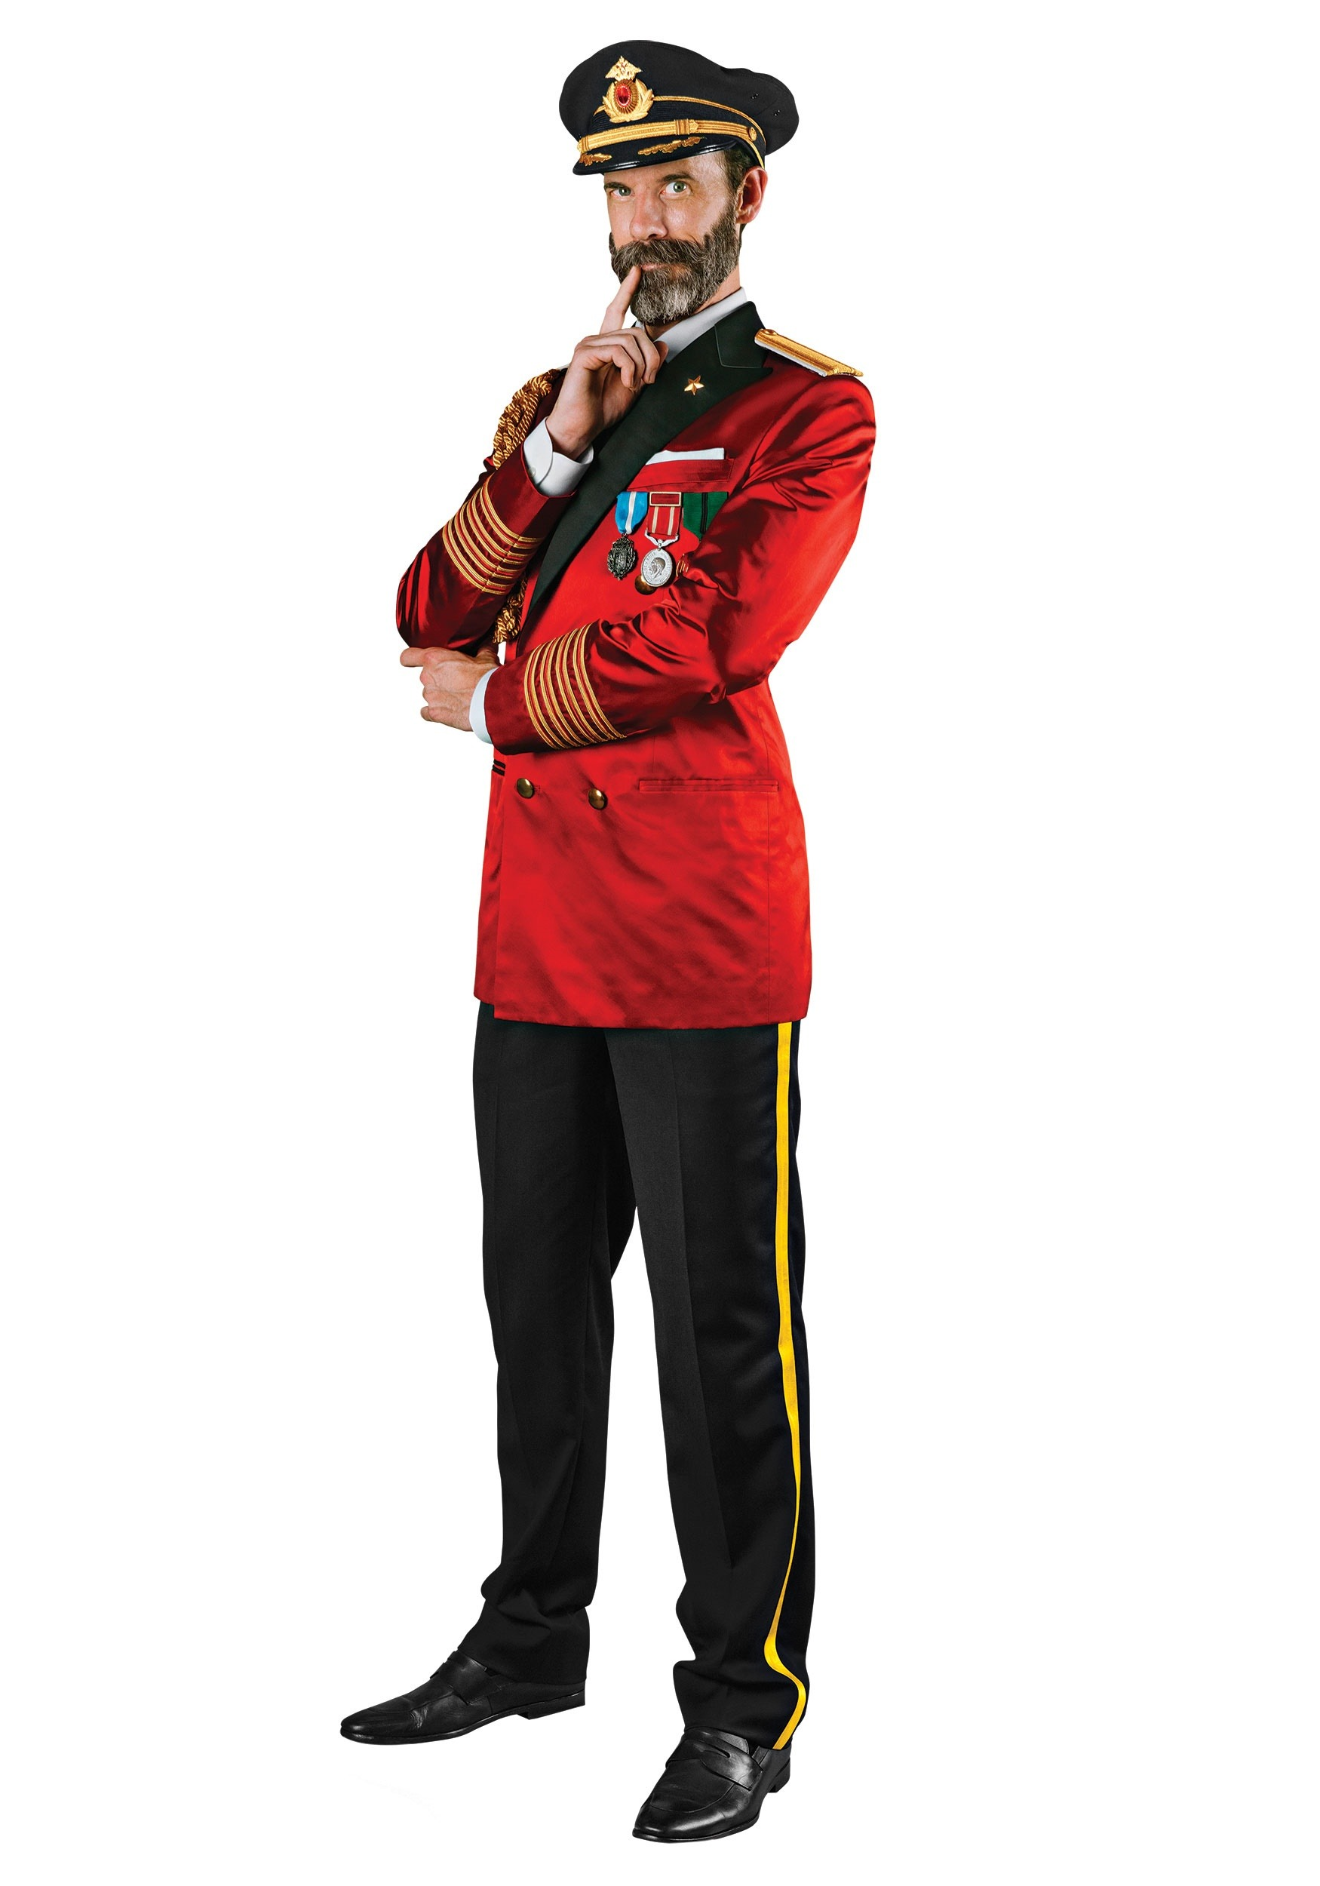
the book of
Psalms
62-65
Worship should be about God.
Captain Obvious

Slide 15
the book of
Psalms
62-65

Slide 16
the book of
Psalms
62-65
C. H. Spurgeon ~ “To dwell with God is better than life at its best; life at ease, in a palace, in health, in honor, in wealth, in pleasure; yea, a thousand lives are not equal to the eternal life which abides in Jehovah’s smile.”

Slide 17
the book of
Psalms
62-65

Slide 18
the book of
Psalms
62-65
Meditation ~ KJV, prayer
NIV, NASB ~ complaint

Slide 19
the book of
Psalms
62-65

Slide 20
the book of
Psalms
62-65
Blameless ~ KJV, perfect
C. H. Spurgeon ~ “Is it possible for justice to invent a punishment sufficiently severe to meet the case of the dastard who defiles my good name, and remains himself in concealment? An open liar is an angel compared with this demon. Vipers and cobras are harmless and amiable creatures compared with such a reptile. The devil himself might blush at being the father of so base an offspring.”

Slide 21
the book of
Psalms
62-65

Slide 22
the book of
Psalms
62-65

Slide 23
the book of
Psalms
62-65

Slide 24
the book of
Psalms
62-65
Heb. 2:8-9a ~ ⁸ You have put all things in subjection under his feet.”
For in that He put all in subjection under him, He left nothing that is not put under him.
But now we do not yet see all things put under him.
^{9a} But we see Jesus …

Slide 25
the book of
Psalms
62-65

Slide 26
the book of
Psalms
62-65
Awesome ~ KJV, terrible

Slide 27
the book of
Psalms
62-65

Slide 28
the book of
Psalms
62-65
C. H. Spurgeon ~ “Philosophers of the forget-God school are too much engrossed with their laws of upheaval to think of the Upheaver. Their theories of volcanic action and glacier action, etc., etc., are frequently used as bolts and bars to shut the Lord out of his own world. Our poet is of another mind, and sees God’s hand settling Alps and Andes on their bases, and therefore he sings in his praise.”

Slide 29
the book of
Psalms
62-65

