Slide 1
Psalms
the book of
54-57

Slide 2
the book of
Psalms
54-57
With Stringed Instruments ~ KJV, Neginoth

Slide 3
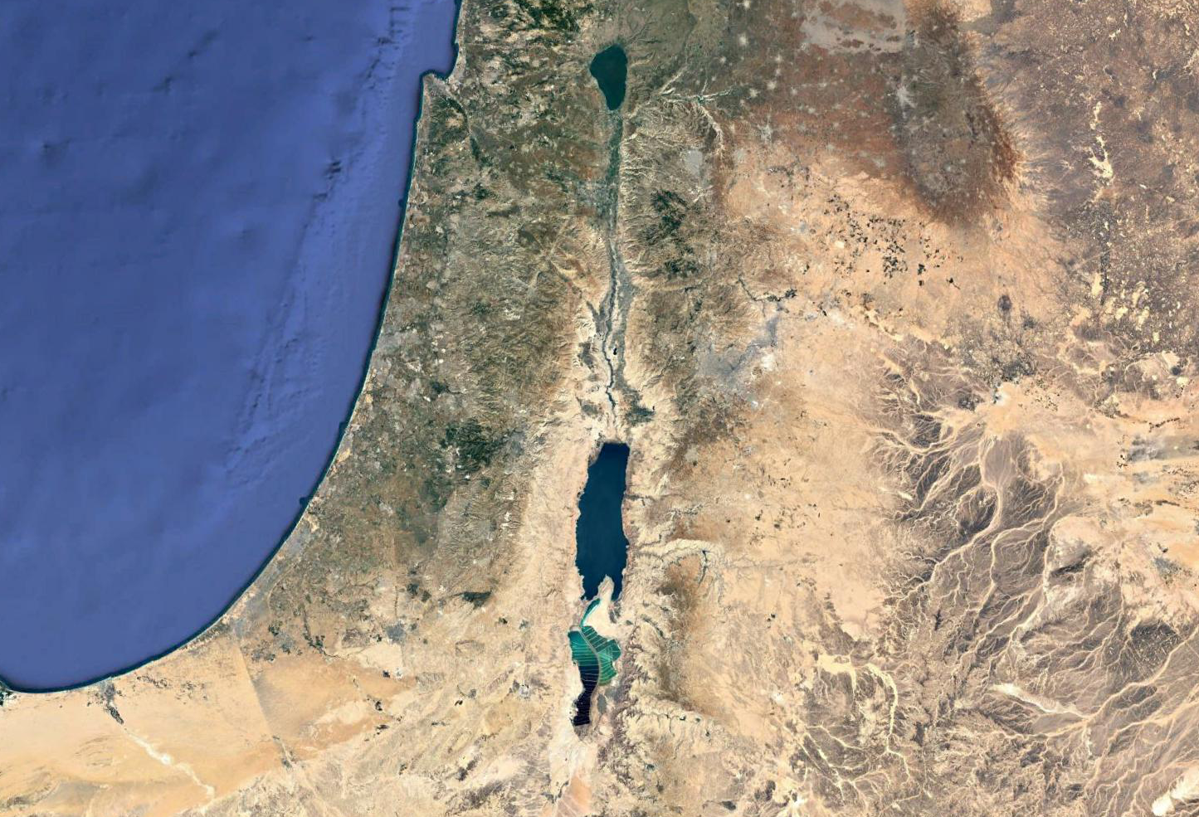
the book of
Psalms
54-57
Bethlehem
Ziph

Slide 4
the book of
Psalms
54-57

Slide 5
the book of
Psalms
54-57
C. H. Spurgeon ~ “They worked for evil, and they shall have their wages. It cannot be that malice should go unavenged. It were cruelty to the good to be lenient to their persecutors. It is appointed, and so it must ever be, that those who shoot upward the arrows of malice shall find them fall upon themselves. The recoil of their own gun has often killed oppressors. Not in ferocious revenge is this spoken, but as an Amen to the sure sentence of the just Judge.”

Slide 6
the book of
Psalms
54-57

Slide 7
the book of
Psalms
54-57
David flees from Saul
1008 BC)
Saul dies in battle
1000 BC)
1020 BC
1010 BC
1000 BC
990 BC
David anointed king
(1025 BC)
Davide hides in Ziph
(1007 BC)
Davide rules all of Israel
(993 BC)
Over 30 years

Slide 8
the book of
Psalms
54-57

Slide 9
the book of
Psalms
54-57
2 Sam. 15:30-31 ~ ³⁰ So David went up by the Ascent of the Mount of Olives, and wept as he went up; and he had his head covered and went barefoot. And all the people who were with him covered their heads and went up, weeping as they went up. ³¹ Then someone told David, saying, “Ahithophel is among the conspirators with Absalom.” And David said, “O Lord, I pray, turn the counsel of Ahithophel into foolishness!”

Slide 10
the book of
Psalms
54-57

Slide 11
the book of
Psalms
54-57
KJV ~ My heart is sore pained

Slide 12
the book of
Psalms
54-57

Slide 13
the book of
Psalms
54-57
Alive into hell ~ KJV, quick into hell
Quick ~ as in quickening
Literally, alive into Sheol

Slide 14
the book of
Psalms
54-57

Slide 15
the book of
Psalms
54-57
Michtam ~ Ps. 56-60 form the last 5 of the 6 Michtam Psalms
From root meaning to mark or engrave

Slide 16
the book of
Psalms
54-57

Slide 17
the book of
Psalms
54-57
C. H. Spurgeon ~ “To trust when there is no cause for fear, is but the name of faith, but to be reliant upon God when occasions for alarm are abundant and pressing, is the conquering faith of God’s elect.”

Slide 18
the book of
Psalms
54-57

Slide 19
the book of
Psalms
54-57
Dan. 10:12-13 ~ ¹² Then he said to me, “Do not fear, Daniel, for from the first day that you set your heart to understand, and to humble yourself before your God, your words were heard; and I have come because of your words. ¹³ But the prince of the kingdom of Persia withstood me twenty-one days; and behold, Michael, one of the chief princes, came to help me, for I had been left alone there with the kings of Persia.

Slide 20
the book of
Psalms
54-57

Slide 21
the book of
Psalms
54-57
C. H. Spurgeon ~ “The machinery of prayer is not always visible, but it is most efficient. God inclines us to pray, we cry in anguish of heart, he hears, he acts, the enemy is turned back. What irresistible artillery is this which wins the battle as soon as its report is heard! What a God is this who hearkens to the cry of his children, and in a moment delivers them from the mightiest adversaries!”

Slide 22
the book of
Psalms
54-57

Slide 23
the book of
Psalms
54-57
C. H. Spurgeon ~ “The practice of making solemn vows in times of trouble is to be commended,
when it is followed by the far less common custom of fulfilling them when the trouble is over.”

Slide 24
the book of
Psalms
54-57

Slide 25
the book of
Psalms
54-57
Do Not Destroy ~ Al Tashcheth (KJV) - 4x

Slide 26
the book of
Psalms
54-57

Slide 27
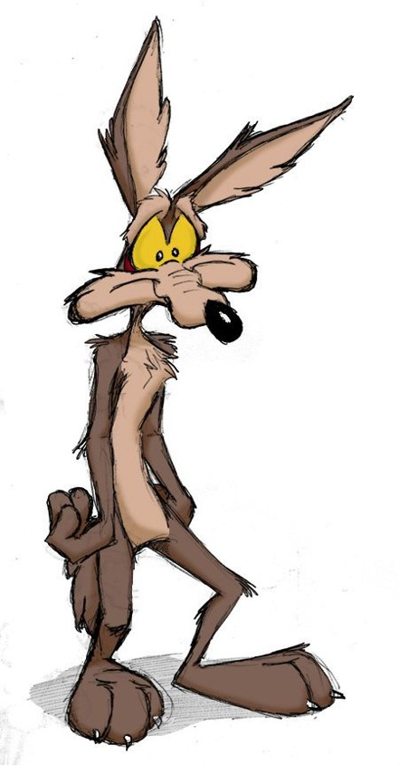
the book of
Psalms
54-57
What in heaven’s name was I thinking ?

Slide 28
the book of
Psalms
54-57

Slide 29
the book of
Psalms
54-57
Glory ~ kabōd – NIV, soul

Slide 30
the book of
Psalms
54-57

