Slide 1
31:1-31

Slide 2
31:1-31
Lemuel ~ from God (Solomon?)
New Unger's Bible Dictionary ~ “A person of whom nothing is known, except that to him the admonitory apothegms of Prov. 31:2-9 were addressed by his mother. The rabbinical commentators identify Lemuel with Solomon, which seems the most likely conjecture. Others (such as Grotius) refer the epithet to Hezekiah, while yet others (such as Gesenius) believe that it refers to some neighboring petty Arabian prince.”

Slide 3
31:1-31
utterance ~ massa’ – Gen 35:14 ~ a son of Ishmael
his mother ~ Bathsheba?

Slide 4
31:1-31

Slide 5
31:1-31
law ~ literally, inscription

Slide 6
31:1-31

Slide 7
31:1-31
virtuous ~ chayil – masculine noun (man of valor)
Judges 6:12 ~ And the Angel of the Lord appeared to him, and said to him, “The Lord is with you, you mighty man of valor!”
Also, v. 3 ~ Do not give your strength to women,
Also translated army, force, host, strength, power

Slide 8
31:1-31
Joe Focht ~ “Why is the virtuous woman so hard to find?
Because she is so seldom sought.”
Eph. 5:25 ~ Husbands, love your wives, just as Christ loved the church and gave himself up for her …

Slide 9
31:1-31

Slide 10
31:1-31
Is. 54:5 ~ For your Maker is your husband, the Lord of hosts is His name; and your Redeemer is the Holy One of Israel; He is called the God of the whole earth.
Living Bible ~ Her husband can trust her, and she will richly satisfy his needs.

Slide 11
31:1-31

Slide 12
31:1-31
willingly ~ chēphets - pleasure, delight

Slide 13
31:1-31

Slide 14
31:1-31
NLT ~ She gets up before dawn to prepare breakfast for her household and plan the day’s work for her servant girls.
Timothy Leary ~ “Women who seek to be equal with men lack ambition.”
Donald Grey Barnhouse ~ “Women are superior to men
88% would rather be homemakers
… at being women.”

Slide 15
31:1-31
“You’re not my mother!” was my retort after I had just become aware that the reason my wife had been so cool towards me all evening was because Mother’s Day had come and gone without so much as a well-wishing on this most auspicious day.
“You’re not my mother.” I had to think long and hard about that statement. True enough, for my own mother had gone on to be with Jesus some time before. So I guess if you want some perfume or something you’re just going to have to hope the kids haven’t spent all their allowance on video games. But that utterance continued to come back

Slide 16
31:1-31
and haunt me.
“You’re not my mother.”
Was that really true?
OK, OK. So you never changed my dirty diaper or kissed a boo-boo or checked the closet for monsters or read me nighttime stories. You never told Larry White to go home when he was teasing me in front of Adrienne Wiegand. You weren’t the one who sewed me a Tarzan outfit when I was seven that made me the envy of Litchfield, Porter and 24th Streets. You never held me in your arms reassured me over the screams of the tornado sirens that everything was going

Slide 17
31:1-31
to be all right (truth be known, it’s me that does that for you).
But you are the one who nursed me when I had the flu and called all the ladies in the church
to pray for me. It was you who scrimped and sacrificed with the household budget to surprise me with that shirt that you knew I wanted. And while you never chased any bullies away from our house, it was you who, when the world was ready to chew me up and spit me out, put your arms around me and looked straight into my eyes and made me believe that I could overcome any bully that world threw at me.

Slide 18
31:1-31
As for your kisses – whoa baby! Boo boos look out!
You’ve believed in me – to the point that I can too. You’ve loved me and taught me that it’s OK to love and risk being hurt. You’ve always been there.
You’ve taught me how to esteem others above myself.
In addition to all this, you’ve given me the privilege of watching you read the stories, kiss the boo-boos and chase the monsters with our own children and for that, Mom, I am truly grateful. My this day be a blessing to you as you have been a blessing to your family. Happy Mother’s Day.

Slide 19
31:1-31

Slide 20
31:1-31
Good News ~ She knows the value of everything she makes, and works late into the night.

Slide 21
31:1-31

Slide 22
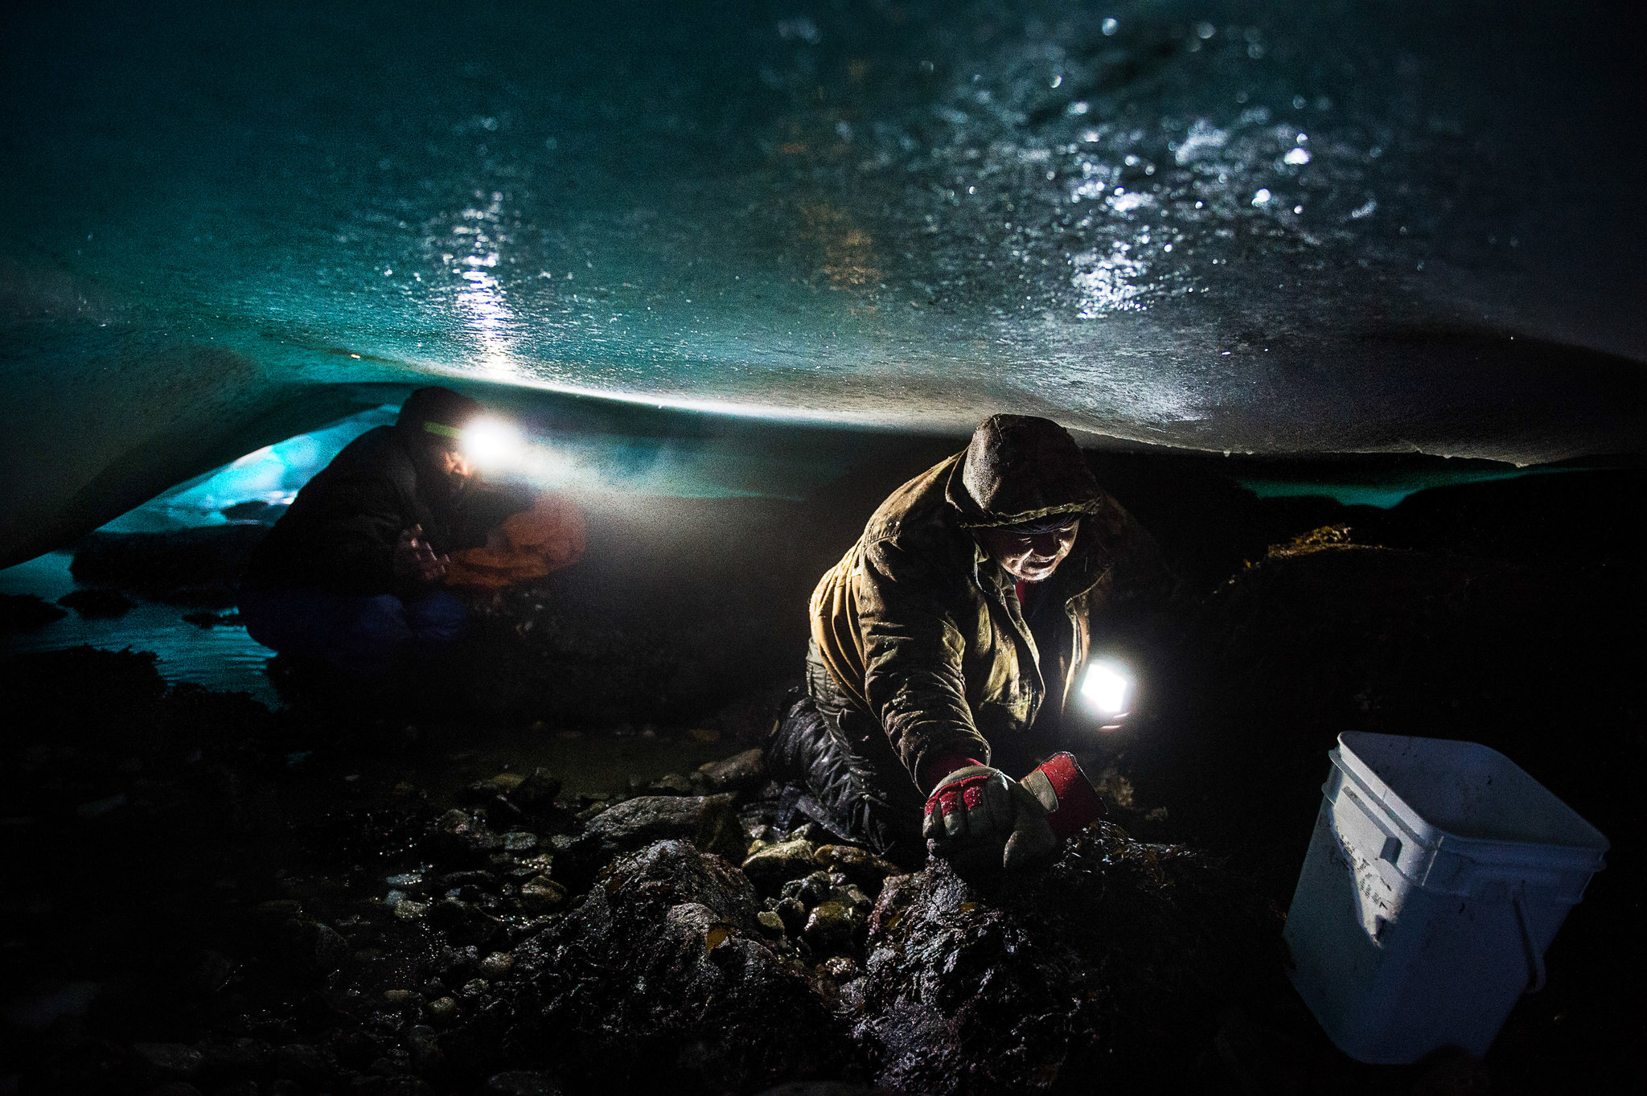
31:1-31

Slide 23
31:1-31

Slide 24
31:1-31
scarlet ~ KJV (footnote) ~ double garments
NLT ~ She has no fear of winter for her household, for everyone has warm clothes.

Slide 25
31:1-31

Slide 26
31:1-31
NIV ~ She is clothed with strength and dignity; she can laugh at the days to come.
Living Bible ~ She is a woman of strength and dignity and has no fear of old age.
Ps. 92:14,15ª ~ ¹⁴ They shall still bear fruit in old age; they shall be fresh and flourishing, ^{15a} to declare that the Lord is upright;

Slide 27
31:1-31

Slide 28
31:1-31
John Killinger (Lost in Wonder, Love, and Praise) ~ “I believe in Jesus Christ, the Son of the living God, who was born of the promise to a virgin named Mary.
I believe in the love Mary gave her Son, that caused her to follow him in his ministry and stand by his cross as he died.
I believe in the love of all mothers, and its importance in the lives of the children they bear.
It is stronger than steel, softer than down, and more resilient than a green sapling on the hillside.
It closes wounds, melts disappointments, and enables the weakest child to stand tall and straight
in the fields of adversity.

Slide 29
31:1-31
John Killinger (Lost in Wonder, Love, and Praise) ~ I believe that this love, even at its best, is only a shadow of the love of God, a dark reflection of all that we can expect of him, both in this life and the next.
And I believe that one of the most beautiful sights in the world is a mother who lets this greater love flow through her to her child, blessing the world with the tenderness of her touch and the tears of her joy.”

Slide 30
31:1-31

Slide 31
31:1-31
Ben Patterson (The Grand Essentials) ~ “I have a theory about old age... I believe that when life has whittled us down, when joints have failed and skin has wrinkled and capillaries have clogged and hardened, what is left of us will be what we were all along, in our essence.
“Exhibit A is a distant uncle ... AIl his life he did nothing but find new ways to get rich ... He spent his senescence very comfortably, drooling and babbling constantly about the money he had made ... When life whittled him down to his essence, all there was left was raw greed. This is what he had cultivated in a thousand little ways over a lifetime.

Slide 32
31:1-31
Ben Patterson (The Grand Essentials) ~ “Exhibit B is my wife’s grandmother ...
When she died in her mid-eighties, she had already been senile for several years. What did this lady talk about? The best example I can think of was when we asked her to pray before dinner. She would reach out and hold the hands of those sitting beside her, a broad, beatific smile would spread across her face, her dim eyes would fill with tears as she looked up to heaven, and her chin would quaver as she poured out her love to Jesus. That was Edna in a nutshell. She loved Jesus and she loved people.

Slide 33
31:1-31
Ben Patterson (The Grand Essentials) ~ She couldn’t remember our names, but she couldn’t keep her hands from patting us lovingly whenever we got near her.
When life whittled her down to her essence, all there was left was love: love for God and love for people.”

Slide 34
31:1-31

