Slide 1
24-26

Slide 2
24-26
Ps. 127:1a ~ Unless the Lord builds the house,
They labor in vain who build it;

Slide 3
24-26

Slide 4
24-26
Ezek. 33:11 ~ Say to them: “As I live,” says the Lord God, “I have no pleasure in the death of the wicked, but that the wicked turn from his way and live. Turn, turn from your evil ways! For why should you die, O house of Israel?”

Slide 5
24-26

Slide 6
24-26
NLT ~ My child, fear the LORD and the king.

Slide 7
24-26

Slide 8
24-26
Good News Bible ~ An honest answer is a sign of true friendship.

Slide 9
24-26

Slide 10
24-26
Deut. 29: 29 ~ The secret things belong to the Lord our God, but those things which are revealed belong to us and to our children forever, that we may do all the words of this law.
Rom. 11:33 ~ Oh, the depth of the riches both of the wisdom and knowledge of God! How unsearchable are His judgments and His ways past finding out!

Slide 11
24-26

Slide 12
24-26
fitly ~ 35 of 36x in KJV – wheel(s)

Slide 13
24-26

Slide 14
24-26
Living Bible ~ It is a badge of honor to accept valid criticism.

Slide 15
24-26

Slide 16
24-26
Living Bible ~ A faithful employee is as refreshing as a cool day in the hot summertime.

Slide 17
24-26

Slide 18
24-26
Seldom ~ 10 of the 11x in the NKJV, it carries the idea of precious value

Slide 19
24-26

Slide 20
24-26
Rom. 12:15 ~ Rejoice with those who rejoice, and weep with those who weep.

Slide 21
24-26

Slide 22
24-26
Good News Bible ~ You will make them burn with shame, and the LORD will reward you.
Jamieson, Fausset, Brown ~ “As metals are melted by heaping coals upon them, so is the heart softened by kindness.”
Abraham Lincoln ~ “Do I not destroy my enemies when I make them my friends?”
Abraham Lincoln ~ “I don’t like that man. I must get to know him better.”

Slide 23
24-26

Slide 24
24-26
May the bird of paradise fly up your nose
May an elephant caress you with his toes
May your wife be plagued with runners in her hose
May the bird of paradise fly up your nose

Slide 25
24-26

Slide 26
24-26
Message ~ A proverb quoted by fools is limp as a wet noodle.

Slide 27
24-26

Slide 28
24-26
Merrihew Standard Version ~ Giving honor to an empty-headed person is as dangerous as firing a plugged-barrel rifle.

Slide 29
24-26

Slide 30
24-26
Good News Bible ~ A fool quoting a wise saying reminds you of a drunk trying to pick a thorn out of his hand.
Living Bible ~ A rebel will misapply an illustration so that its point will no more be felt than a thorn in the hand of a drunkard.

Slide 31
24-26

Slide 32
24-26
NASB ~ Like an archer who wounds everyone,
So is he who hires a fool or who hires those who pass by.
NKJV footnote ~ The Hebrew is difficult; ancient and modern translators differ greatly.

Slide 33
24-26

Slide 34
24-26
Merrihew Standard Version ~ “I can’t go to church today, there’s a 1:250,000 chance I might get hit by meteorite.”

Slide 35
24-26

Slide 36
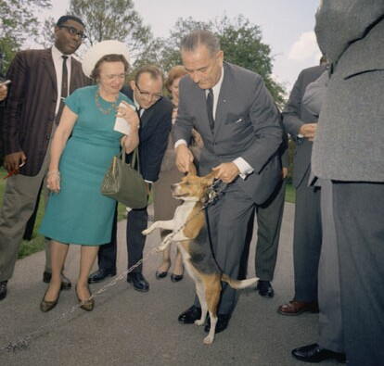
24-26
LBJ and “Him”

Slide 37
24-26

Slide 38
24-26
NLT ~ Smooth words may hide a wicked heart, just as a pretty glaze covers a clay pot.
Good News Bible ~ Insincere talk that hides what you are really thinking is like a fine glaze on a cheap clay pot.

Slide 39
24-26

Slide 40
24-26
disguises ~ KJV, dissembleth

Slide 41
24-26

