Slide 1
22-23

Slide 2
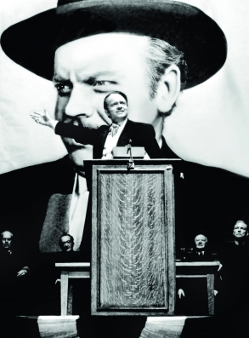
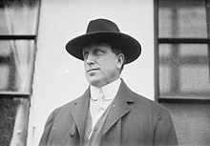
22-23
William Randolph Hearst
“Citizen Kane”

Slide 3
22-23

Slide 4
22-23
NASB ~ The reward of humility and the fear of the Lord
Are riches honor and life.

Slide 5
22-23

Slide 6
22-23
Train up ~ chanak (Hanukkah) dedication
Literally, according to his way
Merrihew Standard Version ~ Dedicate your child to be the individual God has designed him or her to be and when they come of age, they will fulfill that design.

Slide 7
22-23

Slide 8
22-23
Merrihew Standard Version ~ “I can’t go to church today;
I’ve got static cling in my socks!”

Slide 9
22-23

Slide 10
22-23
Not the rod of destruction
the rod of correction

Slide 11
22-23

Slide 12
22-23
Negativity always breeds more negativity
Negativity
Negatella
Junior
Negatina
The Bummers

Slide 13
22-23

Slide 14
22-23
NLT ~ Don’t cheat your neighbor by moving the ancient boundary markers set up by previous generations.

Slide 15
22-23

Slide 16
22-23
appetite ~ nephesh (soul)

Slide 17
22-23

Slide 18
22-23
Good News Bible ~ When you sit down to eat with someone important, keep in mind who he is. If you have a big appetite, restrain yourself. Don’t be greedy for the fine food he serves; he may be trying to trick you.

Slide 19
22-23

Slide 20
22-23
Literally, Will you cause your eyes to fly after it?

Slide 21
22-23

Slide 22
22-23
Prov. 22:9 ~ He who has a generous eye will be blessed,
For he gives of his bread to the poor.
miser ~ KJV, evil eye

Slide 23
22-23

Slide 24
22-23
Redeemer ~ Go-el – Kinsman Redeemer

Slide 25
22-23

Slide 26
22-23
Good News Bible ~ Don’t hesitate to discipline children. A good spanking won’t kill them. As a matter of fact, it may save their lives.
hell ~ sheol

Slide 27
22-23

Slide 28
22-23
inmost being ~ KJV, reins
Literally, kidneys

Slide 29
22-23

Slide 30
22-23
Riotous eaters of flesh
KJV …

Slide 31
22-23

Slide 32
22-23
Responsible for 88,000 deaths per year
#3 cause of death (behind cancer and heart disease)
80% of fire and drowning accidents
60% of all violent crimes
30% of all suicides
Someone is killed by a drunk driver every 50 minutes
30% of automobile fatalities are alcohol-related
More teens die from alcohol-related issues than all illegal drugs combined
Annual costs of alcohol misuse: over $249,000,000,000
Sources: Center for Disease Control and National Institutes of Health

Slide 33
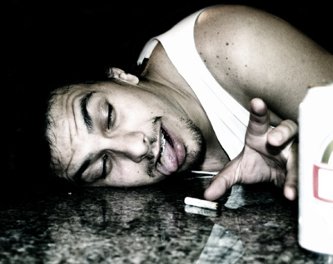
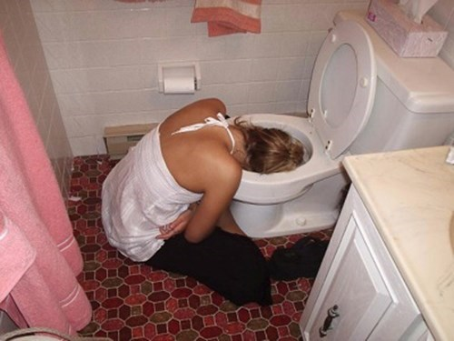
22-23
“This Bud’s for you!”

Slide 34
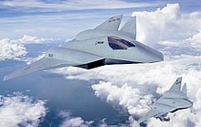
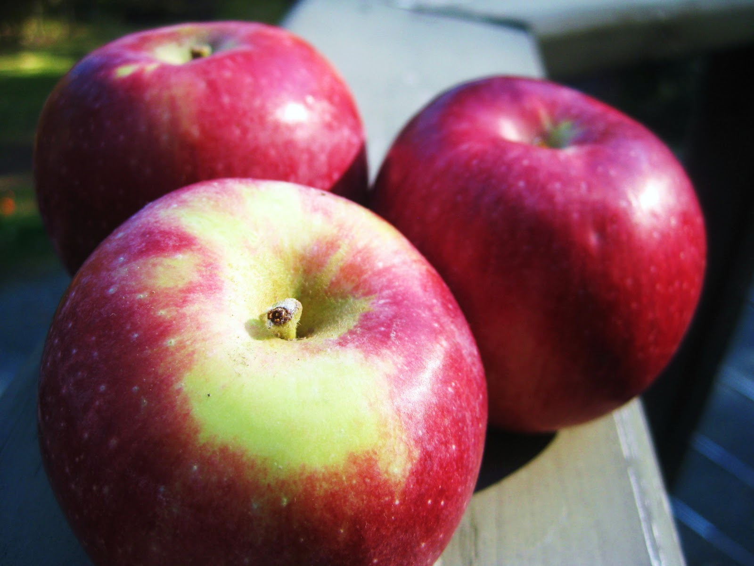
22-23
=
Apples
Boeing F/A-XX stealth fighter
This Photo by Unknown Author is licensed under CC BY-SA
This Photo by Unknown Author is licensed under CC BY-NC-ND
This Photo by Unknown Author is licensed under CC BY-NC

Slide 35
22-23

