Slide 1
10-12

Slide 2
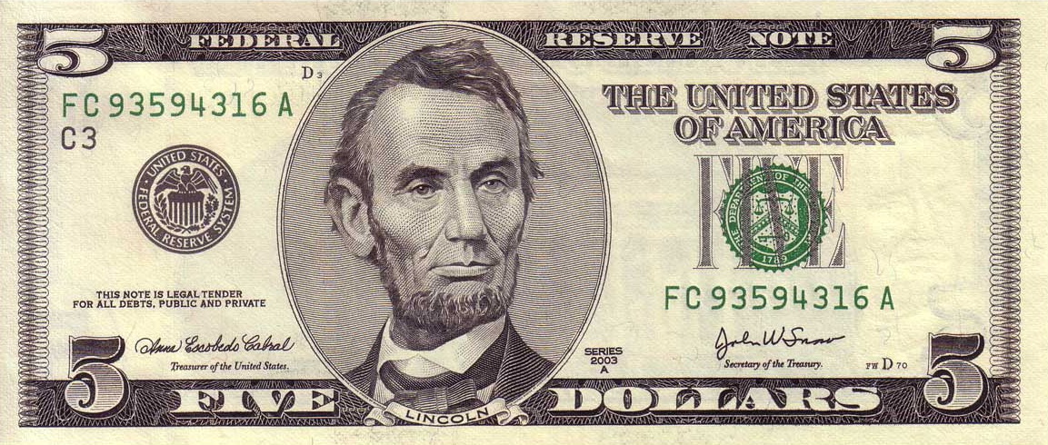
10-12
If every time in the last year you said something positive to or about someone you received $10 …
And every time you said something negative to or about someone you lost $5 …
Today, would you be rich or poor?

Slide 3
10-12

Slide 4
10-12
Proverbs of contrast:
wise/foolish
delightful/slothful
righteousness/evil

Slide 5
10-12

Slide 6
10-12
NLT ~ but babbling fools fall flat on their faces.

Slide 7
10-12

Slide 8
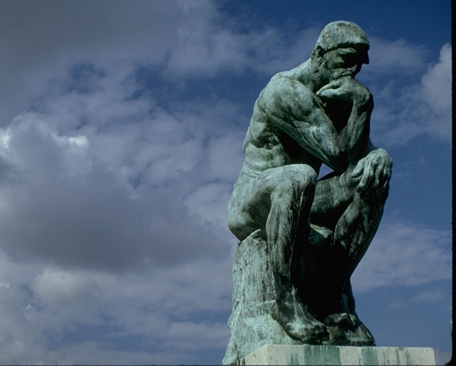
10-12
Nothing is often
a good thing to do – and always a good thing to say

Slide 9
10-12

Slide 10
10-12
Living Bible ~ The Lord’s blessing is our greatest wealth. All our work adds nothing to it!

Slide 11
10-12

Slide 12
10-12
pride/proud are used 14x in Proverbs

Slide 13
10-12

Slide 14
10-12
lust ~ NASB, greed
NIV, evil desires
KJV, nautiness

Slide 15
10-12

Slide 16
10-12
Anonymous ~ “Great minds discuss ideas; average minds discuss events; small minds discuss people.”

Slide 17
10-12

Slide 18
10-12
KJV ~ He that is surety for a stranger shall smart for it: and he that hateth suretiship is sure

Slide 19
10-12

Slide 20
10-12
stupid ~ KJV, brutish
Deer paster,
U
stink.
(from
u know who)

Slide 21
10-12

Slide 22
10-12
Judges 6:12 ~ And the Angel of the Lord appeared to him, and said to him, “The Lord is with you, you mighty man of valor!”
valor ~ chayil
excellent wife (Prov. 12:4) ~ chayil
NIV ~ woman of noble character

Slide 23
10-12

Slide 24
10-12
Living Bible ~ It is better to get your hands dirty – and eat, than to be too proud to work – and starve.

Slide 25
10-12

Slide 26
10-12
regards the life of his animal ~ literally, “knows the soul of his beast”

Slide 27
10-12

Slide 28
10-12
NIV ~ He who works his land will have abundant food, but he who chases fantasies lacks judgment.
Living Bible ~ A hard-working farmer has plenty to eat, but it is stupid to waste time on useless projects.

Slide 29
10-12

Slide 30
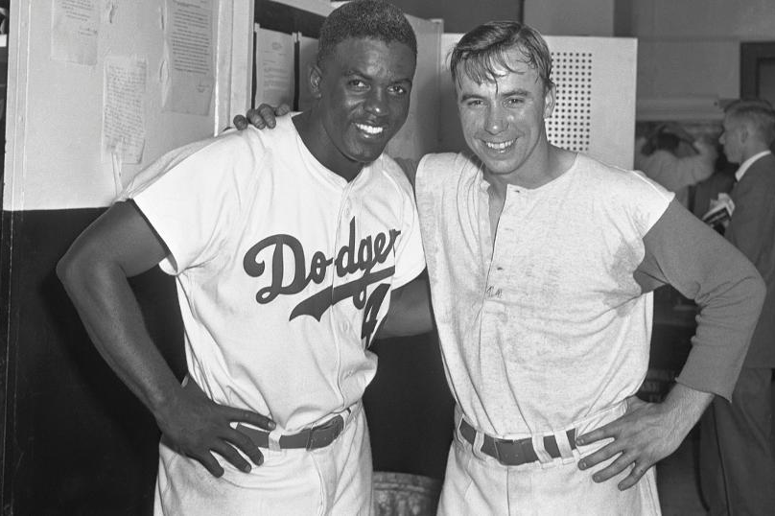
10-12
Jackie Robinson
Peewee Reese

Slide 31
10-12

Slide 32
10-12

Slide 33
10-12
KJV ~ Heaviness in the heart of man maketh it stoop

Slide 34
10-12

