Slide 1
1-3

Slide 2
1-3
Solomon’s birth (c. 990 BC)
Song of Solomon (young man)
Proverbs (middle age)
Ecclesiastes (later years)
990 BC
980 BC
970 BC
960 BC
950 BC
940 BC
Reign 970-931 BC

Slide 3
1-3
Manuel Cervantes (1547-1616) ~ “A short sentence with long experience.”
Ken Merrihew (b. 1951) ~ “‘Cream of Wheat' for the soul.”

Slide 4
1-3
Man’s proverbs are contradicting:
Actions speak louder than words
The pen is mightier than the sword
Beware of Greeks bearing gifts
Don’t look a gift horse in the mouth
Clothes make the man
Don’t judge a book by its cover
Nothing ventured, nothing gained
Better safe than sorry

Slide 5
1-3
Man’s proverbs are contradicting:
Absence makes the heart grow fonder
Out of sight, out of mind
Never put off till to­mor­row what you can do today
Don’t cross the bridge until you come to it

Slide 6
1-3

Slide 7
1-3
Synonymous parallelism:
Repeating a statement twice with similar or synonymous words for emphasis
15:10 - Harsh discipline is for him who forsakes the way,
And he who hates correction will die.

Slide 8
1-3
Antithetic parallelism:
Second line illustrates or emphasizes the first line by stating the opposite idea
13:10 - By pride comes nothing but strife,
But with the well-advised is wisdom.

Slide 9
1-3
Synthetic parallelism:
The second line expands or furthers the idea of the first line
15:11 - Hell and Destruction are before the Lord;
So how much more the hearts of the sons of men.

Slide 10
1-3

Slide 11
1-3
Proverbs 1:1-7 ~ form introduction to the book
v. 1 ~ the title;
vv. 2-6 ~ expresses the two-fold purpose of the book;
v. 7 ~ the motto

Slide 12
1-3

Slide 13
1-3
wisdom ~ “the ability to apply knowledge correctly”
wisdom, wise, etc. ~ over 125x
Ex. 28:3 ~ So you shall speak to all who are gifted artisans, whom I have filled with the spirit of wisdom, that they may make Aaron’s garments, to consecrate him, that he may minister to Me as priest.
instruction ~ “to teach by discipline”
understanding ~ “intelligence, discernment”

Slide 14
1-3

Slide 15
1-3
fear of the Lord ~ 14x (NKJV) in Proverbs
1:7; 1:29; 2:5; 8:13; 9:10; 10:27; 14:26; 14:27; 15:16; 15:33; 16:6; 19:23; 22:4; 23:17
Warren Wiersbe, Be Skillful ~ “It’s not the servile fear of the slave before the master but the reverential and respectful fear of the child before the parent. Children fear not only because their parents can hurt them, but also because they can hurt their parents.”
beginning ~ re’shith - start, choice part, head

Slide 16
1-3

Slide 17
1-3
C. H. Spurgeon ~ “If you’re not seeking the Lord, the Devil is seeking you. If you’re not seeking the Lord, judgment is at your heels.”
This Photo by Unknown Author is licensed under CC BY-SA

Slide 18
1-3

Slide 19
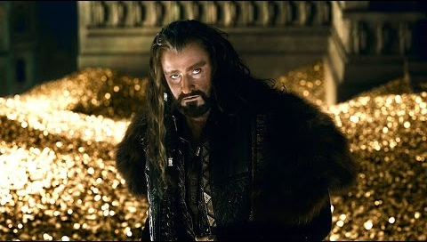
1-3

Slide 20
1-3

Slide 21
1-3
Ask, and it will be given to you;
Seek, and you will find;
Knock, and it will be opened to you.
– Matt.7:7

Slide 22
1-3

Slide 23
1-3
immoral woman ~ KJV, strange woman

Slide 24
1-3

Slide 25
1-3
Eccl. 3:1-8 ~ ¹ For everything there is a season, and a time for every matter under heaven:
² a time to be born, and a time to die;
a time to plant, and a time to pluck up what is planted;
³ a time to kill, and a time to heal;
a time to break down, and a time to build up;
⁴ a time to weep, and a time to laugh;
a time to mourn, and a time to dance;
⁵ a time to cast away stones, and a time to gather stones together; a time to embrace, and a time to refrain from embracing;
⁶ a time to seek, and a time to lose;
a time to keep, and a time to cast away;
⁷ a time to tear, and a time to sew;
a time to keep silence, and a time to speak;
⁸ a time to love, and a time to hate;
a time for war, and a time for peace.

Slide 26
1-3

Slide 27
1-3
1.
Trust in the Lord
Don’t lean on your understanding
2.
Acknowledge Him in everything
3.

Slide 28
1-3

Slide 29
1-3
flesh ~ KJV, naval
Good News Bible ~ If you do, it will be like good medicine, healing your wounds and easing your pains.

Slide 30
1-3

Slide 31
1-3
chastening (v. 11) ~ better, discipline (as other modern English translations)

Slide 32
1-3

Slide 33
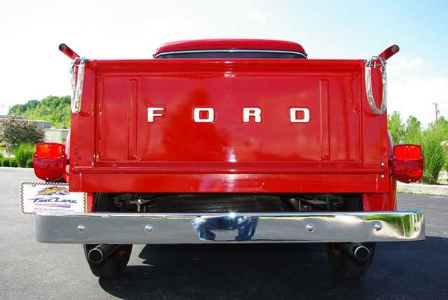
1-3
KJV, NASB ~ afraid of sudden fear
Don’t fear fear

Slide 34
1-3

