Slide 1
2.19-30

Slide 2
2.19-30
Phil. 2.12-13 ~ ¹² Therefore, my beloved, as you have always obeyed, not as in my presence only, but now much more in my absence, work out your own salvation with fear and trembling; ¹³ for it is God who works in you both to will and to do for His good pleasure.

Slide 3
2.19-30
Heb. 13.20-21 ~ ²⁰ Now may the God of peace … ²¹ make you complete in every good work to do His will, working in you what is well pleasing in His sight, through Jesus Christ, to whom be glory forever and ever. Amen.

Slide 4
2.19-30

Slide 5
2.19-30
Eph. 2.4-5, 10 ~
⁴ But God, who is rich in mercy, because of His great love with which He loved us, ⁵ even when we were dead in trespasses, made us alive together with Christ …
¹⁰ For we are His workmanship, created in Christ Jesus for good works, which God prepared beforehand that we should walk in them.

Slide 6
2.19-30

Slide 7
2.19-30
Jesus, I've broken most of the Ten Commandments, shot spit wads in school, tore up my sister's Barbie doll and lots more. I'm desperate. I've got your mama. If you ever want to see her again, give me a bike.
Signed, You know who
Dear Jesus,
I've thought about being a good boy this year and can I have a new bicycle?
Signed, Johnny
Dear Jesus,
I've been a good boy this year and would appreciate a new bicycle. Your Friend,
Johnny
Dear Jesus,
I've been an OK boy this year and I want a new bicycle. Yours Truly,
Johnny

Slide 8
2.19-30

Slide 9
2.19-30
Luke 17.7-10 ~ ⁷ And which of you, having a servant plowing or tending sheep, will say to him when he has come in from the field, “Come at once and sit down to eat”? ⁸ But will he not rather say to him, “Prepare something for my supper, and gird yourself and serve me till I have eaten and drunk, and afterward you will eat and drink”? ⁹ Does he thank that servant because he did the things that were commanded him? I think not.

Slide 10
2.19-30
Luke 17.7-10 ~ ¹⁰ So likewise you, when you have done all those things which you are commanded, say, “We are unprofitable servants. We have done what was our duty to do.”

Slide 11
2.19-30

Slide 12
2.19-30
Like-minded ~ isospuchos – literally, equal-souled

Slide 13
2.19-30

Slide 14
2.19-30
Chuck Swindoll ~ “The longer I live, the more I realize the impact of attitude on life. Attitude, to me, is more important than facts. It is more important than the past, than education, than money, than circumstances, than failures, than successes, than what other people think or say or do. It is more important than appearance, giftedness, or skill. It will make or break a company ... a church ... a home. The remarkable thing is we have a choice

Slide 15
2.19-30
Chuck Swindoll ~ every day regarding the attitude we will embrace for that day. We cannot change the inevitable. The only thing we can do is play on the one string we have, and that is our attitude ... I am convinced that life is 10% what happens to me, and 90% how I react to it. And so it is with you ... we are in charge of our Attitudes.”

Slide 16
2.19-30

Slide 17
2.19-30
Jer. 17.9 ~ The heart is deceitful above all things,
And desperately wicked;
Who can know it?
John 15.5 ~ I am the vine, you are the branches. He who abides in Me, and I in him, bears much fruit; for without Me you can do nothing.

Slide 18
2.19-30

Slide 19
2.19-30
Ps. 103.14 ~ For He knows our frame; He remembers that we are dust.

Slide 20
2.19-30

Slide 21
2.19-30
Messenger ~ apostolos

Slide 22
2.19-30

Slide 23
2.19-30
Rom. 8.3-4 (Phillips) ~ ³ The Law never succeeded in producing righteousness—the failure was always the weakness of human nature. But God has met this by sending his own Son Jesus Christ to live in that human nature which causes the trouble. And, while Christ was actually taking upon himself the sins of men, God condemned that sinful nature. ⁴ So that we are able to meet the Law's requirements, so long as we are living no longer by the dictates of our sinful nature, but in obedience to the promptings of the Spirit.

Slide 24
2.19-30

Slide 25
2.19-30
2 Cor. 5.13-14 - ¹³ For if we are beside ourselves, it is for God; or if we are of sound mind, it is for you. ¹⁴ For the love of Christ compels us, because we judge thus: that if One died for all, then all died;

Slide 26
2.19-30

Slide 27
2.19-30
Merrihew Standard Version ~ And even though he almost died, and didn't give his life a second thought … you ought to give him the honor that is due men like him.

Slide 28
2.19-30

Slide 29
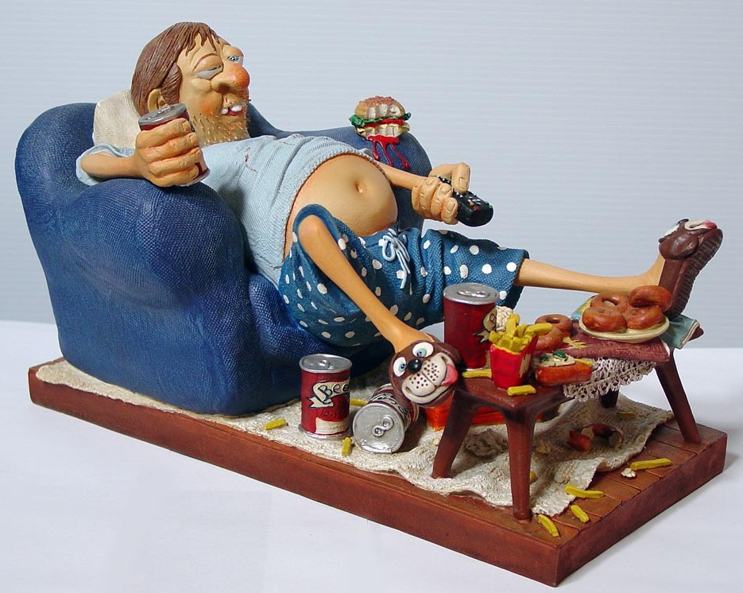
2.19-30
Parable of the Brother-in-law

Slide 30
2.19-30

