Slide 1
1.1-11

Slide 2
1.1-11
Phil. 4.19 ~ my God shall supply all your need according to His riches in glory by Christ Jesus.

Slide 3
1.1-11

Slide 4
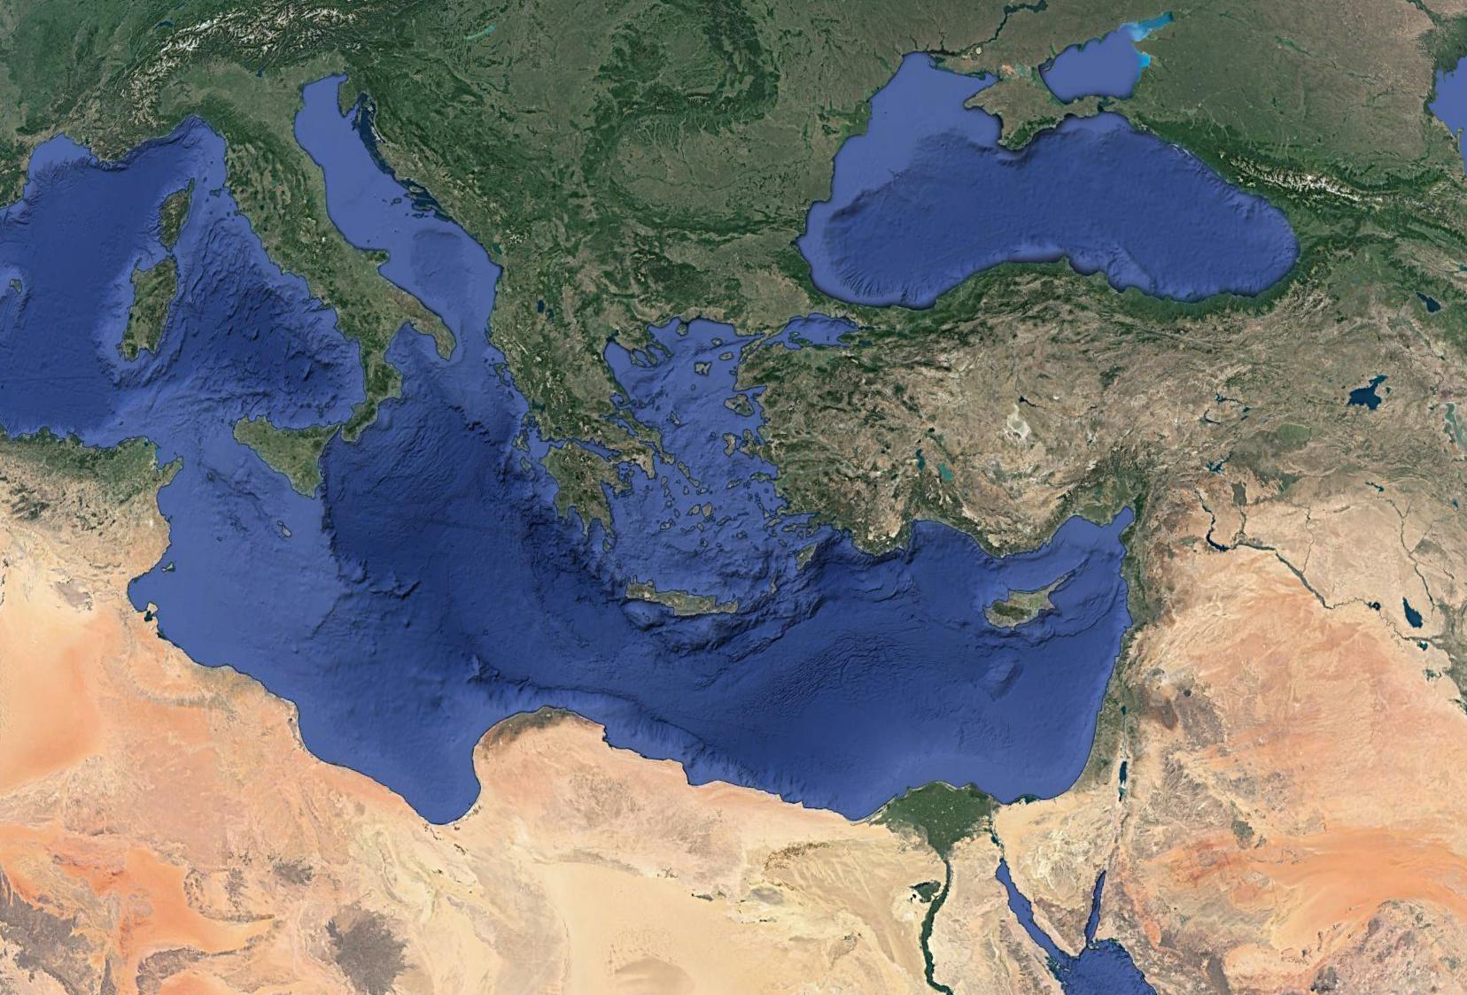
1.1-11
Philippi
Bithynia
Troas
Asia
Egnatian Way
Antioch
Paul’s 2nd Missionary Journey

Slide 5
1.1-11

Slide 6
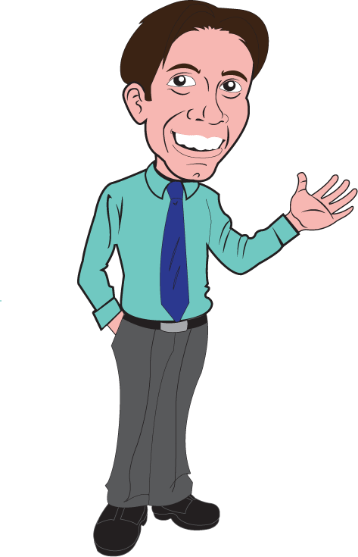
1.1-11
Deacons ~ diakonos – 65x (noun or verb form)
Usually translated ~ minister or servant
Translated as deacon(s) here and 3x in 1 Tim. 3:8-13
“Deacon Jones”?
“Jones is a servant”?
An “office”?
Or a “person”?

Slide 7
1.1-11

Slide 8
1.1-11
Grace and peace ~ uniting East and West

Slide 9
1.1-11

Slide 10
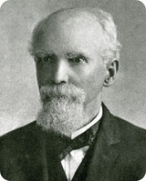
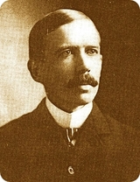
1.1-11
Edward McKendree Bounds
(1835-1913)
“Praying” John Hyde
(1865-1912)

Slide 11
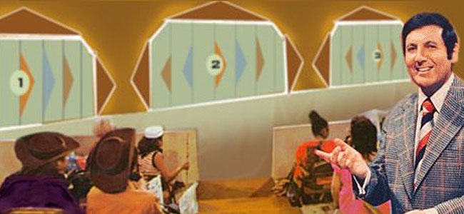
1.1-11

Slide 12
1.1-11
Prov. 3.5-6 ~ ⁵ Trust in the Lord with all your heart,
And lean not on your own understanding;
⁶ In all your ways acknowledge Him,
And He shall direct your paths.
Heb. 11.6 ~ But without faith it is impossible to please Him, for he who comes to God must believe that He is, and that He is a rewarder of those who diligently seek Him.

Slide 13
1.1-11

Slide 14
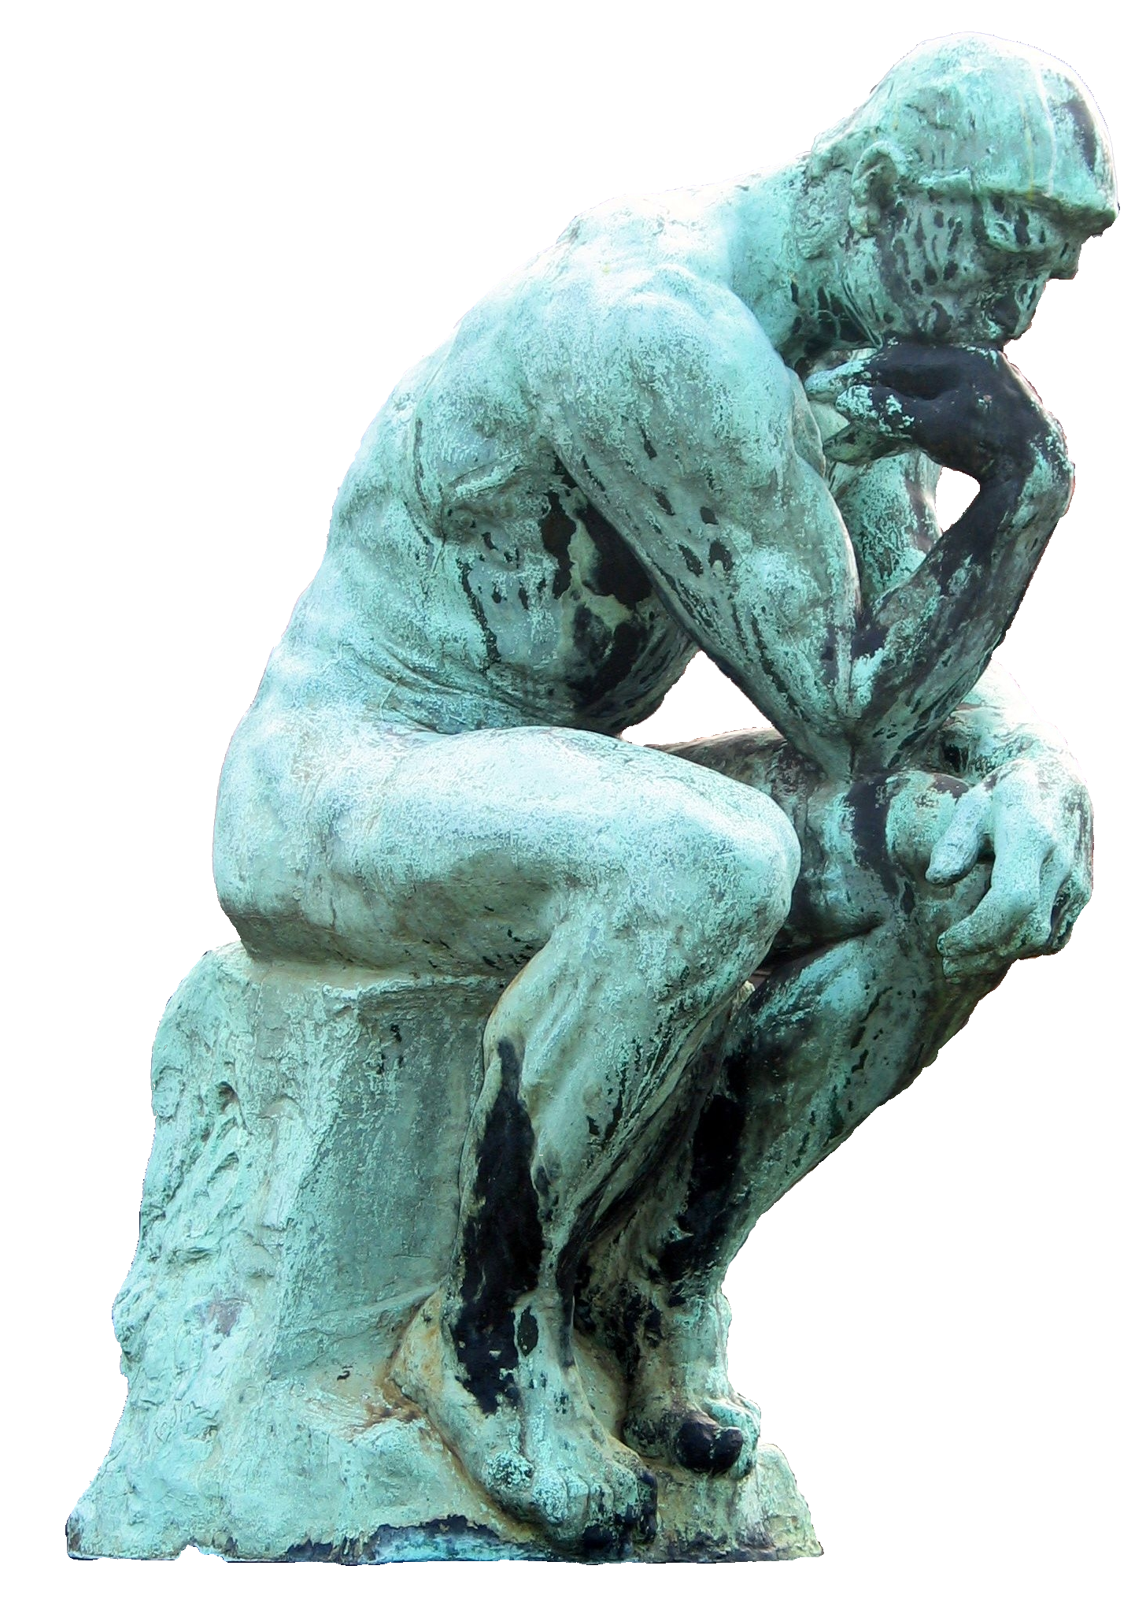
1.1-11

Slide 15
1.1-11
A. W. Tozer ~ “We must hide our unholiness in the wounds of Christ as Moses hid himself in the cleft of the rock while the glory of God passed by. We must take refuge from God in God. Above all we must believe that God sees us perfect in His Son while He disciplines and chastens and purges us that we may be partakers of His holiness.”

Slide 16
1.1-11

Slide 17
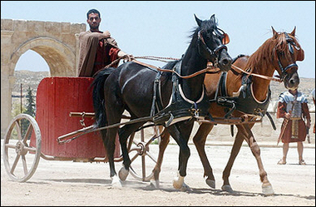
1.1-11
Affections ~ KJV, bowels - splagchnon

Slide 18
1.1-11

Slide 19
1.1-11
Discernment ~ KJV, judgment
NIV ~ depth of insight
Phillips ~ My prayer for you is that you may have still more love – a love that is full of knowledge and wise insight.

Slide 20
1.1-11

Slide 21
1.1-11
Sincere ~ heilikrinēs
heili ~ the sun’s ray
krinō ~ to distinguish, to judge
Sun-judged
or
eilein ~ to swirl around (sifting)
krinō ~ to distinguish, to judge
Judged pure by sifting

Slide 22
1.1-11

Slide 23
1.1-11
Knowledge (v. 9)
Love (v. 10)
Being filled with the fruits of righteousness (v. 11)

Slide 24
1.1-11

