Slide 1
9:1-11:36

Slide 2
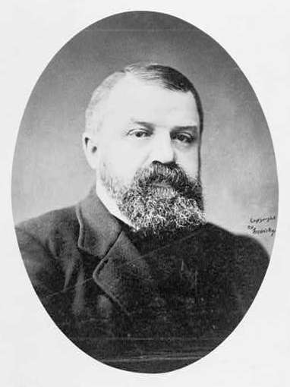
9:1-11:36
D. L. Moody (1837-1899) ~ “While our dear brother is finishing his prayer, let’s turn to number 342 and sing it together!”

Slide 3
9:1-11:36

Slide 4
9:1-11:36
Eccl. 3:11 ~ He has made everything beautiful in its time.
Also He has put eternity in their hearts, except that no one can find out the work that God does from beginning to end.

Slide 5
9:1-11:36

Slide 6
9:1-11:36
acted proudly ~ same word as v. 10

Slide 7
9:1-11:36

Slide 8
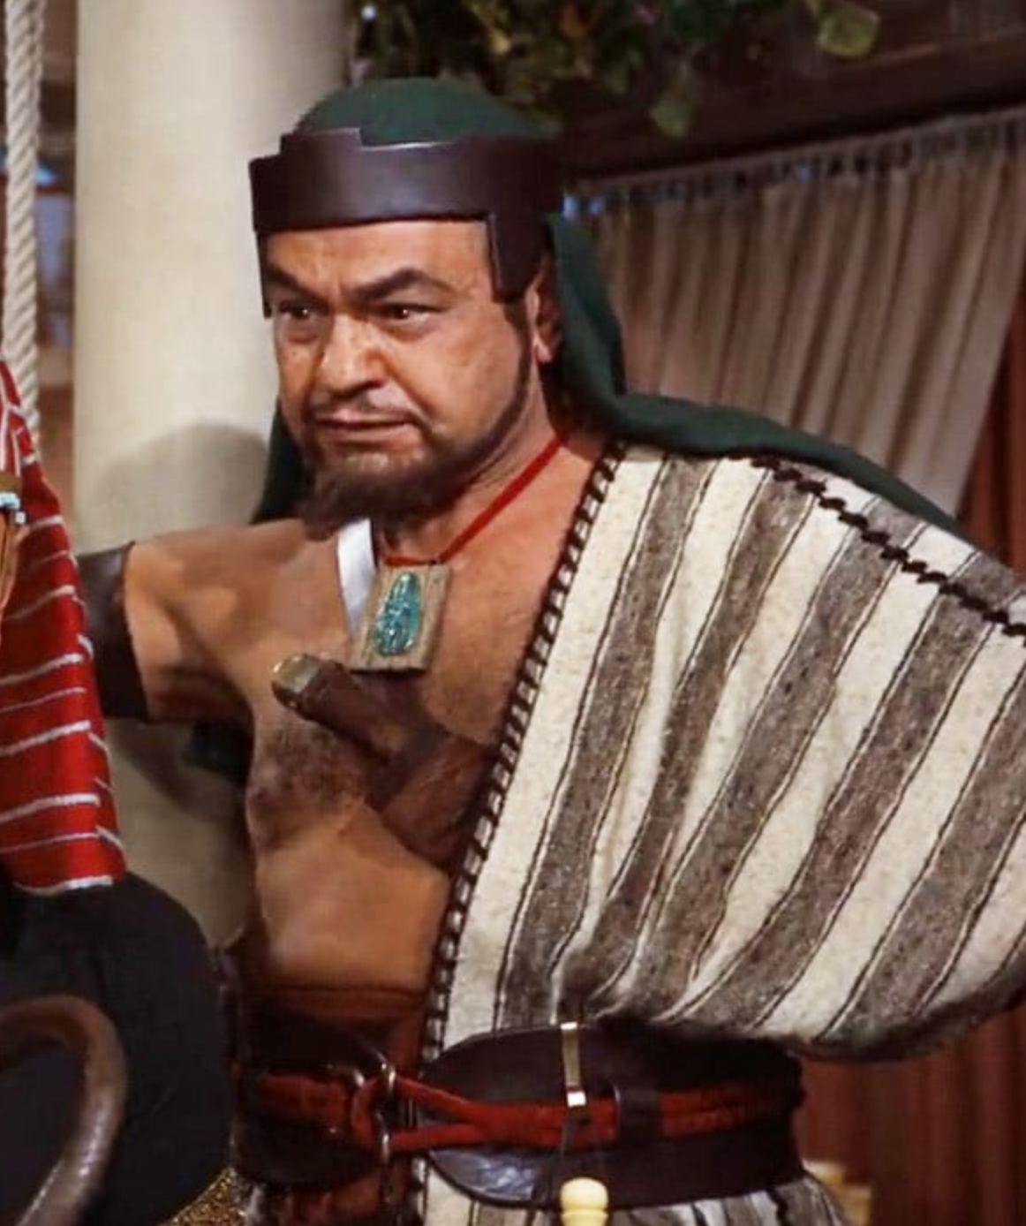
9:1-11:36
Edward G. Robinson (Dathan)

Slide 9
9:1-11:36

Slide 10
9:1-11:36
kindness ~ chesed – usually rendered mercy (KJV)
NASB ~ abounding in lovingkindness;
NIV ~ abounding in love.
ESV ~ abounding in steadfast love,
NLT ~ and rich in unfailing love.

Slide 11
9:1-11:36

Slide 12
9:1-11:36
phat
fat
rich land ~ KJV, land
shaman – to shine; to be oily or gross

Slide 13
9:1-11:36

Slide 14
9:1-11:36
2 Cor. 6:14-16 ~ ¹⁴ Do not be unequally yoked together with unbelievers. For what fellowship has righteousness with lawlessness? And what communion has light with darkness? ¹⁵ And what accord has Christ with Belial? Or what part has a believer with an unbeliever? ¹⁶ And what agreement has the temple of God with idols?

Slide 15
9:1-11:36

Slide 16
9:1-11:36
Acts 15:28-29 ~ ²⁸ For it seemed good to the Holy Spirit, and to us, to lay upon you no greater burden than these necessary things: ²⁹ that you abstain from things offered to idols, from blood, from things strangled, and from sexual immorality.

Slide 17
9:1-11:36

Slide 18
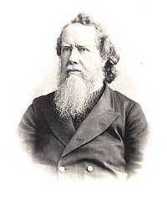
9:1-11:36
Hudson Taylor (1832-1905) ~ “God’s work
done in God's way will never lack God's supply.”

Slide 19
9:1-11:36

Slide 20
9:1-11:36
dough ~ NIV, ground meal

Slide 21
9:1-11:36

Slide 22
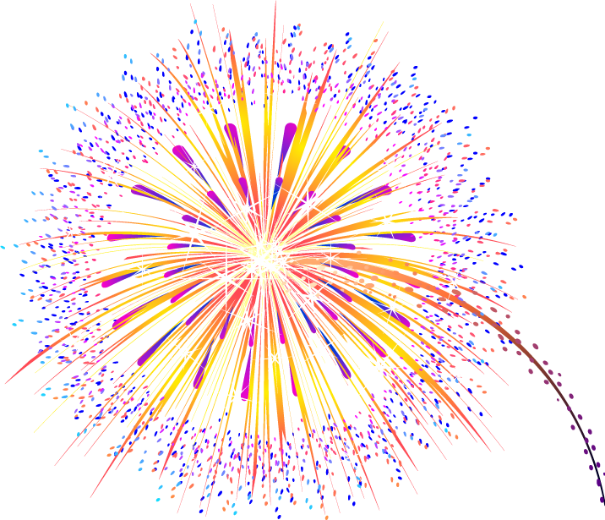
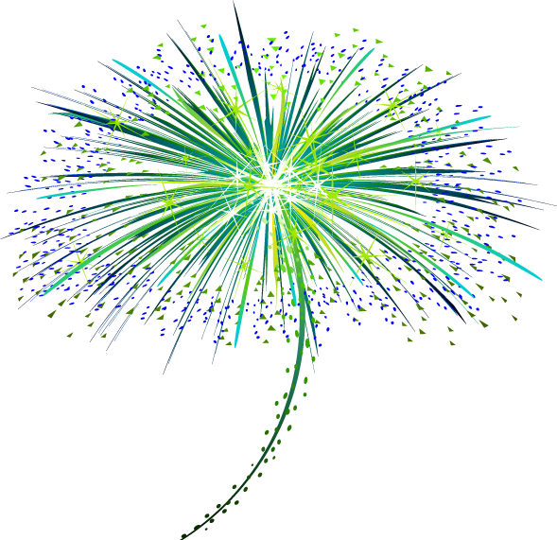
9:1-11:36
$250,000
$225,000
$200,000
$175,000
$150,000
$125,000
$100,000
$75,000
$50,000
$25,000

Slide 23
9:1-11:36

Slide 24
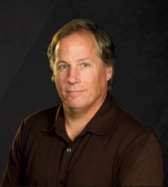
9:1-11:36
David Guzik ~ “If you are reluctant to be a
giver as the Bible says you should, simply talk to those who are. Ask them if it has been a blessing or a curse in their life to give as God says to. God promises He will never owe us anything, and we cannot out-give God - though the return is often far better than dollars and cents.”

Slide 25
9:1-11:36

Slide 26
9:1-11:36
1 Chron. 9:3 ~ Now in Jerusalem the children of Judah dwelt, and some of the children of Benjamin, and of the children of Ephraim and Manasseh:
J. Edwin Orr (1912-1987) ~ “The Spirit of God working through the Word of God, in the lives of the people of God.”

Slide 27
9:1-11:36

