Slide 1
2:9-3:32

Slide 2
2:9-3:32
< 800 miles
Jerusalem
Shushan

Slide 3
2:9-3:32

Slide 4
2:9-3:32
Sanballat ~ “strength”
A satrap of Artaxerxes from Moab
Tobiah ~ “Yahweh is good”
An Ammonite
Sanballat
Tobiah
Spike
Chester

Slide 5
2:9-3:32

Slide 6
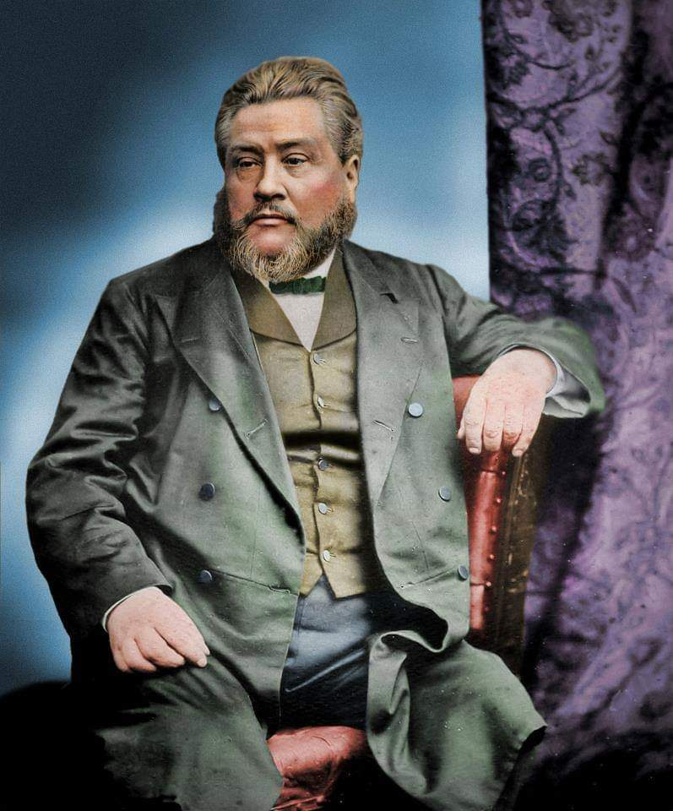
2:9-3:32
C. H. Spurgeon (1834-1892) ~ “You will often find it best not to commit your plans to others. If you want to serve God, go and do it, and then let other people find it out afterwards. You have no need to tell what you are going
to do, and, I may add, there is no need for you retelling what you have done, for very, very frequently God withdraws himself when we boast of what is being done.”

Slide 7
2:9-3:32
Prov. 25:28 ~ Whoever has no rule over his own spirit Is like a city broken down, without walls.

Slide 8
2:9-3:32

Slide 9
2:9-3:32
Prov. 25:28 ~ Whoever has no rule over his own spirit Is like a city broken down, without walls.

Slide 10
2:9-3:32

Slide 11
2:9-3:32
Eliashib ~ my God restores

Slide 12
2:9-3:32

Slide 13
2:9-3:32
Fish gate
Sheep gate

Slide 14
2:9-3:32

Slide 15
2:9-3:32
repairs ~ chazaq – to strengthen (35x in chapter 3)

Slide 16
2:9-3:32

Slide 17
2:9-3:32
did not put their shoulders ~ literally, they were stiff-necked
ESV ~ but their nobles would not stoop to serve their Lord.

Slide 18
2:9-3:32

Slide 19
2:9-3:32
Fish gate
Sheep gate
Old gate

Slide 20
2:9-3:32
Jer. 6:16a ~ Thus says the Lord:
“Stand in the ways and see,
And ask for the old paths, where the good way is,
And walk in it;
Then you will find rest for your souls.”

Slide 21
2:9-3:32

Slide 22
2:9-3:32
Fish gate
Sheep gate
Old gate
Miphkad gate
East gate
Horse gate
Water gate
Valley gate
Fountain gate
Refuse gate

Slide 23
2:9-3:32

Slide 24
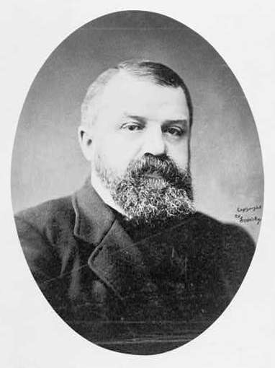
2:9-3:32
D. L. Moody (1837-1899) ~ “A great many people have got a false idea about the church. They have got an idea that the church is a place to rest in … to get into a nicely cushioned pew, and contribute to the charities, listen to the minister, and do their share to keep the church out of bankruptcy, is all they want. The idea of work for them – actual work in the church – never enters their minds.”

Slide 25
2:9-3:32

