Slide 1
1:1-2:8

Slide 2
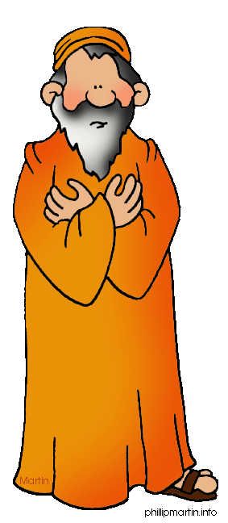
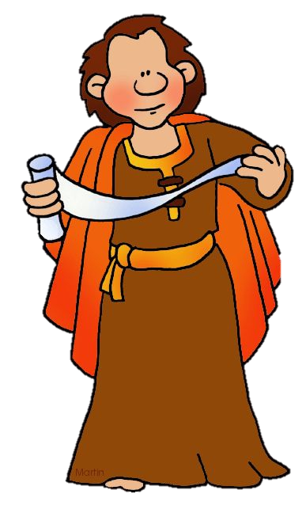
1:1-2:8
Knee-high Miah
Bildad the Shoe-height

Slide 3
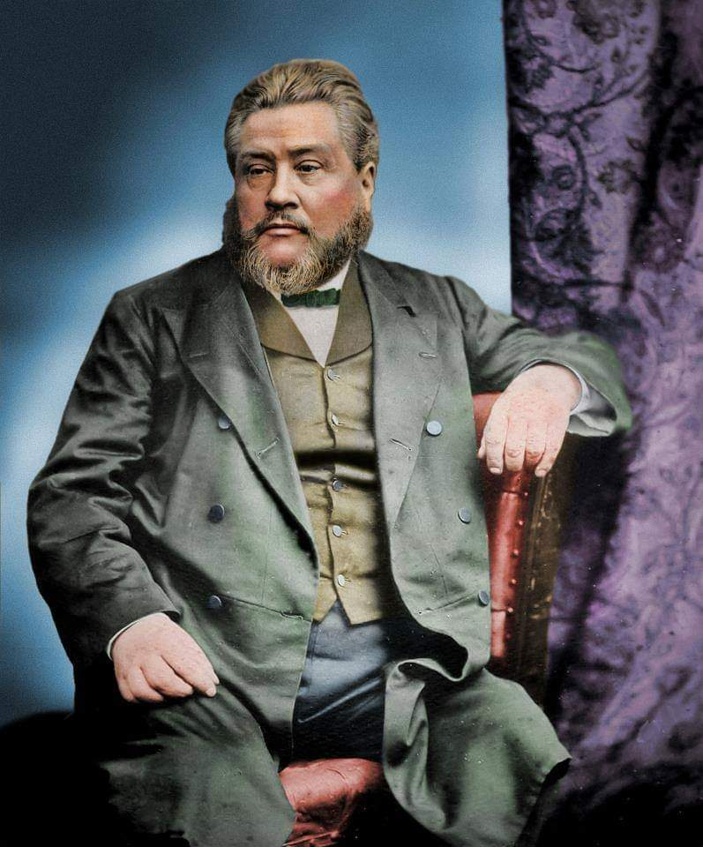
1:1-2:8
C. H. Spurgeon (1834-1892) ~ “We are not called to govern, as he did, with an iron hand, but we ought to be equally inflexible, decided, and resolute for God, and for His holy will.”

Slide 4
1:1-2:8
Authorship:
Ancient Hebrew tradition: Ezra- Nehemiah was written by Ezra
Modern scholarship leans toward Nehemiah

Slide 5
1:1-2:8

Slide 6
1:1-2:8
1st deportation
605 BC
3rd deportation
586 BC
Ezra return
558 BC
590 BC
570 BC
550 BC
530 BC
510 BC
490 BC
470 BC
450 BC
2nd deportation
597 BC
Cyrus’s decree 538 BC
Esther
c. 470 BC
Nehemiah return
444 BC
Cyrus
(559-530 BC)
Darius I
(522-486 BC)
Artaxerxes I
(465-424 BC)
Cambyses II (530-522 BC)
Xerxes I
(485-465 BC)

Slide 7
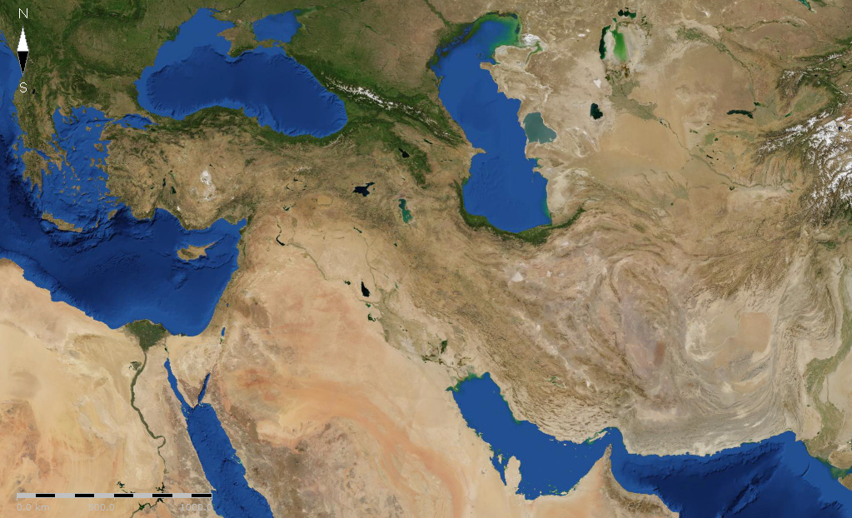
1:1-2:8
Shushan
(Susa)
Persian Empire

Slide 8
1:1-2:8

Slide 9
1:1-2:8
works a habit …
Satan takes an activity …
produces a bondage …

Slide 10
1:1-2:8

Slide 11
1:1-2:8
Here I am! Send me.

Slide 12
1:1-2:8

Slide 13
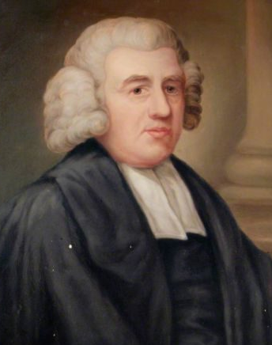
1:1-2:8
confess ~ yadah ~ basic meaning is to cast off
John Newton (1725-1807) ~ “My memory is nearly gone, but I remember two things: That I am a great sinner and that Christ is a great Savior.”
“I am not the man I ought to be. I am not the man I wish to be, and I am not the man I hope to be, but by the grace of God, I am not the man I used to be.”

Slide 14
1:1-2:8

Slide 15
1:1-2:8
Lev. 26:31-33 ~ ³¹ I will lay your cities waste and bring your sanctuaries to desolation, and I will not smell the fragrance of your sweet aromas.
³² I will bring the land to desolation, and your enemies who dwell in it shall be astonished at it.
³³ I will scatter you among the nations and draw out a sword after you; your land shall be desolate and your cities waste.

Slide 16
1:1-2:8
Deut. 30:2-5 ~ ² and you return to the LORD your God and obey His voice, according to all that I command you today, you and your children, with all your heart and with all your soul, ³ that the LORD your God will bring you back from captivity, and have compassion on you, and gather you again from all the nations where the LORD your God has scattered you. ⁴ If any of you are driven out to the farthest parts under heaven, from there the LORD your God will gather you, and from there He will bring you. ⁵ Then the LORD your God will bring you to the land which your fathers possessed, and you shall possess it.

Slide 17
1:1-2:8

Slide 18
1:1-2:8
At least one LXX text (LXXB): eunochos (eunuch) instead of
oinochoos (cupbearer)

Slide 19
1:1-2:8

Slide 20
1:1-2:8
1 Thess. 5:17 ~ pray without ceasing,

Slide 21
1:1-2:8

Slide 22
1:1-2:8
Dan. 9:25 ~ Know therefore and understand,
That from the going forth of the command
To restore and build Jerusalem
Until Messiah the Prince,
There shall be seven weeks and sixty-two weeks;
The street shall be built again, and the wall,
Even in troublesome times.

Slide 23
1:1-2:8
Artaxerxes’ decree
Mar. 5, 444 BC
Wall rebuilt
595 BC
Triumphal Entry
Mar. 30, AD 33
Daniel’s 69 “weeks”
400 BC
300 BC
200 BC
100 BC
BC/AD
62
weeks
7
weeks
69
weeks

Slide 24
1:1-2:8

Slide 25
1:1-2:8
Ps. 20:6-9 ~ ⁶ Now I know that the LORD saves His anointed;
He will answer him from His holy heaven
With the saving strength of His right hand.
⁷ Some trust in chariots, and some in horses;
But we will remember the name of the LORD our God.
⁸ They have bowed down and fallen;
But we have risen and stand upright.
⁹ Save, LORD!
May the King answer us when we call.

Slide 26
1:1-2:8

