Slide 1
MATTHEW 24:1-8
A free CD of this message will be available following the service
IT WILL ALSO be available LATER THIS WEEK
VIA cALVARYOKC.COM

Slide 2
MATTHEW 24:1-8
1975
40 years later
2015
Long hair
Longing for hair
KEG
EKG
Acid rock
Acid reflux
Moving to California cuz it’s cool
Moving to Arizona cuz it’s warm
Acid rock
Acid reflux
Seeds and stems
Roughage

Slide 3
MATTHEW 24:1-8
1975
40 years later
2015
Going to a new, hip joint
Getting a new hip joint
Rolling Stones
Kidney stones
Down with the system
Upgrade the system
Disco
Costco
Parents begging you to get a haircut
Children begging you to shave their heads
Hoping for a BMW
Hoping for a BM

Slide 4
MATTHEW 24:1-8

Slide 5
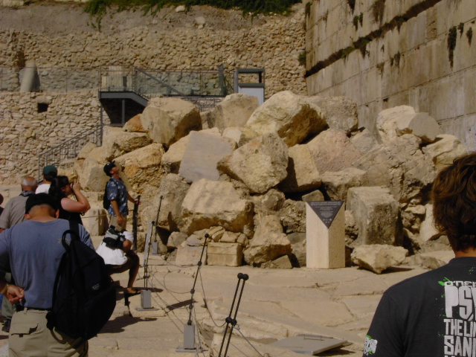
MATTHEW 24:1-8

Slide 6
MATTHEW 24:1-8

Slide 7
MATTHEW 24:1-8
Three questions:
1. When will this happen?
Luke 21:20-24
2. What will be the sign(s) of Your coming?
Matt. 24:31-44
3. What will be the sign(s) of the end of the age?
Matt. 24:4-30

Slide 8
MATTHEW 24:1-8

Slide 9
MATTHEW 24:1-8
End ~ compound word meaning with completion
Consummation
Eschatology
2 Tim. 3:1 ~ But know this, that in the last days perilous times will come:
Last ~ eschatos (last things)
+ logos (to study)

Slide 10
MATTHEW 24:1-8
?
Premillennialism
Pre-Tribulationalism
?
Amillennialism
?
?
Pan-Tribulationalism
?
Post-Tribulationalism
Preterism
?
Mid-Tribulationalism
Postmillennialism
Pre-wrath Rapture

Slide 11
MATTHEW 24:1-8
1 Thess. 4:13 ~ But I do not want you to be ignorant, brethren,
¼ of the Bible is prophetic at the time of its writing
1. 100% track record on fulfilled prophecies
2. Every prophecy has been fulfilled literally
3. Usually not done according to conventional wisdom

Slide 12
MATTHEW 24:1-8

Slide 13
MATTHEW 24:1-8
Preterism (from a Latin word meaning “past”) ~ “a belief system in which most or all of the eschatological events in the Bible were fulfilled during the Roman-Jewish War of AD 66-73.”
Matt. 24:21 ~ For then there will be great tribulation, such as has not been since the beginning of the world until this time, no, nor ever shall be.

Slide 14
MATTHEW 24:1-8

Slide 15
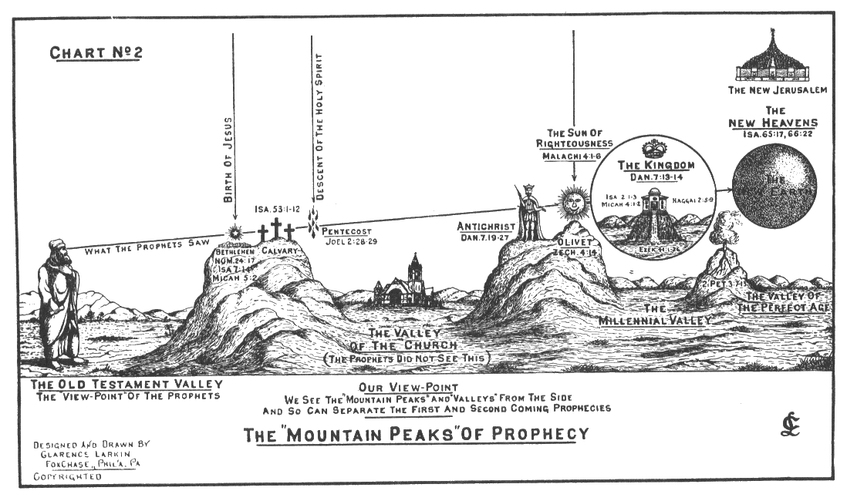
MATTHEW 24:1-8
Law (Principle) of Double Reference
Eternity
2nd Coming
1st Coming
Millennium

Slide 16
MATTHEW 24:1-8
Dan. 9:27a ~ Seventy weeks (i.e. 7-year periods) are determined
For your people and for your holy city
Premillennial, pre-tribulational Rapture of the Church

Slide 17
MATTHEW 24:1-8
Outline for Matthew 24
vv. 4-8 ~ this present age
vv. 9-22 ~ 1st half of the Tribulation
vv. 23-26 ~ 2nd half of the Tribulation
vv. 27-51 ~ the Rapture of the Church

Slide 18
MATTHEW 24:1-8

Slide 19
MATTHEW 24:1-8
Sorrows ~ NASB, NIV – birth pangs, ōdin
Rom. 8:20-23 ~ ²⁰ For the creation was subjected to futility, not willingly, but because of Him who subjected it in hope; ²¹ because the creation itself also will be delivered from the bondage of corruption into the glorious liberty of the children of God. ²² For we know that the whole creation groans and labors with birth pangs together until now. ²³ Not only that, but we also who have the firstfruits of the Spirit, even we ourselves groan within ourselves, eagerly waiting for the adoption, the redemption of our body.

Slide 20
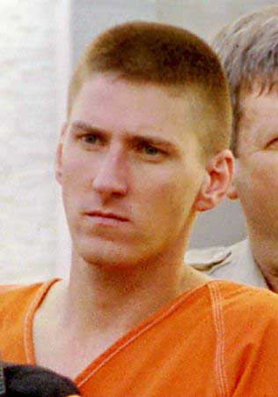
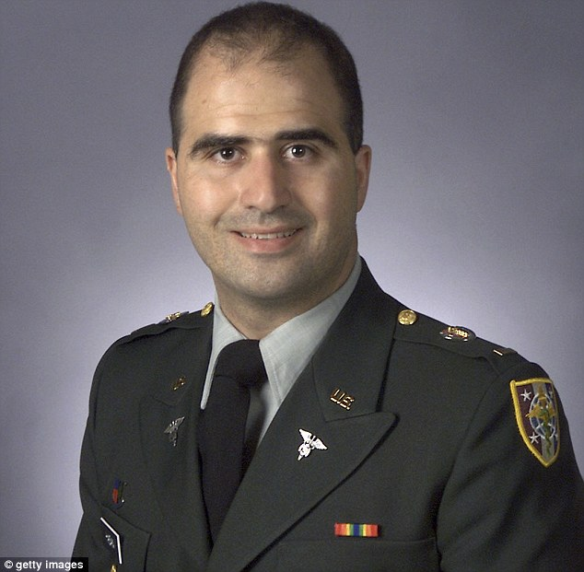
MATTHEW 24:1-8
Sorrows ~ NASB, NIV – birth pangs, ōdin
Hayat Boumeddiene
Timothy McViegh
“Jihadi John”
Dzhokhar Tsarnaev
Nidal Hasan

Slide 21
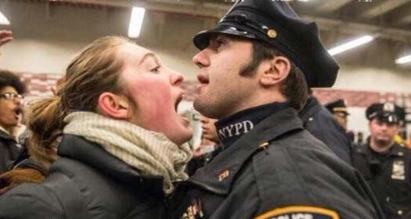
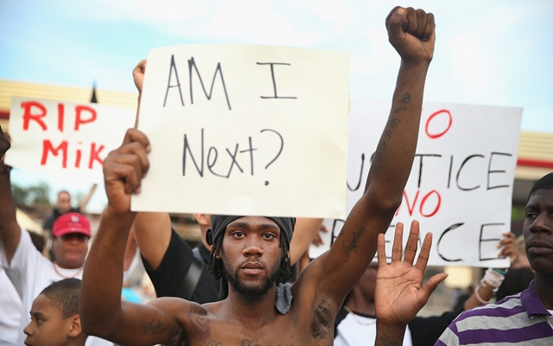
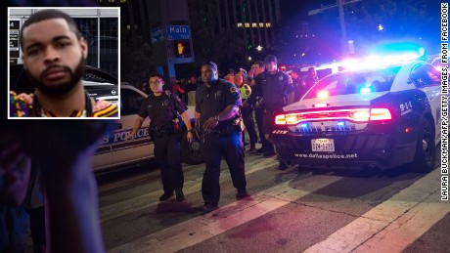
MATTHEW 24:1-8
Sorrows ~ NASB, NIV – birth pangs, ōdin
Social Unrest
Racial division
Political Chaos

Slide 22
MATTHEW 24:1-8
Sorrows ~ NASB, NIV – birth pangs, ōdin
USGS ~ magnitude of 6.0 or greater
1890-99
= 1
1900-09
= 3
1910-19
= 2
1920-29
= 2
1930-39
= 5
1940-49
= 4
1950-59
= 9
1960-69
= 13
1970-79
= 51
1980-89
= 86
1990-99
= 1365
2000-09
= 1591

Slide 23
MATTHEW 24:1-8
Matt. 24:32-34 ~ ³² “Now learn this parable from the fig tree: When its branch has already become tender and puts forth leaves, you know that summer is near. ³³ So you also, when you see all these things, know that it is near—at the doors! ³⁴ Assuredly, I say to you, this generation will by no means pass away till all these things take place.

Slide 24
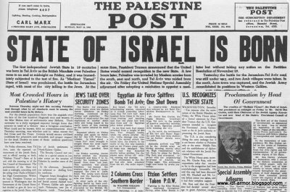
MATTHEW 24:1-8
May 14, 1948
June 7, 1967

Slide 25
MATTHEW 24:1-8

Slide 26
MATTHEW 24:1-8
2 Pet. 3:9 ~ The Lord is not slack concerning His promise, as some count slackness, but is longsuffering toward us, not willing that any should perish but that all should come to repentance.

Slide 27
MATTHEW 24:1-8

