Slide 1
MATTHEW 22:15-33
A free CD of this message will be available following the service
IT WILL ALSO be available LATER THIS WEEK
VIA cALVARYOKC.COM

Slide 2
MATTHEW 22:15-33
Pharisees ~ Separated ones
Sadducees ~ Righteous ones
Oral law was given on Mt. Sinai
Rejected oral law
Only Pentateuch was inspired
Soul is resurrected, the body is not
No angels
Souls of righteous: reincarnated
Soul is not immortal
No resurrection of the dead or afterlife
Souls of wicked: eternal torment
Herodians ~ Followers of Herod
Pro-Herodian monarchy
Herod the Great was the Messiah?
Pro-Rome

Slide 3
MATTHEW 22:15-33

Slide 4
MATTHEW 22:15-33
Denis Diderot ~ “We swallow with one gulp the lie that flatters us, and drink drop by drop the truth which is bitter to us.”
Anonymous ~ “A flatterer is one who says things to your face that he wouldn't say behind your back.”

Slide 5
MATTHEW 22:15-33

Slide 6
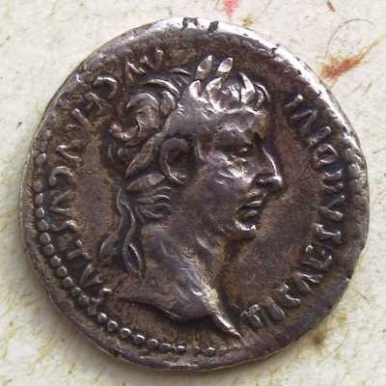
MATTHEW 22:15-33
Tax ~ kēnsos – census
Caesar Augustus Tiberius
Son of divine Augustus

Slide 7
MATTHEW 22:15-33

Slide 8
MATTHEW 22:15-33
Image ~ eikōn – icon

Slide 9
MATTHEW 22:15-33

Slide 10
MATTHEW 22:15-33
Pay (v. 17) ~ didōmi – to give
Render (v. 21) ~ apodidōmi – (apo – from) to give back

Slide 11
MATTHEW 22:15-33

Slide 12
MATTHEW 22:15-33
36% of Evangelicals believe tithing is biblical
Another 23% did not feel it needed to be the local church
Less than 10% actually do

Slide 13
MATTHEW 22:15-33

Slide 14
MATTHEW 22:15-33
$150 billion
$125 billion
$100 billion
$165B
$25B
$12B
$15B
$1B
$75 billion
$100-
110B
$50 billion
$25 billion
If every Christian tithed
World hunger
End illiteracy
Water & sanitation
Missions

Slide 15
MATTHEW 22:15-33
1 Cor. 11:7a ~ For a man indeed ought not to cover his head, since he is the image and glory of God …
Image ~ eikōn

Slide 16
MATTHEW 22:15-33

Slide 17
MATTHEW 22:15-33
Marveled ~ thaumazō – to wonder or to be in awe
Good News Bible ~ took them by surprise

Slide 18
MATTHEW 22:15-33

Slide 19
MATTHEW 22:15-33
Ex. 3:13-14 ~ ¹³ Then Moses said to God, “Indeed, when I come to the children of Israel and say to them, ‘The God of your fathers has sent me to you,’ and they say to me, ‘What is His name?’ what shall I say to them?”
¹⁴ And God said to Moses, “I AM WHO I AM.” And He said, “Thus you shall say to the children of Israel, ‘I AM has sent me to you.’”
Literally, “I WILL BE THAT I WILL BE … say … ‘I WILL BE has sent me’”

Slide 20
MATTHEW 22:15-33
Ex. 3:13-14 ~
I AM, not I was
Yahweh
Y
H
W
H
I AM ~ – tetragrammaton (14 letter word meaning “4-letter word”)
i
d
a
Generic Hebrew word for Lord ~
A
n
o
Anglicized to Jehovah

Slide 21
MATTHEW 22:15-33

Slide 22
MATTHEW 22:15-33
Astonished ~ ekplēssō
ek ~ out of
plēssō ~ to smite or blow

Slide 23
MATTHEW 22:15-33

