Slide 1
MATTHEW 15:1-20
A free CD of this message will be available following the service
IT WILL ALSO be available LATER THIS WEEK
VIA cALVARYOKC.COM

Slide 2
MATTHEW 15:1-20
Land of Gennesaret
Jordan R.
80+ mi.
Jerusalem

Slide 3
MATTHEW 15:1-20

Slide 4
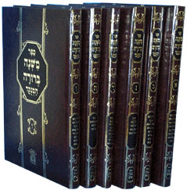
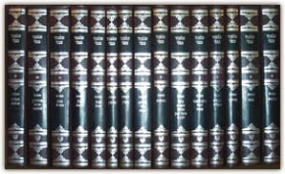
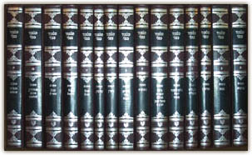
MATTHEW 15:1-20
Mishnah ~ Oral tradition
Gemara ~ Commentary on the Mishnah
Mishnah (c. 220 BC-AD 135)
Talmud
Gemara (AD 350-400)
48 volumes

Slide 5
MATTHEW 15:1-20

Slide 6
MATTHEW 15:1-20
1 Cor. 8:13 ~ Therefore, if makes my brother stumble, I will never again , lest I make my brother stumble.
food
beer
drink
meat
eat
wine

Slide 7
MATTHEW 15:1-20

Slide 8
MATTHEW 15:1-20
Literally, “You yourselves” (emphatic)

Slide 9
MATTHEW 15:1-20

Slide 10
MATTHEW 15:1-20
Corban ~ Mark 7:11
From Hebrew qorban – 82x in Old Testament, usually translated offering

Slide 11
MATTHEW 15:1-20

Slide 12
MATTHEW 15:1-20
Do not
have no other
gods before Me
Do not
Commit murder
Do not commit adultery
Do not Make any carved images
Do not steal
Do not take the name of the Lord in vain
Do not bear false witness
Remember the sabbath
Do not covet
Honor your father and mother

Slide 13
MATTHEW 15:1-20
A. W. Tozer ~ “To escape the error of salvation by works we have fallen into the opposite error of salvation without obedience. In our eagerness to get rid of the legalistic doctrine of works we have thrown out the baby with the bath and gotten rid of obedience as well.”

Slide 14
MATTHEW 15:1-20

Slide 15
MATTHEW 15:1-20
Offended ~ skandalizō ~ 15x (either verb or noun form) in Matthew

Slide 16
MATTHEW 15:1-20

Slide 17
MATTHEW 15:1-20
G. Campbell Morgan ~ “This is the supreme test of religion. Is our religion a thing of the heart, a communion between our inner life and God, a force that drives us to the watch-tower in the morning to catch a gleam of the glory of the pathway of His feet, a passion that sends us back to Him with shame and disgust when we have sinned? That is the true religion. If Jesus, in all the virtue of His life and love, sits sentinel in our heart we shall guard our lips, and be careful as to what we eat or drink;

Slide 18
MATTHEW 15:1-20
G. Campbell Morgan ~ “but it is not the things that enter in, but the things that come out of the center which defile the man. That is the perpetual test. Christ's estimate concerning tradition must be ours also. Wherever tradition violates the commandment of God it is to be violated.”

Slide 19
MATTHEW 15:1-20

