Slide 1
MATTHEW 14:1-21
A free CD of this message will be available following the service
IT WILL ALSO be available LATER THIS WEEK
VIA cALVARYOKC.COM

Slide 2
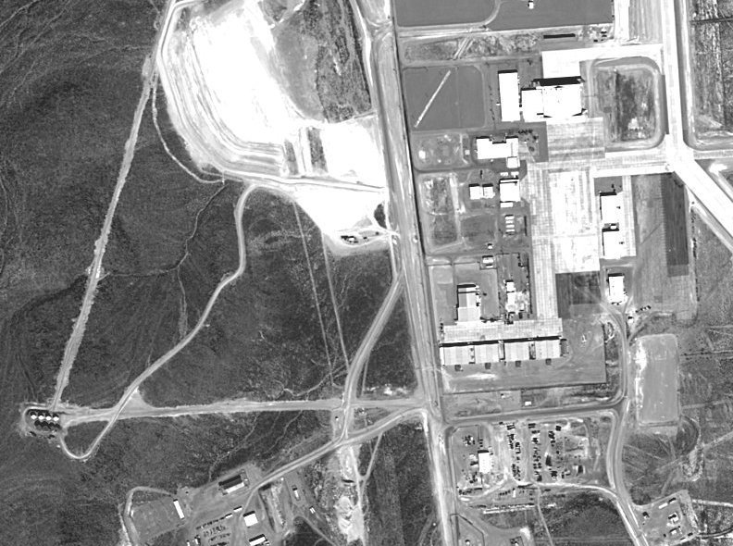
MATTHEW 14:1-21
Area 51

Slide 3
MATTHEW 14:1-21

Slide 4
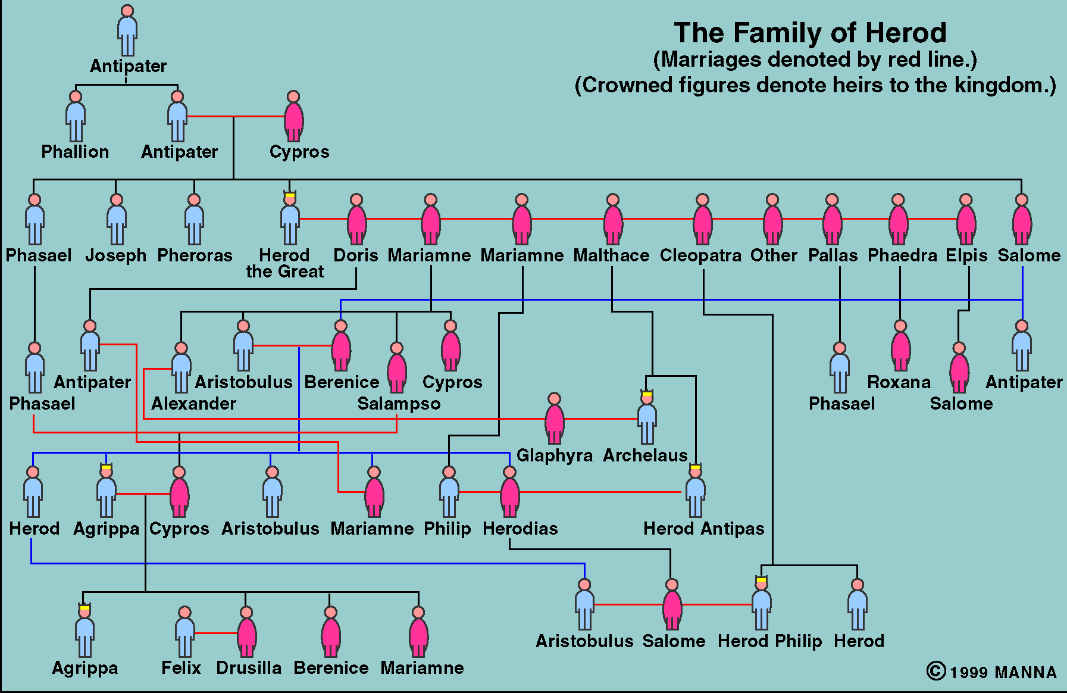
MATTHEW 14:1-21
Caesar Augustus ~ “It is better to be Herod’s pig (hus) than his son (huios).”
Herod the Great
Marries Mariamne II
They have a son, Philip
He has another wife, Malthace
They have a son, Antipas
Herod’s sister, Salome, has a daughter, Berenice
Berenice has a daughter, Herodias
She marries her 2nd cousin, Philip
They have a daughter, Salome
Herodias leaves Philip for Antipas
Salome dances for Antipas

Slide 5
MATTHEW 14:1-21
Tetrarchy of Israel
Herod Philip
Herod
Decapolis
Decapolis
Herod Archelaus
Antipas
Archelaus
Philip
Antipas

Slide 6
MATTHEW 14:1-21

Slide 7
MATTHEW 14:1-21
Luke 23:8-9 ~ ⁸ Now when Herod saw Jesus, he was exceedingly glad; for he had desired for a long time to see Him, because he had heard many things about Him, and he hoped to see some miracle done by Him. ⁹ Then he questioned Him with many words, but He answered him nothing.

Slide 8
MATTHEW 14:1-21

Slide 9
MATTHEW 14:1-21
Lev. 18:16 ~ You shall not uncover the nakedness of your brother’s wife; it is your brother’s nakedness.
Lev. 20:21 ~ If a man takes his brother’s wife, it is an unclean thing. He has uncovered his brother’s nakedness. They shall be childless.
Had been saying ~ imperfect sense – literally, had been saying and kept on saying

Slide 10
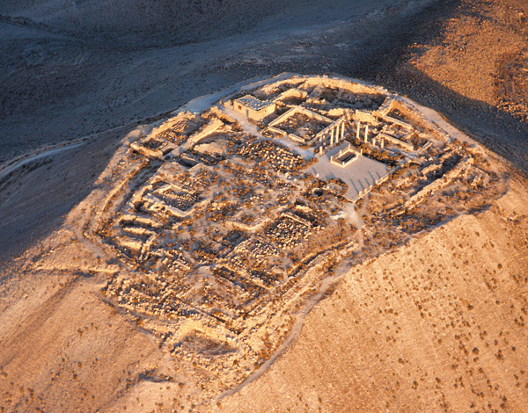
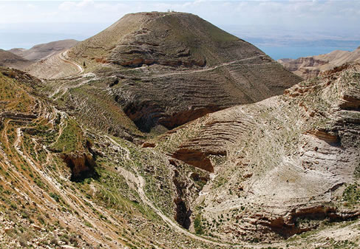
MATTHEW 14:1-21
Fortress of Machaerus

Slide 11
MATTHEW 14:1-21

Slide 12
MATTHEW 14:1-21
Girl ~ diminutive form of Greek word for damsel – i.e. little girl
Used of Jairus’ 12 year old daughter

Slide 13
MATTHEW 14:1-21

Slide 14
MATTHEW 14:1-21
Compassion ~ splagchnizomai

Slide 15
MATTHEW 14:1-21

Slide 16
MATTHEW 14:1-21
Filled ~ literally, glutted

Slide 17
MATTHEW 14:1-21

Slide 18
MATTHEW 14:1-21
William Barclay ~ “There are some people who read the miracles of Jesus, and feel no need to understand. Let them remain forever undisturbed in the sweet simplicity of their faith. There are others who read and their minds question and they feel they must understand. Let them take no shame of it …”

Slide 19
MATTHEW 14:1-21

