Slide 1
MATTHEW 13:24-43
A free CD of this message will be available following the service
IT WILL ALSO be available LATER THIS WEEK
VIA cALVARYOKC.COM

Slide 2
MATTHEW 13:24-43
Matt. 19:23-24 ~ ²³ Then Jesus said to His disciples, “Assuredly, I say to you that it is hard for a rich man to enter the kingdom of heaven. ²⁴ And again I say to you, it is easier for a camel to go through the eye of a needle than for a rich man to enter the kingdom of God.”
Mark 4:26 ~ And He said, “The kingdom of God is as if a man should scatter seed on the ground,”

Slide 3
MATTHEW 13:24-43
The kingdom of heaven/God = “God’s rule”
Two aspects:
1. Spiritual ~ seen through those who have been born again by the Holy Spirit
2. Literal ~ seen through the return of Jesus in His physical reign during the Millennium
“The extent of the rule of God in the hearts of men”

Slide 4
MATTHEW 13:24-43

Slide 5
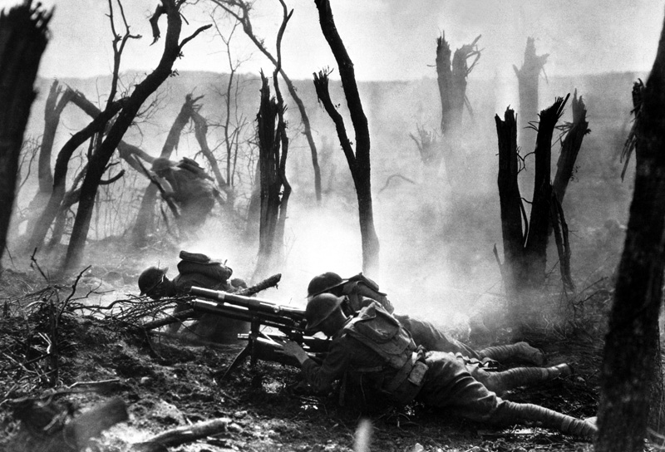
MATTHEW 13:24-43
17,000,000 deaths from 1914-1918
“The war to end all wars”

Slide 6
MATTHEW 13:24-43

Slide 7
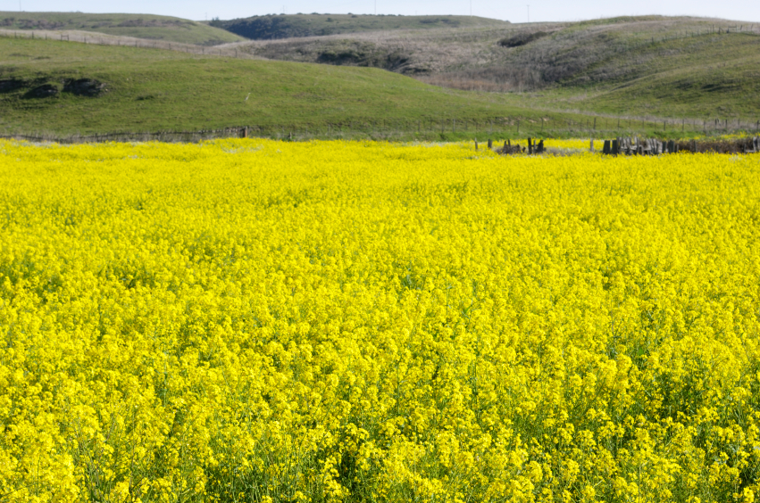
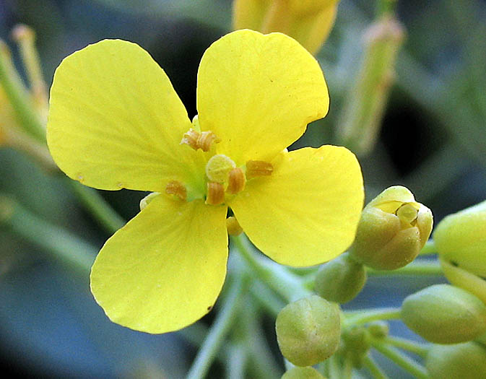
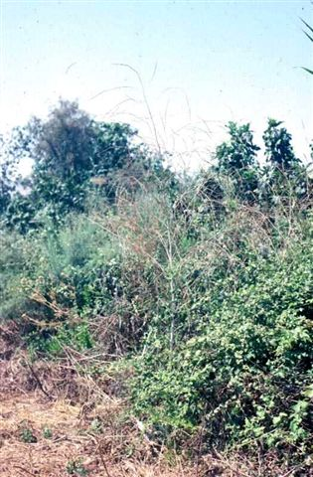
MATTHEW 13:24-43
Brassica Cruciferae

Slide 8
MATTHEW 13:24-43
Age of persecution ~ c. AD 100-311
Edict of Toleration, AD 311 – Made Christianity tolerated
Edict of Milan, AD 313 – Made Christianity legal
Edict of Theodosius, AD 380 – Made Christianity mandatory

Slide 9
MATTHEW 13:24-43
Legalized
Tolerated
Edict of Milan (AD 313)
Edict of Toleration (AD 311)
ASLEEP
Mandatory
ALIVE
DEAD
Rejected
Age of Persecu-tion (c. AD 100-311)
Edict of
Theodosius (AD 380)
Persecution-o-meter

Slide 10
MATTHEW 13:24-43

Slide 11
MATTHEW 13:24-43
Gal. 5:9 (while addressing false doctrine) ~ a little leaven leavens the whole lump

Slide 12
MATTHEW 13:24-43

Slide 13
MATTHEW 13:24-43
Wheat
Tares (Darnel)

Slide 14
MATTHEW 13:24-43
Parable of the Soils
Parable of the Wheat and Tares
Sower
“Christians”
Son of Man
Good seed
Word of God
Sons of Kingdom
Field
Hearts of men
World

Slide 15
MATTHEW 13:24-43

