Slide 1
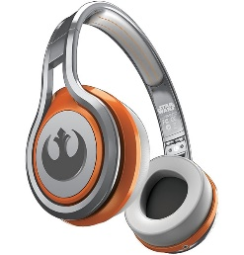
MATTHEW 10:5-23
A free CD of this message will be available following the service
IT WILL ALSO be available LATER THIS WEEK
VIA cALVARYOKC.COM

Slide 2
MATTHEW 10:5-23
Disciples ~ mathētēs, a learner
Apostles ~ apostolos, one who is sent out

Slide 3
MATTHEW 10:5-23

Slide 4
MATTHEW 10:5-23
Dear Ma and Pa:
I am well. Hope you are. Tell Brother Walt and Brother Elmer the Marine Corps beats workin for old man Minch by a mile. Tell them to join up quick afore maybe all of the places gets filled.
I was restless at first because you gots to stay in bed till nearly 6 am, but I'm gettin so's I like to sleep late. Tell Walt and Elmer all you do afore breakfast is smooth your cot and shine some things. No hogs to slop, feed to pitch, mash to mix, wood to split, fire to lay. Practically nothin.
Men gots to shave but it ain‘t so bad, they's warm water.

Slide 5
MATTHEW 10:5-23
Breakfast is strong on trimmins like fruit juice, cereal, eggs, bacon, etc., but kind of weak on chops, potatoes, ham, steak, fried eggplant, pie and other regular food, but tell Walt and Elmer you can always sit by the two city boys that live on coffee. Their food plus yours holds you till noon when you gets fed again.
Ain't no wonder these city boys can't walk much.
We go on “route marches,” which the platoon sergeant says are long walks to harden us. If he thinks so, it ain't my place to tells him no difference. A “route march” is about as far as to our mailbox at home. Then the city guys get

Slide 6
MATTHEW 10:5-23
sore feet and we all ride back in trucks.
The country is nice but awful flat. The sergeant is like a school teacher. He nags a lot. The Captain is like the school board. Majors and Colonels just ride around and frown. They don't bother you none.
This next will just kill Walt and Elmer with laughin’. I keep gettin medals for shootin. I don't know why. The bulls-eye is nigh as big as a chipmunk head and it don't move, and it ain't shootin back at you like the Higgett boys at home. All you gots to do is lie there all comfortable and hit it. You don't even load your own cartridges.

Slide 7
MATTHEW 10:5-23
They comes in boxes.
Then we have what they call hand-to-hand combat trainin. You gets to wrestle with them city boys. I have to be real careful though cuz they breaks real easy.
It ain't like fightin with that ole bull at home.
I'm about the best they gots in this except for that Tug Jordan from over at Silver Lake. I only beat him once. He joined up the same time as me, but I'm only 5'6" and 130 pounds, and he's 6'8" and weighs near 300 pounds dry.
Be sure and tell Walt and Elmer to hurry and join afore other fellers gets on to this setup and come stampedin in.
Yer lovin daughter, Gail

Slide 8
MATTHEW 10:5-23

Slide 9
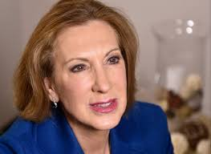
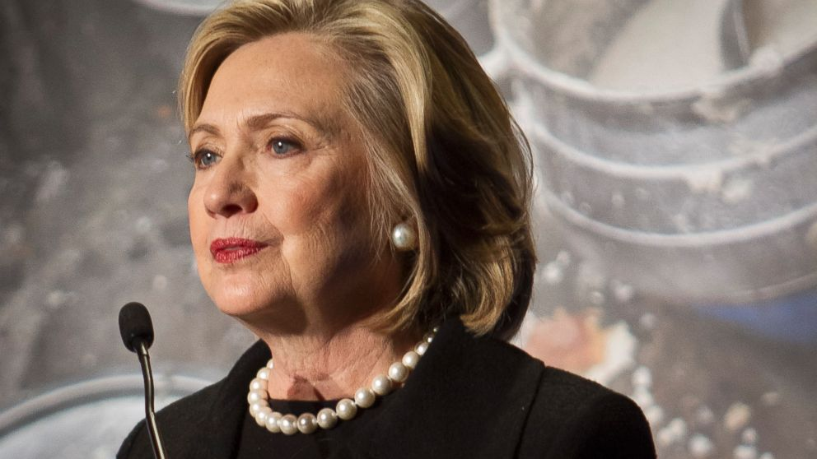
MATTHEW 10:5-23
Peter and Andrew
James and John
Simon the Zealot and Matthew the tax collector?
Carly Fiorina
Hillary Clinton
Rand Paul
Bernie Sanders

Slide 10
MATTHEW 10:5-23

Slide 11
MATTHEW 10:5-23
Bag ~ KJV, scrip; a traveler's bag for carrying provisions

Slide 12
MATTHEW 10:5-23

Slide 13
MATTHEW 10:5-23
Message ~ When you enter a town or village, don’t insist on staying in a luxury inn. Get a modest place with some modest people, and be content there until you leave.

Slide 14
MATTHEW 10:5-23

Slide 15
MATTHEW 10:5-23
Harmless ~ unmixed (NIV, NASB; innocent)
Rom. 16:19 ~ but I want you to be wise in what is good, and simple concerning evil.
Phil. 2:15 ~ that you may become blameless and harmless, children of God without fault in the midst of a crooked and perverse generation, among whom you shine as lights in the world.

Slide 16
MATTHEW 10:5-23

Slide 17
MATTHEW 10:5-23
Law (Principle) of Double Reference
Isaiah 11:1–3 ~ ¹ There shall come forth a Rod from the stem of Jesse,
And a Branch shall grow out of his roots.
² The Spirit of the Lord shall rest upon Him,
The Spirit of wisdom and understanding,
The Spirit of counsel and might,
The Spirit of knowledge and of the fear of the Lord.
³ His delight is in the fear of the Lord,
And He shall not judge by the sight of His eyes,
Nor decide by the hearing of His ears;

Slide 18
MATTHEW 10:5-23
Law (Principle) of Double Reference
Isaiah 11:4 ~ But with righteousness He shall judge the poor,
And decide with equity for the meek of the earth;
He shall strike the earth with the rod of His mouth,
And with the breath of His lips He shall slay the wicked.

Slide 19
MATTHEW 10:5-23

Slide 20
MATTHEW 10:5-23
Saved ~ sōzō – same as 9:22 (your faith has made you well)
Save, whole, well, preserved

Slide 21
MATTHEW 10:5-23

Slide 22
MATTHEW 10:5-23
Matt. 24:43 ~ But know this, that if the master of the house had known what hour the thief would come, he would have watched and not allowed his house to be broken into.

Slide 23
MATTHEW 10:5-23

Slide 24
MATTHEW 10:5-23
Three God-ordained institutions:
Organized religion
~ v. 17
Government
~ v. 18
Family
~ v. 21

Slide 25
MATTHEW 10:5-23

Slide 26
MATTHEW 10:5-23
Calvin Miller (“Taste of Joy”) ~ “Many Christians are only "Christaholics" and not disciples at all. Disciples are cross-bearers; they seek Christ. Christaholics seek happiness. Disciples dare to discipline themselves, and the demands they place on themselves leave them enjoying the happiness of their growth. Christaholics are escapists looking for a shortcut to nirvana. Like drug addicts, they are trying to "bomb out" of their depressing world.

Slide 27
MATTHEW 10:5-23
Calvin Miller (“Taste of Joy”) ~ “There is no automatic joy. Christ is not a happiness capsule; he is the way to the Father. But the way to the Father is not a carnival ride in which we sit and do nothing while we are whisked through various spiritual sensations.”

Slide 28
MATTHEW 10:5-20

