Slide 1
MATTHEW 7:1-12
A free CD of this message will be available following the service
IT WILL ALSO be available LATER THIS WEEK
VIA cALVARYOKC.COM

Slide 2
MATTHEW 7:1-12
Chapter 5 ~ heart issues
Chapter 6 ~ hand issues
Chapter 7 ~ human issues

Slide 3
MATTHEW 7:1-12

Slide 4
MATTHEW 7:1-12
Judge ~ krinō – to judge
Literally, “You – stop judging!”
Matt. 7:1a ~ Thou shalt not judge!
John 8:7 ~ He who is without sin among you, let him throw a stone at her first.
Devos for Backsliders

Slide 5
MATTHEW 7:1-12

Slide 6
MATTHEW 7:1-12
When are we told to judge?
1) Ourselves – 1 Cor. 11:31 ~ For if we would judge ourselves, we would not be judged.
2) An erring brother – Gal. 6:1 ~ Brethren, if a man is overtaken in any trespass, you who are spiritual restore such a one in a spirit of gentleness, considering yourself lest you also be tempted.
John 7:24 ~ Do not judge according to appearance, but judge with righteous judgment.

Slide 7
MATTHEW 7:1-12
When are we told to judge?
3) Fruit inspectors ~ Matt. 7:15-20
4) Divisive people – Rom. 16:17 ~ Now I urge you, brethren, note those who cause divisions and offenses, contrary to the doctrine which you learned, and avoid them.

Slide 8
MATTHEW 7:1-12
David Guzik ~ “The Christian is called to show unconditional love, but the Christian is not called to unconditional approval.”

Slide 9
MATTHEW 7:1-12
3 ways:
Assumption (opinion)
Aim (motive)
Actions (discernment)

Slide 10
MATTHEW 7:1-12

Slide 11
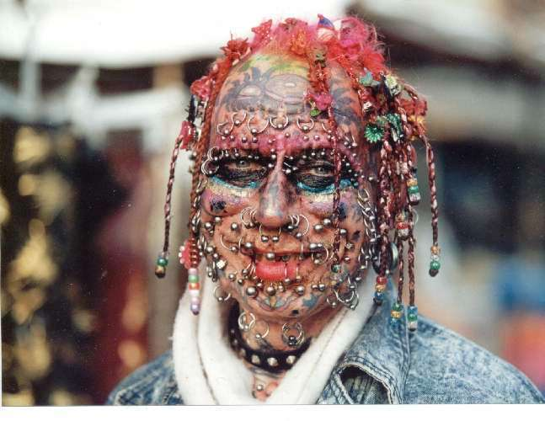
MATTHEW 7:1-12

Slide 12
MATTHEW 7:1-12

Slide 13
MATTHEW 7:1-12
Speck ~ something very small; grain chaff, dust
Plank ~ from root meaning to hold up (hence: large support roof beam)

Slide 14
MATTHEW 7:1-12

Slide 15
MATTHEW 7:1-12
Two extremes to avoid:
Cursory glance
James 1:22-24 ~ ²² But be doers of the word, and not hearers only, deceiving yourselves. ²³ For if anyone is a hearer of the word and not a doer, he is like a man observing his natural face in a mirror; ²⁴ for he observes himself, goes away, and immediately forgets what kind of man he was.

Slide 16
MATTHEW 7:1-12
Two extremes to avoid:
Intensive, condemning examination
1 John 3:18-21 ~ ¹⁸ My little children, let us not love in word or in tongue, but in deed and in truth. ¹⁹ And by this we know that we are of the truth, and shall assure our hearts before Him. ²⁰ For if our heart condemns us, God is greater than our heart, and knows all things. ²¹ Beloved, if our heart does not condemn us, we have confidence toward God.

Slide 17
MATTHEW 7:1-12
Two extremes to avoid:
Intensive, condemning examination
Ps. 51:10, 13 ~ ¹⁰ Create in me a clean heart, O God,
And renew a steadfast spirit within me.
¹³ Then I will teach transgressors Your ways,
And sinners shall be converted to You.

Slide 18
MATTHEW 7:1-12

Slide 19
MATTHEW 7:1-12
Lacking discernment
Judgmentalism
Righteous judgment

Slide 20
MATTHEW 7:1-12

Slide 21
MATTHEW 7:1-12
Leonard Ravenhill ~ “The Church has many organizers, but few agonizers; many who pay, but few who pray; many resters, but few wrestlers; many who are enterprising, but few who are interceding – people who are praying and praying. A worldly Christian will stop praying and a praying Christian will stop worldliness. Tithes may build a church, but tears will give it life. That is the difference between the modern church and the early church. In the matter of effective praying, never have so many left so much to so few. Brethren, let us pray.”

Slide 22
MATTHEW 7:1-12

Slide 23
MATTHEW 7:1-12
2 undeniable truths …
1) He always only has my best interests at heart
2) I can't do better than to let Him have His will with me
… and a question
Am I seeking God or what He can give me?

Slide 24
MATTHEW 7:1-12
Luke 11:13 ~ If you then, being evil, know how to give good gifts to your children, how much more will your heavenly Father give the Holy Spirit to those who ask Him!
2 Pet. 1:3 ~ … His divine power has given to us all things that pertain to life and godliness, through the knowledge of Him who called us by glory and virtue,

Slide 25
MATTHEW 7:1-12

Slide 26
MATTHEW 7:1-12
Confucius (551-479 BC) ~ “What you do not want done to you, do not do to others.”
Isocrates (436-338 BC) ~ “Whatever angers you when you suffer it at the hands of others do not do it to others.”
Rabbi Hillel (110 BC-AD 10) ~ “That which is despicable to you, do not do to your fellow, this is the whole , and the rest is commentary, go and learn it.” (Babylonian Talmud, Shabbat 31a)

Slide 27
MATTHEW 7:1-12

