Slide 1
A CD of this message will be available (free of charge) immediately following today's message
12:1-17
This message will be available via podcast later this week at calvaryokc.com

Slide 2
12:1-17
C. H. Spurgeon ~ “If you do not hear the well beloved Son of God, you have refused your last hope. He is God’s ultimatum. Nothing remains when Christ is refused. No one else can be sent; heaven itself contains no further messenger. If Christ be rejected, hope is rejected.”

Slide 3
12:1-17

Slide 4
12:1-17
Pharisees ~ strict separatists
Herodians ~ Herod loyalists (Pro-Roman)

Slide 5
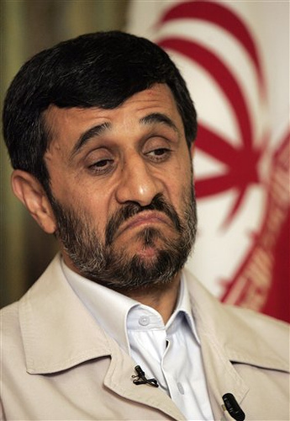
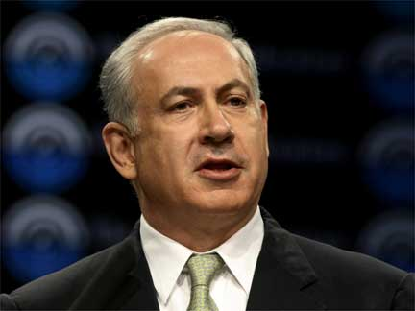
12:1-17
Ahmadinejad
Netanyahu

Slide 6
12:1-17

Slide 7
12:1-17
Render ~ apodidomi – literally to give back

Slide 8
12:1-17
Rom. 13:1 ~ Let every soul be subject to the governing authorities. For there is no authority except from God, and the authorities that exist are appointed by God.

Slide 9
12:1-17

Slide 10
12:1-17
Luke 11:42 ~ But woe to you Pharisees! For you tithe mint and rue and all manner of herbs, and pass by justice and the love of God. These you ought to have done, without leaving the others undone.

Slide 11
12:1-17
1 Cor. 16:1-2 ~ ¹ Now concerning the collection for the saints, as I have given orders to the churches of Galatia, so you must do also: ² On the first day of the week let each one of you lay something aside, storing up as he may prosper, that there be no collections when I come.

Slide 12
12:1-17
Matt. 6:3 ~ But when you do a charitable deed, do not let your left hand know what your right hand is doing,
2 Cor. 9:7 ~ So let each one give as he purposes in his heart, not grudgingly or of necessity; for God loves a cheerful giver.
Cheerful ~ hilaros

Slide 13
12:1-17
Jesus taught on money more than He did heaven and hell combined
11 of 39 parables deal with money and stewardship
1 out of every 7 verses in Luke talks about money

Slide 14
12:1-17
Matt. 5:21-22; 27-28
MURDER
HATRED
ADULTERY
LUST
TITHING
GRACE
Kingdom
Law

Slide 15
12:1-17
Tiberius Augustus
Pontifex
Maximus
Son of Divine Augustus

Slide 16
12:1-17
Wiersbe ~ "Caesar's image is on his coins, so they must be minted by his authority. The fact that you possess these coins and use them indicates that you think they are worth something. Therefore, you are already accepting
Caesar's authority,
or you would not use his money! But don't forget that you created in the image of God and therefore must live under God's authority as well."

Slide 17
12:1-17

