Slide 1
A CD of this message will be available (free of charge) immediately following today's message
8:22-38
This message will be available via podcast later this week at calvaryokc.com

Slide 2
8:22-38
Mark 7:33-34 ~ ³³ And He took him aside from the multitude, and put His fingers in his ears, and He spat and touched his tongue. ³⁴ Then, looking up to heaven, He sighed, and said to him, "Ephphatha," that is, "Be opened."

Slide 3
8:22-38
Adam Clarke ~ “It is likely that this was done merely to separate the eyelids; as, in certain cases of blindness, they are found always gummed together. It required a miracle to restore the sight, and this was done in
consequence of
Christ having laid his hands upon the blind man: it required no miracle to separate the eyelids, and, therefore, natural means only were employed - this was done by rubbing them with spittle.”

Slide 4
8:22-38

Slide 5
8:22-38
John the Baptist ~ the Moralist
Elijah ~ the Miracle Man
Jeremiah ~ weeping for the lost
One of the prophets ~ revealer of God's mind

Slide 6
8:22-38

Slide 7
8:22-38
You ~ emphatic and plural
John 6:51 ~ I am the living bread which came down from heaven. If anyone eats of this bread, he will live forever; and the bread that I shall give is My flesh, which I shall give for the life of the
world.

Slide 8
8:22-38
John 8:12 ~ I am the light of the world. He who follows Me shall not walk in darkness, but have the light of life.
John 10:7 ~ I am the door of the sheep

Slide 9
8:22-38
John 10:11 ~ I am the good shepherd. The good shepherd gives His life for the sheep.
John 11:25 ~ I am the resurrection and the life. He who believes in Me, though he may die, he shall live.

Slide 10
8:22-38
John 14:6 ~ I am the way, the truth, and the life. No one comes to the Father except through Me.
John 15:1 ~ I am the true vine, and My Father is the vinedresser.

Slide 11
8:22-38
Rev. 1:8 ~ I am the Alpha and the Omega, the Beginning and the End … who is and who was and who is to come, the Almighty.

Slide 12
8:22-38
LIar
deceiver
Lunatic
Deluded
Lord
Diety

Slide 13
8:22-38

Slide 14
8:22-38
John 6:35 ~ I am
the bread of life. He who comes to Me shall never hunger, and he who believes in Me shall never thirst.
I am ~ egō eimi
Ex. 3:14 ~ And God said to Moses, "I AM WHO I AM." And He said, "Thus you shall say to the children of Israel, 'I AM
has sent me to you.' "

Slide 15
8:22-38

Slide 16
8:22-38
Literally, began rebuking Him
epitimaō – casting out demons and calming the sea

Slide 17
8:22-38

Slide 18
8:22-38
Luke 9:23 ~ Then He said to them all, "If anyone desires to come after Me, let him deny himself, and take up his cross daily, and follow Me.”
Dying to self is dying to self

Slide 19
8:22-38

Slide 20
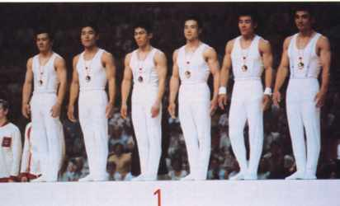
8:22-38
Shun Fujimoto

Slide 21
8:22-38

