Slide 1
A CD of this message will be available (free of charge) immediately following today's message
6:30-56
This message will be available via podcast later this week at calvaryokc.com

Slide 2
6:30-56
Arrived before them ~ KJV, outwent them

Slide 3
6:30-56

Slide 4
6:30-56
You is emphatic ~ i. e. You give them something to eat

Slide 5
6:30-56

Slide 6
6:30-56
Groups ~ sumposion (symposium)

Slide 7
6:30-56

Slide 8
6:30-56
Gave ~ imperfect tense – gave and kept on giving

Slide 9
6:30-56

Slide 10
6:30-56
Filled ~ chortazō – literally, glutted
TLB ~ They ate till they could hold no more!

Slide 11
6:30-56

Slide 12
6:30-56
Ex. 4:1-5
Phi. 4:19 ~ And my God shall supply all your need according to His riches in glory by Christ Jesus.

Slide 13
6:30-56

Slide 14
6:30-56
John 6:15 ~ Therefore when Jesus perceived that they were about to come and take Him by force to make Him king,

Slide 15
6:30-56

Slide 16
6:30-56
Deserted Place ~ Matt. 14:13
To Bethsaida ~ Mark 6:45
deserted place belonging to the city called Bethsaida ~ Luke 9:10
Toward Capernaum ~ John 6:17
however, other boats came from Tiberias, near the place where they ate bread after the Lord had given thanks ~ John 6:23)

Slide 17
6:30-56

Slide 18
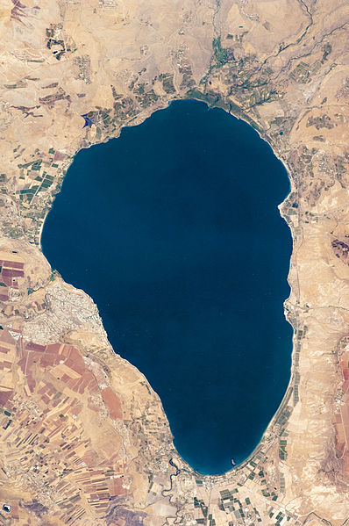
6:30-56
Capernaum
Bethsaida
(Galilee)
Mt. Arbel
Tiberius
Jesus
Disciples
5 mi.

Slide 19
6:30-56
Golan Heights
Capernaum
Bethsaida (Julias)
Bethsaida
(Galilee)
Mt. Arbel
Tiberias
Jesus
Disciples
Others
5 mi.

Slide 20
6:30-56
John 6:23 (ESV) ~ Other boats from Tiberias came near the place where they had eaten the bread after the Lord had given thanks.

Slide 21
6:30-56

Slide 22
6:30-56
John 6:25–66

Slide 23
6:30-56

Slide 24
6:30-56
Himself
– A. B. Simpson
Once it was the blessing, Now it is the Lord; Once it was the feeling, Now it is His Word. Once His gifts I wanted, Now the Giver own; Once I sought for healing, Now Himself alone.
Once ’twas painful trying, Now ’tis perfect trust; Once a half salvation, Now the uttermost. Once ’twas ceaseless holding, Now He holds me fast; Once ’twas constant drifting, Now my anchor’s cast.
Once I hoped in Jesus, Now I know He’s mine; Once my lamps were dying, Now they brightly shine. Once for death I waited, Now His coming hail; And my hopes are anchored, Safe within the veil.

Slide 25
6:30-56

