Slide 1
A CD of this message will be available (free of charge) immediately following today's message
2:13-3:6
This message will be available via podcast later this week at calvaryokc.com

Slide 2
2:13-3:6
Levi ~ Hebrew form of Louis ~ "joined"
Matthew ~ "gift of Yahweh"

Slide 3
2:13-3:6

Slide 4
2:13-3:6
William Lane ~ “When a Jew entered the customs service he was regarded as an outcast from society: he was disqualified as a judge or a witness in a court session, was excommunicated from the synagogue, and in the eyes of the community his disgrace extended to his family.”

Slide 5
2:13-3:6

Slide 6
2:13-3:6
C. T. Studd ~
“Some like to dwell
Within the sound
Of church and chapel bell.
But I want to run a rescue shop
Within a yard of Hell.”

Slide 7
2:13-3:6

Slide 8
2:13-3:6
7 Last words of the church
“We’ve
never
done
it
that
way
before”
"Religion is the monu-mental chapter in the history of human egotism" – Will James

Slide 9
2:13-3:6

Slide 10
2:13-3:6
Deut. 23:25 ~ When you come into your neighbor's standing grain, you may pluck the heads with your hand, but you shall not use a sickle on your neighbor's standing grain.

Slide 11
2:13-3:6
Statement of Faith: "We believe that the 1st of the week is the Lord's Day or Christian Sabbath; and is to be kept sacred to religious purposes, by abstaining from all secular labor and sinful recreations."
Secular ~ 1 Cor. 10:31b ~ whatever you do, do all to the glory of God
Sinful ~ Sinful recreations are OK the other 6 days?
Sabbath ~ (DBLSD): “The seventh day of the Jewish week, ceremonial day of rest; known in our culture as Saturday”

Slide 12
2:13-3:6

Slide 13
2:13-3:6
"Any application of the Sabbath Law which operates to the detriment of man is out of harmony with God's purpose" – G. Campbell Morgan

Slide 14
2:13-3:6
“There is a Sunday conscience, as well as a Sunday coat; and those who make religion a secondary concern put the coat and conscience carefully by to put on only once a week.” – Charles Dickens

Slide 15
2:13-3:6
Rom. 14:5-6a ~ ⁵ One person esteems one day above another; another esteems every day alike. Let each be fully convinced in his own mind. ^{6a} He who observes the day, observes it to the Lord; and he who does not observe the day, to the Lord he does not observe it.

Slide 16
2:13-3:6

Slide 17
2:13-3:6
Life ~ not bios (manner of living)
or zōē (intrinsic life)
but psuchē (soul)

Slide 18
2:13-3:6

Slide 19
2:13-3:6
Looked around ~ periblepō
peri ~ around
blepō ~ to physically see with understanding or discernment
Grieved ~ present tense (grieving)

Slide 20
2:13-3:6

Slide 21
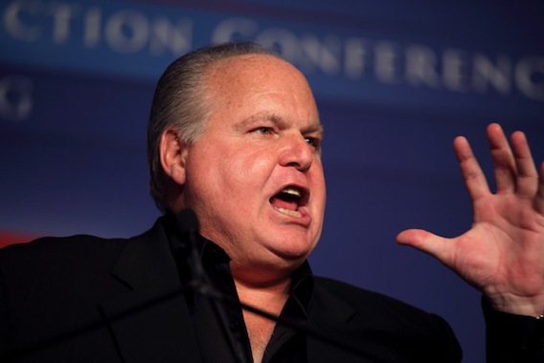
2:13-3:6
James Carville
Rush Limbaugh

Slide 22
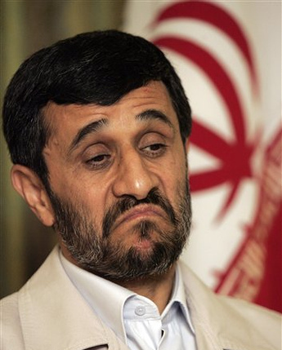
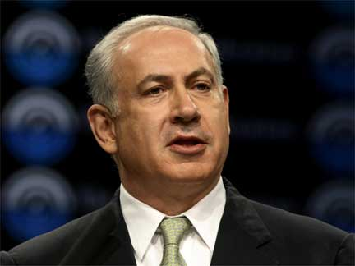
2:13-3:6
Ahmadinejad
Netanyahu

Slide 23
2:13-3:6

