Slide 1
A CD of this message will be available (free of charge) immediately following today's message
2:1-12
This message will be available via podcast later this week at calvaryokc.com

Slide 2
2:1-12
Chuck Smith ~ “It is bad to develop a critical spirit. Once you develop a critical spirit, then you find that you are able to find fault with anything and everything. It’s sad when a person puts himself on the place of judgment where he feels that
he has the right to judge the actions, the activities, the thoughts, the intents, the motives of other people.”
Mark 15:10 ~ For he knew that the chief priests had handed Him over because of envy.

Slide 3
2:1-12

Slide 4
2:1-12
Preached ~ not euaggelizō (to bring good news) or kerussō (to herald), but
laleō – to use words in order to declare one’s mind and disclose one’s thoughts

Slide 5
2:1-12
NASB, was speaking
Imperfect tense – kept on speaking

Slide 6
2:1-12

Slide 7
2:1-12
Uncovered ~ apostegazō – apo (away from) + stegē (roof)
Roof ~ stegē – literally, they de-roofed the roof

Slide 8
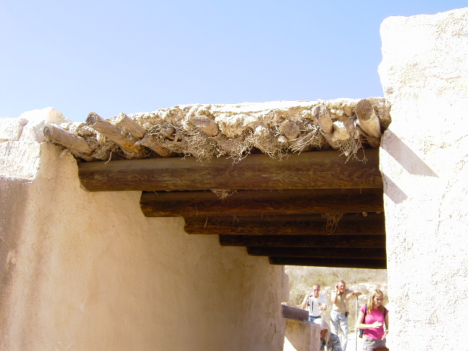
2:1-12
G. Campbell Morgan ~ “Such a rendering is entirely misleading. The force of the word is that they broke up the roof of the house, tearing up the fabric, in order to lower the man down on his pallet into the presence of Jesus.”

Slide 9
2:1-12

Slide 10
2:1-12
Warren Wiersbe ~ “Forgive-ness is the greatest miracle that Jesus ever performs. It meets the greatest need; it costs the greatest price; and it brings the greatest blessing and the most lasting results.”

Slide 11
2:1-12

Slide 12
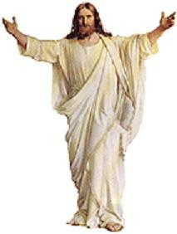
2:1-12
Who is this Jesus?
?
Liar
Lunatic
Lord

Slide 13
2:1-12

Slide 14
2:1-12
⁴ Who redeems your life from destruction, Who crowns you with lovingkindness and tender mercies,
⁵ Who satisfies your mouth with good things, So that your youth is renewed like the eagle’s.
Ps. 103:1-5 ~ ¹ Bless the LORD, O my soul; And all that is within me, bless His holy name!
² Bless the LORD, O my soul, And forget not all His benefits:
³ Who forgives all your iniquities, Who heals all your diseases,

Slide 15
2:1-12

Slide 16
2:1-12
Ps. 103:12 ~ As far as the east is from the west, So far has He removed our trans-gressions from us.
12,400 mi.

Slide 17
2:1-12

Slide 18
2:1-12
Pertinacity ~ persistent determination
Synonyms: doggedness, perseverance, persistence, tenacity

