Slide 1
19:28-48

Slide 2
19:28-48
Zech. 9:9 ~ Rejoice greatly, O daughter of Zion!
Shout, O daughter of Jerusalem!
Behold, your King is coming to you;
He is just and having salvation,
Lowly and riding on a donkey,
A colt, the foal of a donkey.

Slide 3
19:28-48
Ps. 118:25-26 ~ ²⁵ Save now, I pray, O Lord;
O Lord, I pray, send now prosperity.
²⁶ Blessed is he who comes in the name of the Lord!
We have blessed you from the house of the Lord.

Slide 4
19:28-48

Slide 5
19:28-48
Teacher ~ didaskolos – KVJ, master
John 2:4 ~ Jesus said to her, “Woman, what does your concern have to do with Me? My hour has not yet come.”

Slide 6
19:28-48

Slide 7
19:28-48
Understanding
Daniel’s
Seventy
sevens

Slide 8
19:28-48

Slide 9
19:28-48
weeks ~ shavuwa` - group of seven
Seventy “weeks” of years
70 x 7 years = 490 years
7 weeks (49 years)
62 weeks (434 years)
1 week (7 years)

Slide 10
19:28-48
Dan. 9:24-27 ~ ²⁴ “Seventy weeks are determined
For your people and for your holy city,
To finish the transgression,
To make an end of sins,
To make reconciliation for iniquity,
To bring in everlasting righteousness,
To seal up vision and prophecy,
And to anoint the Most Holy.
²⁵ “Know therefore and understand,
That from the going forth of the command
To restore and build Jerusalem
Until Messiah the Prince,

Slide 11
19:28-48
Dan. 9:24-27 ~ There shall be seven weeks and sixty-two weeks;
The street shall be built again, and the wall,
Even in troublesome times.
²⁶ “And after the sixty-two weeks
Messiah shall be cut off, but not for Himself;
And the people of the prince who is to come
Shall destroy the city and the sanctuary.
The end of it shall be with a flood,
And till the end of the war desolations are
determined.

Slide 12
19:28-48
Dan. 9:24-27 ~ ²⁷ Then he shall confirm a covenant with many for one week;
But in the middle of the week
He shall bring an end to sacrifice and offering.
And on the wing of abominations shall be one who makes desolate,
Even until the consummation, which is determined,
Is poured out on the desolate.”

Slide 13
19:28-48
1st Division (7 seven-year periods):
From the command to rebuild the city until its completion
49 years ~ from 444 BC to 395 BC
2nd Division (62 seven-year periods):
From the completion of the city to the coming of the Messiah
434 years
3rd Division (1 seven-year period)

Slide 14
19:28-48
1st div. (49 yr.) + 2nd div. (434 yr.)
49 years (1st Division)
+ 434 years (2nd Division)
483 years
Hebrew lunar year = 360 days
360 days
x 483 years
173,800 days

Slide 15
19:28-48
Convert the Hebrew reckoning to our Gregorian calendar:
173,880 days ÷ 365.25 = 476.06 years
444 BC
Mar. 5 – when the command to rebuild was given
+ 476 years
The length of the 7 weeks and the 62 weeks added together
AD 33
Mar. 30 – the Sunday before Passover or the day of the Triumphal Entry

Slide 16
19:28-48
7 weeks = 49 years
69 weeks = 483 years
173,880 days
=
62 weeks = 434 years
483 yr.
49 yr.
434 yr.
400 BC
300 BC
200 BC
100 BC
BC/AD
Artaxerxes' decree (Mar. 5, 444 BC)
Triumphal Entry (Mar. 30, AD 33)
Jerusalem rebuilt (395 BC)

Slide 17
19:28-48

Slide 18
19:28-48
3 incontrovertible facts:
1. The 69 weeks of Daniel began with Artaxerxes’ command to rebuild the city walls of Jerusalem
2. They culminated with the Triumphal Entry when Jesus publicly received worship as the promised Messiah
3. The unfulfilled prophecies concerning Daniel’s 70th week will be just
as precise

Slide 19
19:28-48

Slide 20
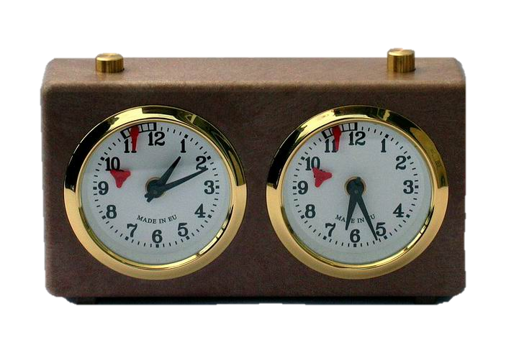
19:28-48
Phillips ~ all because you did not know when God Himself was visiting you!
NLT ~ because you did not accept your opportunity for salvation.

Slide 21
19:28-48
Luke 21:24 ~ And they will fall by the edge of the sword, and be led away captive into all nations. And Jerusalem will be trampled by Gentiles until the times of the Gentiles are fulfilled.
Was fulfilled on June 7, 1967
Rom. 11:25 ~ For I do not desire, brethren, that you should be ignorant of this mystery, lest you should be wise in your own opinion, that blindness in part has happened to Israel until the fullness of the Gentiles has come in.
Will be fulfilled on at the Rapture

Slide 22
19:28-48

Slide 23
19:28-48
Is. 56:7 ~ Even them I will bring to My holy mountain,
And make them joyful in My house of prayer.
Their burnt offerings and their sacrifices
Will be accepted on My altar;
For My house shall be called a house of prayer for all nations.
Jer. 7:11 ~ Has this house, which is called by My name, become a den of thieves in your eyes? Behold, I, even I, have seen it,” says the Lord.

Slide 24
19:28-48

Slide 25
19:28-48
1 Cor. 3:16 ~ Do you not know that you are the temple of God and that the Spirit of God dwells in you?
you ~ singular
1 Cor. 6:19 ~ Or do you not know that your body is the temple of the Holy Spirit who is in you, whom you have from God, and you are not your own?
you, your ~ plural

Slide 26
19:28-48

