Slide 1
17:11-37

Slide 2
17:11-37
‘Close’
only counts in horseshoes and hand
grenades

Slide 3
17:11-37

Slide 4
17:11-37
midst ~ actually NIV, the border between

Slide 5
17:11-37

Slide 6
17:11-37
well ~ sōzō – 93 of 110x in KJV, translated save

Slide 7
17:11-37

Slide 8
17:11-37
observation ~ only here in New Testament
In classical Greek: to observe the future by signs
In New Testament times: the idea of scrutiny, empiricism

Slide 9
17:11-37
within you ~ entos – 2x in the New Testament
Matt. 23:26 ~ You blind Pharisee, first cleanse the inside of the cup and dish, that the outside of them may be clean also.
NASB ~ better, in your midst
kingdom = King’s Domain
“The extent of the rule of God in the hearts of men”

Slide 10
17:11-37

Slide 11
17:11-37
His day ~
His Day
The Day of the Lord ~ 9 of the Old Testament prophets

Slide 12
17:11-37
End Times stuff. Huh?
End Times stuff. Yay!
End Times stuff. Boo!
This Photo by Unknown Author is licensed under CC BY-SA

Slide 13
17:11-37
1 Thess. 4:15-18 ~ ¹⁵ For this we say to you by the word of the Lord, that we who are alive and remain until the coming of the Lord will by no means precede those who are asleep. ¹⁶ For the Lord Himself will descend from heaven with a shout, with the voice of an archangel, and with the trumpet of God. And the dead in Christ will rise first. ¹⁷ Then we who are alive and remain shall be caught up together with them in the clouds to meet the Lord in the air. And thus we shall always be with the Lord. ¹⁸ Therefore comfort one another with these words.

Slide 14
17:11-37
Dan. 9:27 ~ Then he (the Antichrist) shall confirm a covenant with many for one week; (one 7-year period)
But in the middle of the week
He shall bring an end to sacrifice and offering.
And on the wing of abominations shall be one who makes desolate,

Slide 15
17:11-37
Rev. 20:1-3 ~ ¹ Then I saw an angel coming down from heaven, having the key to the bottomless pit and a great chain in his hand. ² He laid hold of the dragon, that serpent of old, who is the Devil and Satan, and bound him for a thousand years; ³ and he cast him into the bottomless pit, and shut him up, and set a seal on him, so that he should deceive the nations no more till the thousand years were finished. But after these things he must be released for a little while.

Slide 16
17:11-37
Rapture
2nd Coming
the Day of the Lord
1007 yr.
2000 yr.?
1
2
3
4
5
6
7
Church age
Tribulation
1000 yr. Millennium

Slide 17
17:11-37

Slide 18
17:11-37
generation ~ genea – generation or race

Slide 19
17:11-37

Slide 20
17:11-37
Gen. 6:5, 11-13 ~ ⁵ Then the Lord saw that the wickedness of man was great in the earth, and that every intent of the thoughts of his heart was only evil continually.
¹¹ The earth also was corrupt before God, and the earth was filled with violence. ¹² So God looked upon the earth, and indeed it was corrupt; for all flesh had corrupted their way on the earth.
¹³ And God said to Noah, “the end of all flesh has come before Me, for the earth is filled with violence through them; and behold, I will destroy them with the earth.”

Slide 21
17:11-37

Slide 22
17:11-37
Noah as a type of Israel
Lot as a type of the Church
God preserved him through the flood
God delivered him from the judgment
Israel will go through the Tribulation
The Church will be delivered from the Tribulation

Slide 23
17:11-37

Slide 24
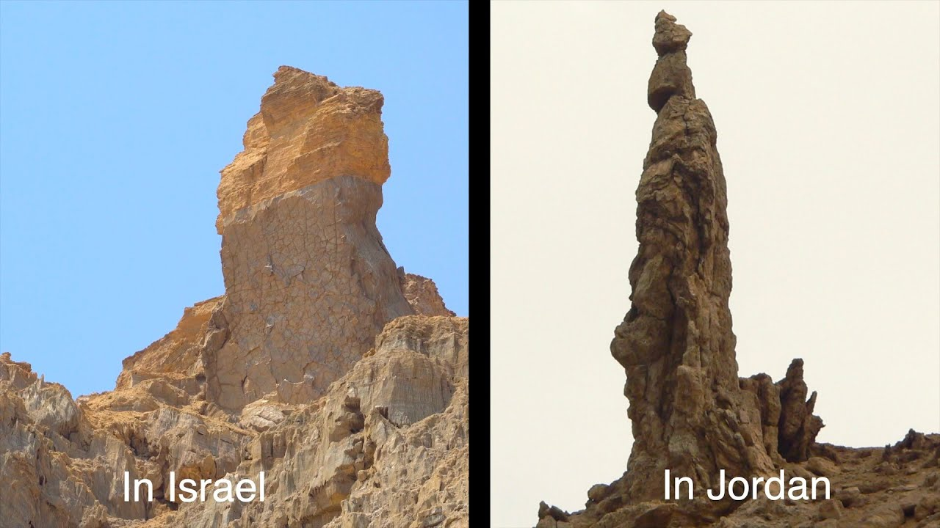
17:11-37
“Lot’s wife”

Slide 25
17:11-37

Slide 26
17:11-37
eagles ~ better, NIV, NASB – vultures
Luke 21:24b ~ Jerusalem will be trampled until the times of the Gentiles be fulfilled.
Rom. 11:25b ~ … blindness in part has happened to Israel until the fullness of the Gentiles has come in.

Slide 27
17:11-37

