Slide 1
14:15-35

Slide 2
14:15-35
Got to the
parking lot and my
car had been stolen …
No,
you don’t understand.
So I thought I’d
come here to end it all,
Got a note from my
wife saying she had ran off with my best
friend.
Today I overslept, missed a big meeting at work. Got fired.
And then you come
along and drink my
poison
Left my wallet in the
taxi

Slide 3
14:15-35

Slide 4
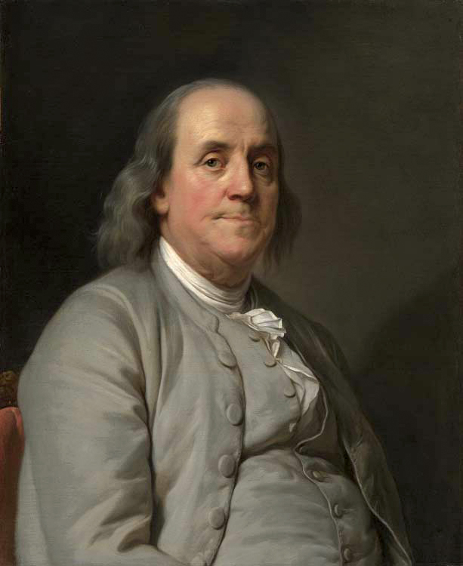
14:15-35
Benjamin Franklin (1706-1790) ~ “A man who is good at making excuses is seldom good for anything else.”

Slide 5
14:15-35

Slide 6
14:15-35
compel (v. 23) ~ anagkazō – ana (between) + ankalē (arm)

Slide 7
14:15-35

Slide 8
14:15-35
hate ~ miseō – a very old and very strong word meaning to hate or detest

Slide 9
14:15-35

Slide 10
14:15-35
Matt. 18:6 (NLT) ~ But if anyone causes one of these little ones who trusts in me to lose faith, it would be better for that person to be thrown into the sea with a large millstone tied around the neck.

Slide 11
14:15-35

Slide 12
14:15-35
There is room at the guillotine for you
At the firing squad, at the firing squad, where I first saw the light

Slide 13
14:15-35
This Photo by Unknown Author is licensed under CC BY-SA-NC

Slide 14
14:15-35

Slide 15
14:15-35
all ~ pan – all, any, every, the whole

Slide 16
14:15-35

Slide 17
14:15-35
John 16:33 ~ These things I have spoken to you, that in Me you may have peace. In the world you will have tribulation; but be of good cheer, I have overcome the world.
Rom. 8:37 ~ Yet in all these things we are more than conquerors through Him who loved us.

Slide 18
14:15-35

Slide 19
14:15-35

Slide 20
14:15-35

Slide 21
14:15-35
Rom. 8:18 ~ For I consider that the sufferings of this present time are not worthy to be compared with the glory which shall be revealed in us.
2 Pet. 1:3a ~ His divine power has given to us all things that pertain to life and godliness,

Slide 22
14:15-35

Slide 23
14:15-35
William Arnot (1808–1875) ~ “It doesn’t take much of a man to be a Christian,
but it does take all of him.”

Slide 24
14:15-35

Slide 25
14:15-35
salary ~ salarium – denoting the soldier’s allotment of salt

Slide 26
14:15-35

Slide 27
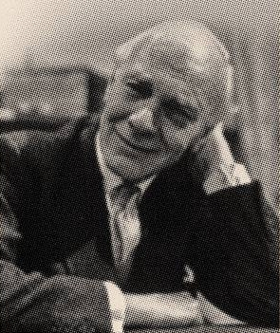
14:15-35
Malcolm Muggeridge (1903-1990) ~ “I have one foot in heaven and one foot on earth, and the foot on earth is on a banana peel.”

Slide 28
14:15-35

