Slide 1
12:11-32

Slide 2
12:11-32
And live as
though He might return at any
minute
Work as
though Jesus wasn’t ever coming
back
John Q. Anonymous

Slide 3
12:11-32

Slide 4
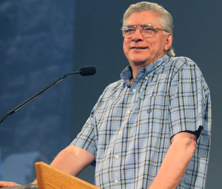
12:11-32
Joe Focht ~ “This is not an argument about fairness … this is about one brother who wants to keep and one brother who wants to get.”

Slide 5
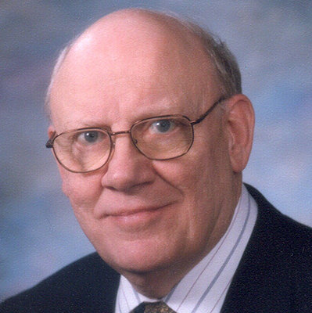
12:11-32
take heed ~ present, active imperative
beware ~ present, middle imperative
Merrihew Standard Version ~ “Always be taking heed and you yourselves be always on guard against covetousness.”
Warren Wiersbe (1929-2019) ~ “The heart of every problem is the problem in the heart.”

Slide 6
12:11-32

Slide 7
12:11-32
Ps. 14:1 ~ The fool has said in his heart,
“There is no God.” (also, Ps. 53:1)

Slide 8
12:11-32

Slide 9
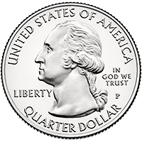
12:11-32
This Photo by Unknown Author is licensed under CC BY-NC

Slide 10
12:11-32
Eccl. 7:2 ~ Better to go to the house of mourning
Than to go to the house of feasting,
For that is the end of all men;
And the living will take it to heart.

Slide 11
12:11-32

Slide 12
12:11-32
worry ~ merimnaō – from root meaning to divide

Slide 13
12:11-32

Slide 14
12:11-32
Prov. 13:22 ~ A good man leaves an inheritance to his children’s children,
But the wealth of the sinner is stored up for the righteous.
Consider ~ katanoeō – think about attentively

Slide 15
12:11-32
Elizabeth Cheney ~ Robin to the Sparrow
Said the robin to the sparrow:
“There is one thing I would really like to know,
Why these anxious human beings
Rush about and worry so.”
Said the sparrow to the robin:
“Friend, I think that it must be
That they have no heavenly Father
Such as cares for you and me.”

Slide 16
12:11-32

Slide 17
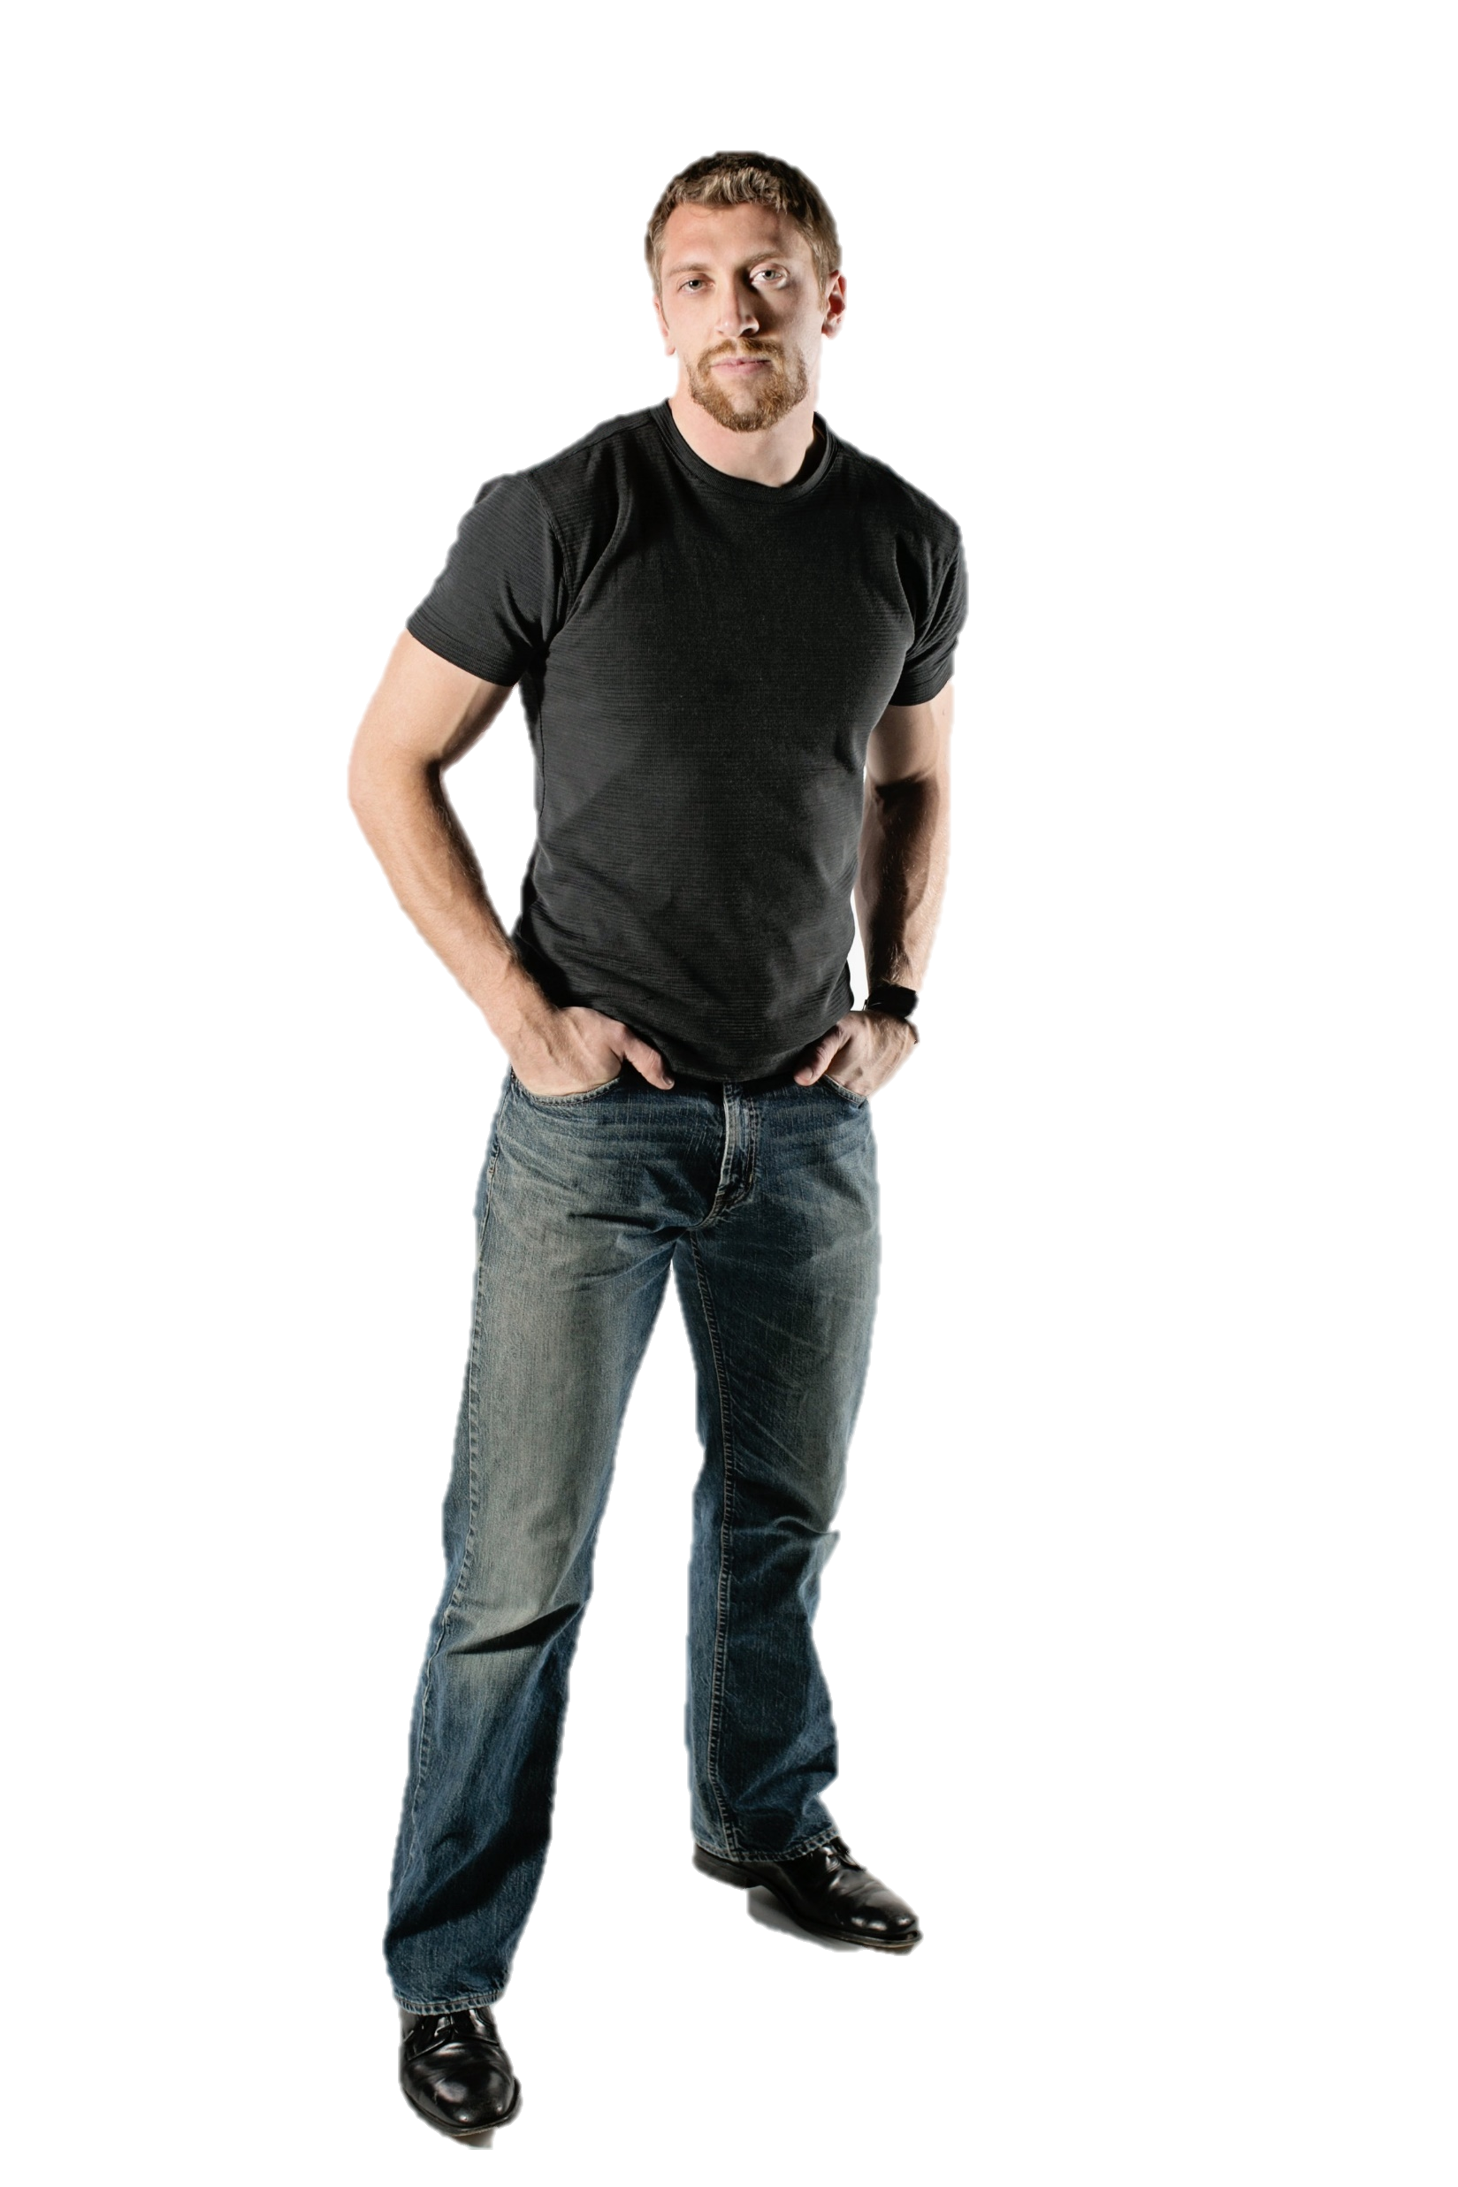
12:11-32
Christians don’t worry …
I know better.
The things I worry about don’t
happen
Don’t tell
me worrying
doesn’t do
any good
we are concerned
I. B. Stressed

Slide 18
12:11-32

Slide 19
12:11-32
Worry
Concern
Runs in circles
Goal oriented
Destructive behavior
Constructive behavior
Focuses on circumstances
Focuses on response to circumstances

Slide 20
12:11-32

Slide 21
12:11-32
anxious mind ~ meterōizō – to suspend (meteor)

Slide 22
12:11-32

Slide 23
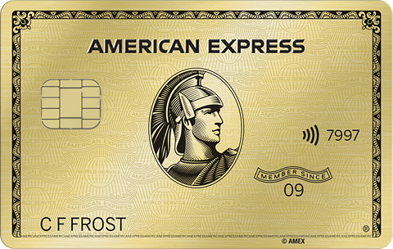
12:11-32
HEAVEN EXPRESS
7777
7777 777777 77777
1981
I M Saved
Don’t leave home without it

Slide 24
12:11-32

