Slide 1
10:21-37

Slide 2
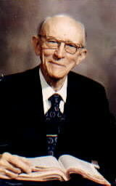
10:21-37
Vance Havner (1901-1986) ~ “Most church members do not give Satan enough trouble to arouse his opposition.”

Slide 3
10:21-37

Slide 4
10:21-37
WORLD'S EASIEST QUIZ
1) How long did the Hundred Years War last?
116 years
2) Which country makes Panama hats?
Ecuador
3) From which animal do we get cat gut?
Sheep and horses
4) In which month do Russians celebrate the October Revolution?
November

Slide 5
10:21-37
WORLD'S EASIEST QUIZ
5) What is a camel’s hair brush made of?
Squirrel fur
6) The Canary Islands in the Pacific are named after what animal?
Dogs
7) What was King George VI’s first name?
Albert
8) What color is the purple finch?
Crimson

Slide 6
10:21-37
WORLD'S EASIEST QUIZ
9) Where are Chinese gooseberries from?
New Zealand
10) What is the color of the black box in a commercial airplane?
Orange
11) In what month is Valentine’s Day really celebrated?
February

Slide 7
10:21-37

Slide 8
10:21-37
John 6:44a ~ No one can come to Me unless the Father who sent Me draws him;

Slide 9
10:21-37
Syllogism: A major premise and a minor premise in which both are considered to be true that logically leads to a conclusion that is also considered to be true
All mammals have hair
Major premise:
Minor premise:
Scott has hair
Logical conclusion:
Therefore, Scott is a mammal

Slide 10
10:21-37
Syllogism: A major premise and a minor premise in which both are considered to be true that logically leads to a conclusion that is also considered to be true
Major premise:
All dogs love food
Minor premise:
Scott loves food
Logical conclusion:
Therefore, …

Slide 11
10:21-37
Syllogism: A major premise and a minor premise in which both are considered to be true that logically leads to a conclusion that is also considered to be true
Major premise:
Only those whom God choses can come to Him
Minor premise:
Logical conclusion:
Not everyone comes to Him
Therefore, God prevents some from coming to Him

Slide 12
10:21-37
2 Pet. 3:9 ~ The Lord is not slack concerning His promise, as some count slackness, but is longsuffering toward us, not willing that any should perish but that all should come to repentance.
John 12:32 ~ “And I, if I am lifted up from the earth, will draw all peoples to Myself.”

Slide 13
10:21-37

Slide 14
10:21-37
1 Pet. 1:10-11 ~ ¹⁰ Of this salvation the prophets have inquired and searched carefully, who prophesied of the grace that would come to you, ¹¹ searching what, or what manner of time, the Spirit of Christ who was in them was indicating when He testified beforehand the sufferings of Christ and the glories that would follow.

Slide 15
10:21-37

Slide 16
10:21-37
lawyer (nomikos - according (or pertaining) to law)
Matt. 4:7 ~ Jesus said to him, “It is written again, ‘You shall not tempt the Lord your God.’”
1 Cor. 10:9 ~ nor let us tempt Christ, as some of them also tempted, and were destroyed by serpents;

Slide 17
10:21-37

Slide 18
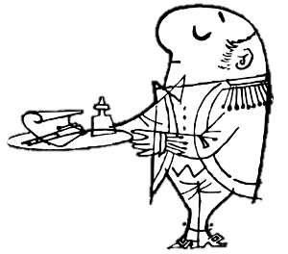
10:21-37
“You can always
tell a servant by how they act when they’re treated like one.”

Slide 19
10:21-37

Slide 20
10:21-37
17 miles
Jerusalem
2500’ above sea level
Jericho
Sea level
1000’ below sea level

Slide 21
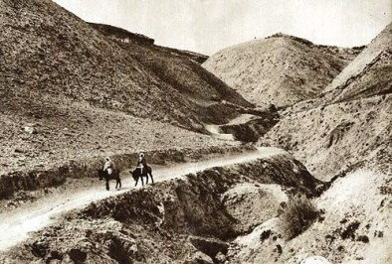
10:21-37
Jerusalem to Jericho Road

Slide 22
10:21-37

Slide 23
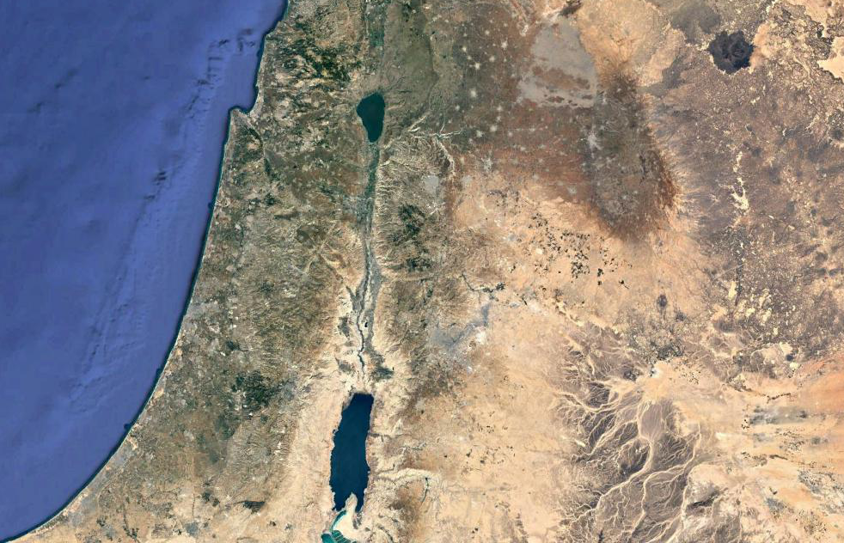
10:21-37
Capernaum
Samaria
Judea
Jerusalem

Slide 24
10:21-37

Slide 25
10:21-37
AN ALLEGORICAL FOLLY
The man is a lost sinner
Stuck between heaven (Jerusalem) and hell (Jericho)
Bruised and bloodied by the world (the thieves)
Half dead (dead spiritually, alive physically)
Religion is unable to help him (priest and Levite)
The Samaritan is Jesus
The 2 denarii are His provision until He does return

Slide 26
10:21-37
AN ALLEGORICAL FOLLY
Who is my neighbor?

Slide 27
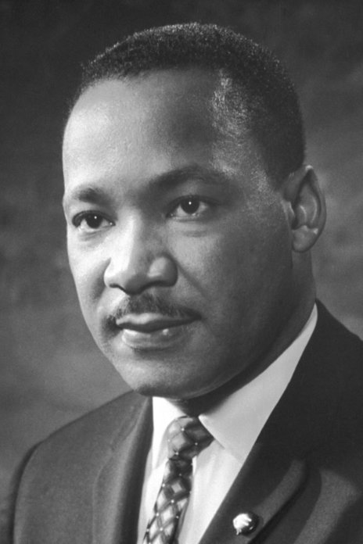
10:21-37
Martin Luther King, Jr. (1929-1968) ~ “The first question which the priest and the Levite asked was: ‘If I stop to help this man, what will happen to me?’ But … the good Samaritan reversed the question: ‘If I do not stop to help this man, what will happen to him?’”

Slide 28
10:21-37

