Slide 1
9:18-36

Slide 2
9:18-36
Cool Hand Luke (1967)

Slide 3
9:18-36

Slide 4
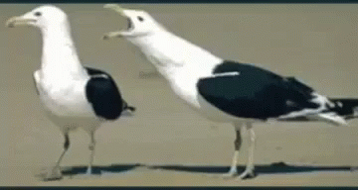
9:18-36
Words women use and what they really mean
1. Fine …
2. Five minutes …
3. Nothing …
4. Go ahead …
5. Loud sigh …
Wives, if your husband tells you he’ll fix it, he will. You don’t have to remind him about it every 6 months
6. That’s OK …
7. Thanks …
8. Whatever …
9. Don’t worry about it. I got it …

Slide 5
9:18-36

Slide 6
9:18-36

Slide 7
9:18-36

Slide 8
9:18-36
Matt. 16:23; Mark 8:33 ~ “… you are not mindful of the things of God, but the things of men.”

Slide 9
9:18-36

Slide 10
9:18-36
“But you – who do you say that I am?”

Slide 11
9:18-36

Slide 12
9:18-36
Jesus’ 7 “I AM” statements in John
1. John 6:51 ~ I am the living bread which came down from heaven. If anyone eats of this bread, he will live forever; and the bread that I shall give is My flesh, which I shall give for the life of the world.
2. John 8:12 ~ I am the light of the world. He who follows Me shall not walk in darkness, but have the light of life.
3. John 10:7 ~ I am the door of the sheep.
4. John 10:11 ~ I am the good shepherd. The
good shepherd gives His life for the
sheep.

Slide 13
9:18-36
Jesus’ 7 “I AM” statements in John
5. John 11:25 ~ I am the resurrection and the life. He who believes in Me, though he may die, he shall live.
6. John 14:6 ~ I am the way, the truth, and the life. No one comes to the Father except through Me.
7. John 15:1 ~ I am the true vine, and My Father is the vinedresser.
Rev. 1:8 ~ I am the Alpha and the Omega, the Beginning and the End … who is and who was and who is to come, the Almighty. (see Is. 46:10)

Slide 14
9:18-36

Slide 15
9:18-36
Jesus was either the
Grossly disoriented
Liar –
Greatest deceiver of all time
Glorious Deity
Lunatic
Lord –

Slide 16
9:18-36
Jesus’ 7 “I AM” statements in John
John 6:35 ~ I am the bread of life. He who comes to Me shall never hunger, and he who believes in Me shall never thirst.

Slide 17
9:18-36

Slide 18
9:18-36
1 Cor. 2:9-10 ~ ⁹ But as it is written:
“Eye has not seen, nor ear heard,
Nor have entered into the heart of man
The things which God has prepared for those who love Him.” (Is. 64:4)
¹⁰ But God has revealed them to us through His Spirit. For the Spirit searches all things, yes, the deep things of God.

Slide 19
9:18-36

Slide 20
9:18-36
DYING TO SELF
When you are forgotten, or neglected, or purposely set at naught, and you don’t sting and hurt with the insult or the oversight, but your heart is happy, being counted worthy to suffer for Christ.
THAT IS DYING TO SELF
When your good is evil spoken of, when your wishes are crossed, your advice disregarded, your opinions ridiculed, and you refuse to let anger rise in your heart, or even defend yourself, but take in all in
patient, loving silence.
THAT IS DYING TO SELF

Slide 21
9:18-36
DYING TO SELF
When you lovingly and patiently bear any disorder, any irregularity, any impunctuality, or any annoyance; when you stand face-to- face with waste, folly, extravagance, spiritual insensibility – endure it as Jesus endured.
THAT IS DYING TO SELF
When you are content with any food, any offering, any climate, any society, any raiment, any interruption by the will of God.
THAT IS DYING TO SELF

Slide 22
9:18-36
DYING TO SELF
When you never care to refer to yourself in conversation, or to record your own good works, or itch after commendations, when you can truly love to be unknown.
THAT IS DYING TO SELF
When you can see your brother prosper and have his needs met and can honestly rejoice with him in spirit and feel no envy, nor question God, while your own needs are far greater and in desperate
circumstances.
THAT IS DYING TO SELF

Slide 23
9:18-36
DYING TO SELF
When you can receive correction and reproof from one of less stature than yourself and can humbly submit inwardly as well as outwardly, finding no rebellion or resentment rising up within your heart.
THAT IS DYING TO SELF
Phil. 3:10 ~ That I may know Him, and the power of his resurrection, and the fellowship of his sufferings, being made conformable unto his death.
THAT IS DYING TO SELF

Slide 24
9:18-36

Slide 25
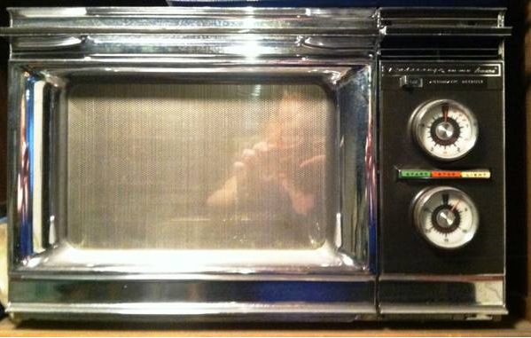
9:18-36
If it doesn’t say “AMANA” …
… it isn’t a

Slide 26
9:18-36

Slide 27
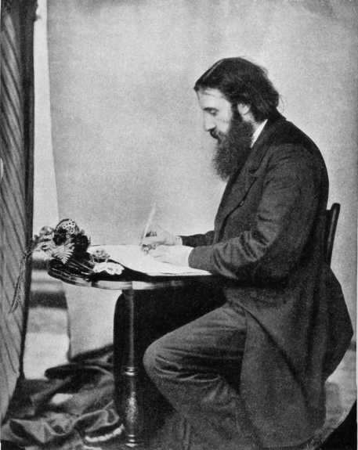
9:18-36
George MacDonald (1824-1905) ~ “Christ died to save us, not from suffering, but from ourselves; not from injustice, far less from justice, but from being unjust. He died that we might live —but live as he lives, by dying as he died who died to himself that he might live unto God. If we do not die to ourselves, we cannot live to God, and he that does not live to God, is dead.”
This Photo by Unknown Author is licensed under CC BY-SA

Slide 28
9:18-36

Slide 29
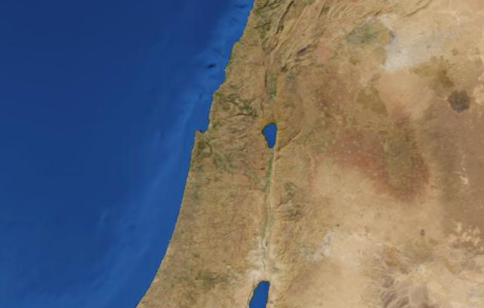
9:18-36
Mt. Herman
Caesarea Philippi
Mt. Tabor

Slide 30
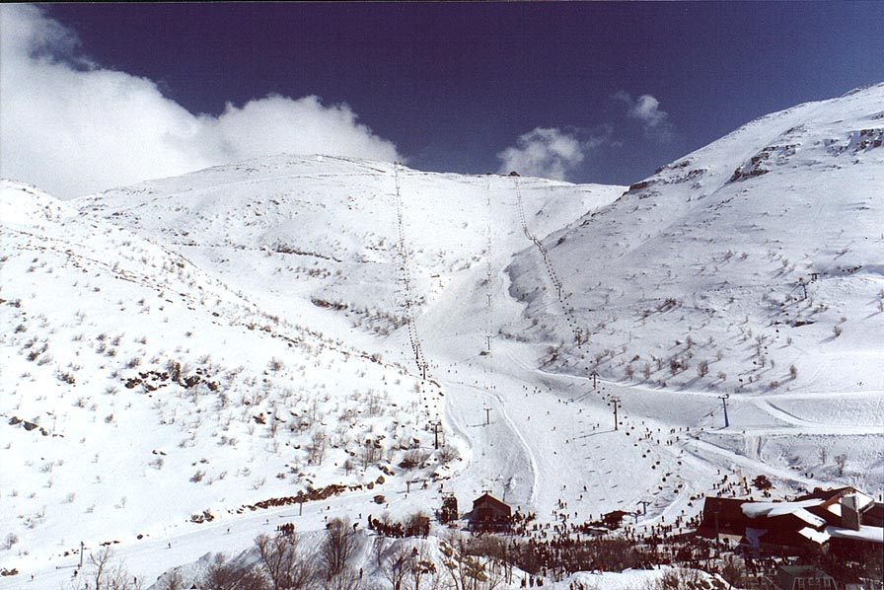
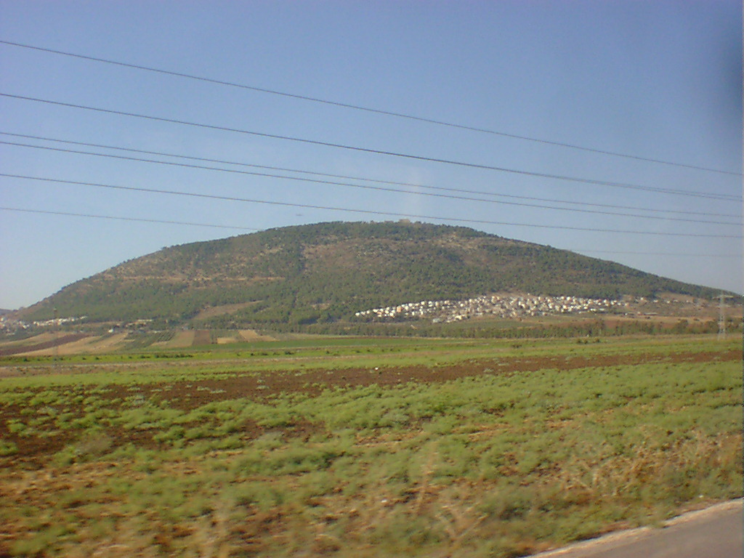
9:18-36
Mt. Hermon
Mt. Tabor

Slide 31
9:18-36
9232’
Mt. Hermon
1843’
Mt. Tabor

Slide 32
9:18-36

Slide 33
9:18-36
altered ~ heteros – another of a different kind
Mark 9:3 ~ transfigured ~ metamorphoō – to change from within
NIV ~ His clothes became as bright as a flash of lightning.

Slide 34
9:18-36

Slide 35
9:18-36
decease ~ NASB, NIV – departure
exodos
NLT ~ exodus

Slide 36
9:18-36

Slide 37
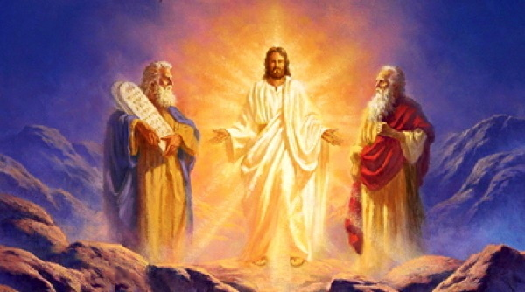
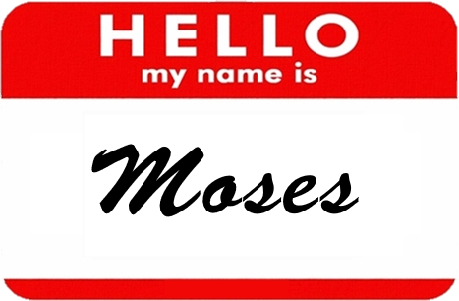
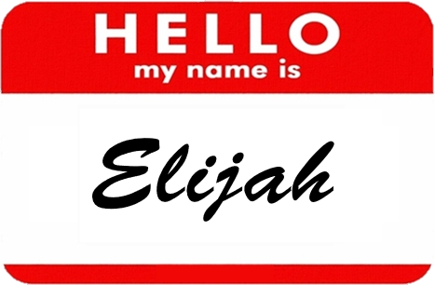
9:18-36

Slide 38
9:18-36
Why Moses and Elijah?
Moses
~ the Law
Old Testament
Elijah
~ the Prophets
Moses
~ died without seeing the promises
All
redeemed
Elijah
~ the Rapture

Slide 39
9:18-36

Slide 40
9:18-36
Mark 9:10 ~ So they kept this word to themselves, questioning what the rising from the dead meant.
from ~ ek – out of or out from among

Slide 41
9:18-36

