Slide 1
7:1-23

Slide 2
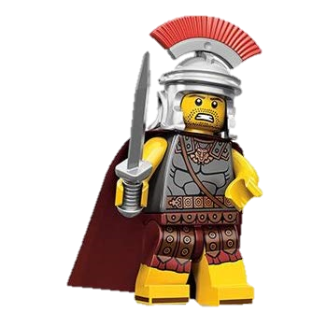
7:1-23
Centurions in the New Testament:
In Capernaum (Matt. 8:5-13; Luke 7:1-10)
At the Cross (Matt. 27:54; Mark 13:32)
Cornelius (Acts 10)
Paul’s journey to Rome (Acts 27:1-28:16)

Slide 3
7:1-23
Polybius (c. 208 – c. 125 BC) ~ “Must not be so much seekers after danger as men who can command, steady in action, and reliable; they ought not to be over anxious to rush into
the fight; but when hard pressed they must be ready to hold their ground and die at their post.”

Slide 4
7:1-23

Slide 5
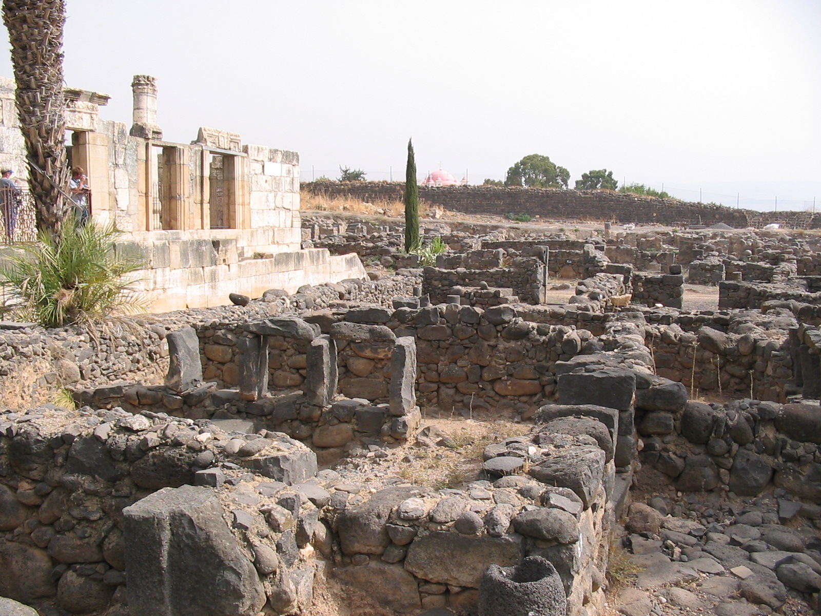
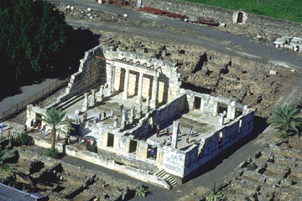
7:1-23
Capernaum Synagogue (c. AD 200)
N
1st century basalt buildings

Slide 6
7:1-23

Slide 7
7:1-23
marveled ~ thaumazō
33x in the Gospels
31x by others marveling at Jesus
2x by Jesus
Mark 6:6a ~ And He marveled because of their unbelief

Slide 8
7:1-23

Slide 9
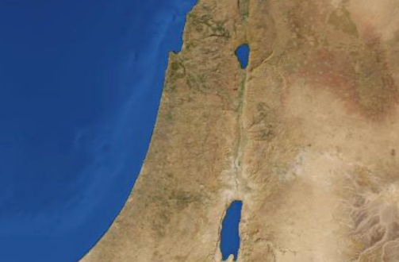
7:1-23
Capernaum
25 mi
Nain

Slide 10
7:1-23

Slide 11
7:1-23
compassion ~ splagchnizomai
Verb form of splagchnon ~ bowels
compassion ~ from Latin – to suffer with

Slide 12
7:1-23

Slide 13
7:1-23
has visited ~ episkoptomai – medical term
epi ~ upon + skoptomai ~ to peer about

Slide 14
7:1-23
the Great Physician
the Doctor is in
the Doctor is out
This Photo by Unknown Author is licensed under CC BY

Slide 15
7:1-23

Slide 16
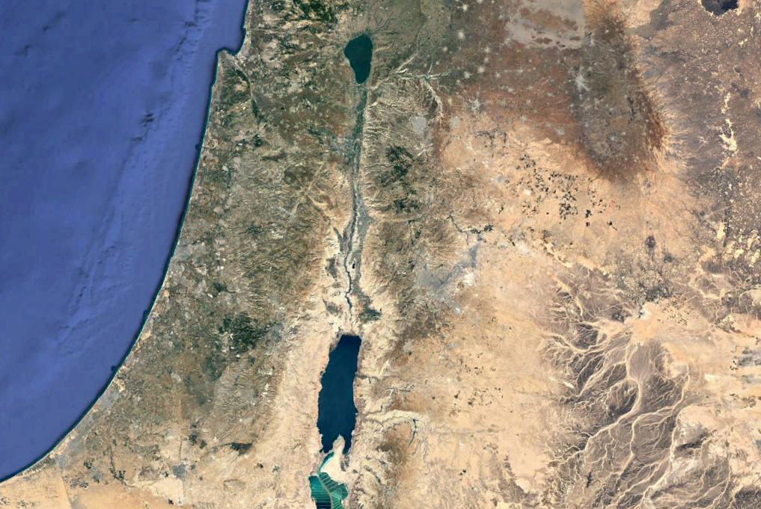
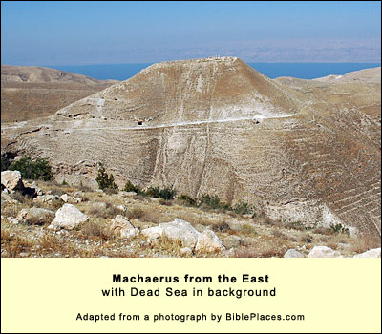
7:1-23
Maccaerus
Fortress

Slide 17
7:1-23
N

Slide 18
7:1-23
Luke 4:18b ~ To proclaim liberty to the captives

Slide 19
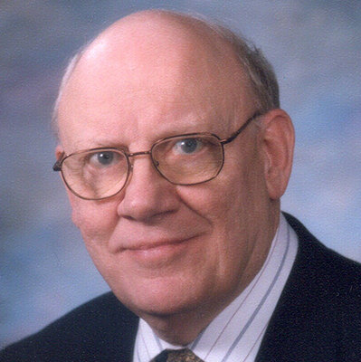
7:1-23
Warren Wiersbe (1929-2019) ~ “There is a difference between doubt and unbelief. Doubt is a matter of the mind: we cannot understand what God is doing or why He is doing it. Unbelief is a matter of the will: we refuse to believe God’s Word and obey
what He tells us to do.”

Slide 20
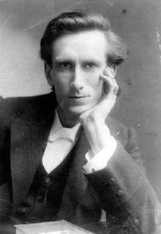
7:1-23
Oswald Chambers (1874-1917) ~ “Doubt is not always a sign that a man is wrong … it may be a sign that he is thinking.”
“It is not our trust that keeps us, but the God in whom we trust who keeps us.”
“Trustfulness is based on confidence in God, whose ways I do not understand. If I did, there would be no need for trust.”

Slide 21
7:1-23

Slide 22
7:1-23
offended ~ skandalizō
Wuest ~ And spiritually prosperous is he whoever does not find in me that of which he disapproves and which hinders him from acknowledging my authority.

Slide 23
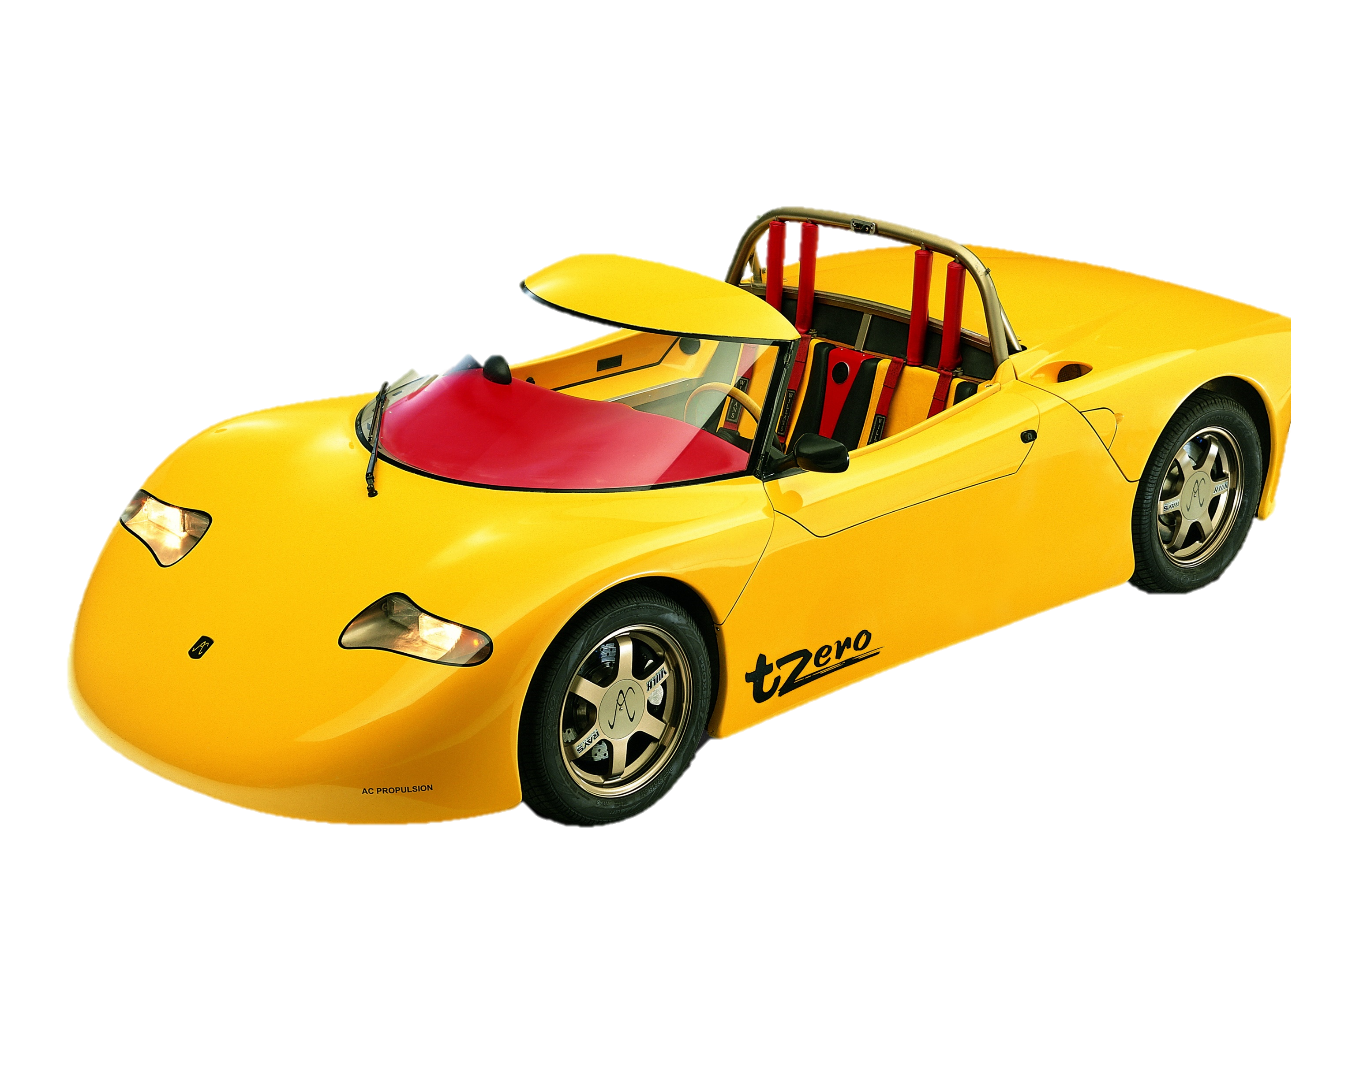
7:1-23
GOD
Faith
God’s promises
Sight

Slide 24
7:1-23

