Slide 1
5:16-39

Slide 2
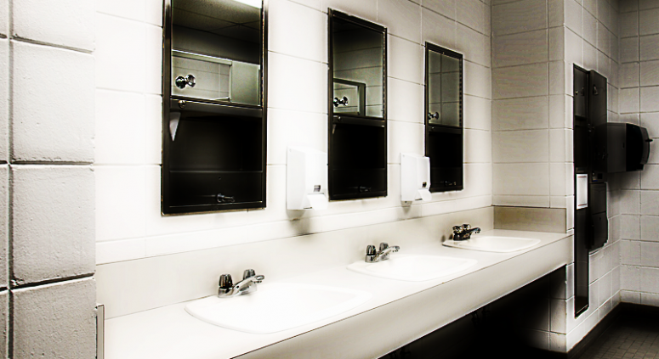
5:16-39

Slide 3
5:16-39

Slide 4
5:16-39
Luke 5:15 ~ However, the report went around concerning Him all the more; and great multitudes came together to hear, and to be healed by Him of their infirmities.

Slide 5
5:16-39

Slide 6
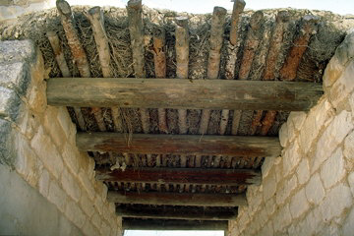
5:16-39
bed ~ klinidion – a diminutive form of klinē – bed or table
6-8” mud and thatch
3” poles
8” beams

Slide 7
5:16-39

Slide 8
5:16-39
Son of Man ~ 1st of 25x in Luke

Slide 9
5:16-39

Slide 10
5:16-39
amazed ~ ekstasis – literally, out of place or beside themselves (ecstasy)
strange things ~ paradoxos – paradox (a seemingly absurd or self-contradictory statement or proposition that when investigated or explained may prove to be well founded or true.)

Slide 11
5:16-39

Slide 12
5:16-39
Levi ~ Leuis ~ “joined”
Matthew ~ Matthios – “gift of Yahweh”

Slide 13
5:16-39

Slide 14
5:16-39
Follow Me ~ literally, “I command you hereafter to be following Me”

Slide 15
5:16-39

Slide 16
5:16-39
They held the Scriptures in very high esteem
They thought their righteousness would flow from that
They believed their interpretation of the Scriptures was only acceptable one
They thought living according to their interpretation brought righteousness
They allowed their interpretation to supersede the Scriptures
Therefore, by contrast, anyone who disagreed with them was deemed as unrighteous

Slide 17
5:16-39

Slide 18
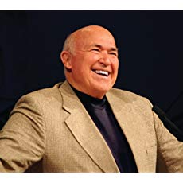
5:16-39
Chuck Smith (1927-2013) ~ “It is bad to develop a critical spirit. Once you develop a critical spirit, then you find that you are able to find fault with anything and everything. It’s sad when a person puts himself on the place of judgment where he feels that he has the right to judge the actions, the activities, the thoughts, the intents, the motives of other people.”

Slide 19
5:16-39

Slide 20
5:16-39
tear ~ schizo

Slide 21
5:16-39

Slide 22
5:16-39

