Slide 1
4:14-37

Slide 2
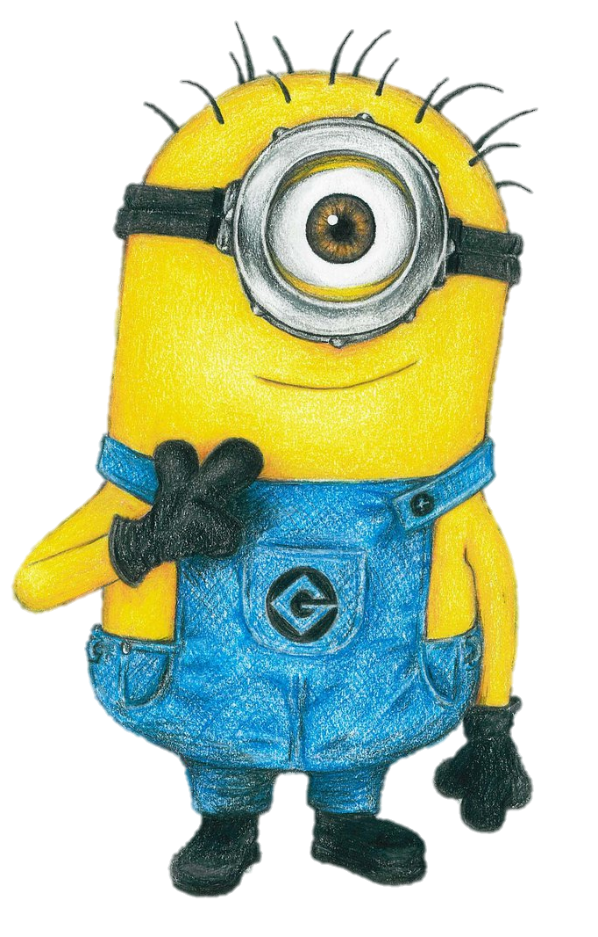
4:14-37

Slide 3
4:14-37

Slide 4
4:14-37
news ~ phēmē

Slide 5
4:14-37
Josephus: 204 towns and villages
Population over 10,000
Galilee

Slide 6
4:14-37

Slide 7
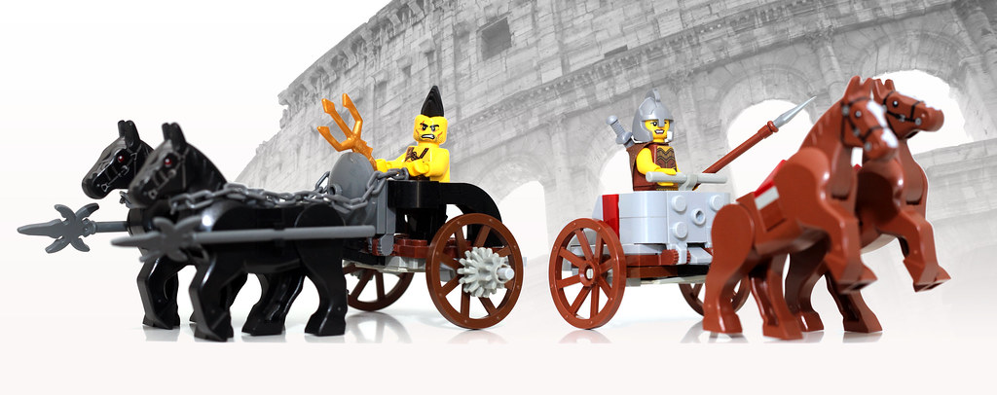
4:14-37
Chariot up, Baby!

Slide 8
4:14-37

Slide 9
4:14-37
Is. 61:2b ~ the day of vengeance of our God.
Isaiah’s prophecy ca. 725 BC
Is. 61:1-2a fulfilled ca. 30 AD
Is. 61:2b
fulfilled ca. 2000 AD
2000 years
500
BC/AD
500
1000
1500
2000
1st Coming
2nd Coming

Slide 10
4:14-37

Slide 11
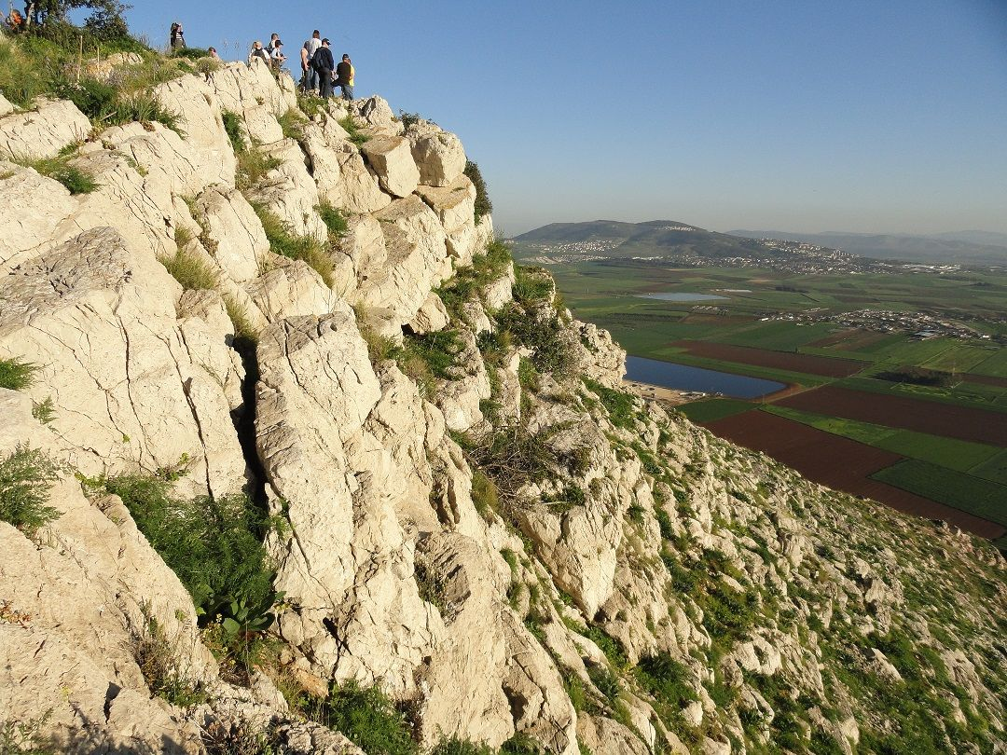
4:14-37
Mt. of Jumpification
Mt. Precipice, Nazareth

Slide 12
4:14-37

Slide 13
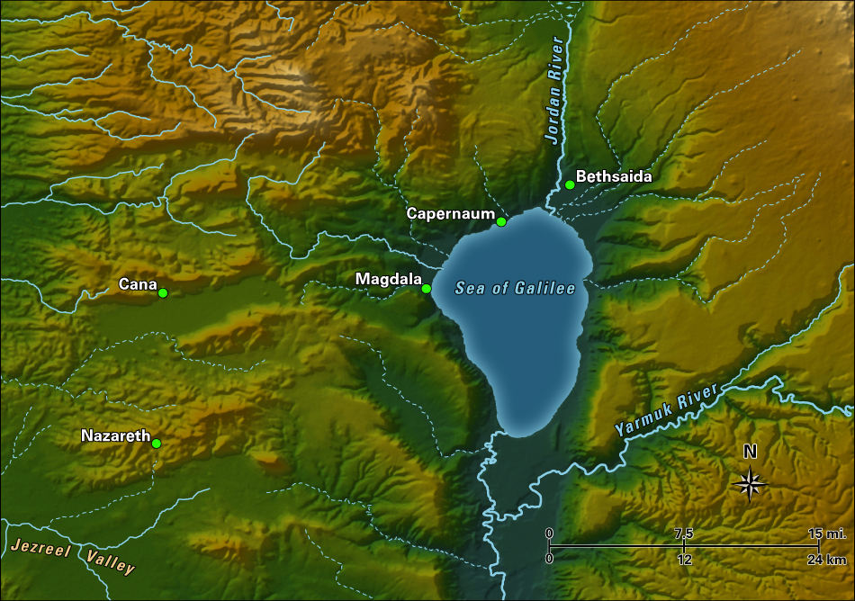
4:14-37
20 mi.

Slide 14
4:14-37

Slide 15
4:14-37
Jam. 2:19 ~ You believe that there is one God. You do well. Even the demons believe – and tremble!
F
F
orsaking
A
A
ll
I
I
T
T
rust
H
H
im

Slide 16
4:14-37

Slide 17
4:14-37
Be quiet ~ phimoō – verb form of the noun muzzle
KJV, Hold thy peace

Slide 18
4:14-37

Slide 19
4:14-37
John 6:66 ~ From that time many of His disciples went back and walked with Him no more.

Slide 20
4:14-37

