Slide 1
4:1-13

Slide 2
4:1-13
led ~ (Wuest) in the control of the Holy Spirit,
NASB ~ led about
Mark 1:12 ~ Immediately the Spirit drove Him into the wilderness.
drove ~ ekballō – to cast out

Slide 3
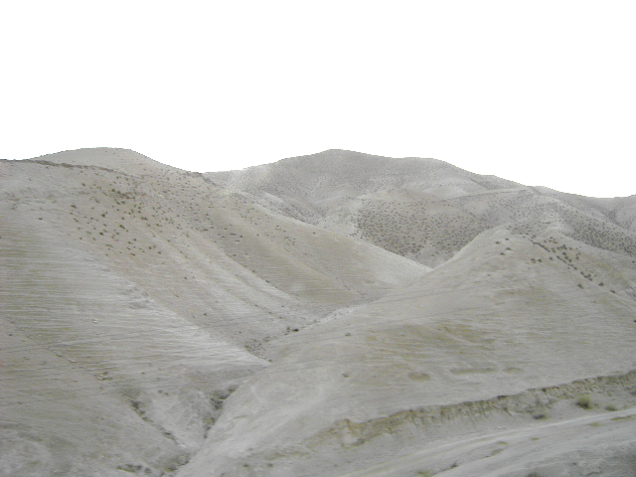
4:1-13
Judean Wilderness
120
110
100
Up to 120-125º
90
80
70
60
50
40
30
This Photo by Unknown Author is licensed under CC BY-SA

Slide 4
4:1-13

Slide 5
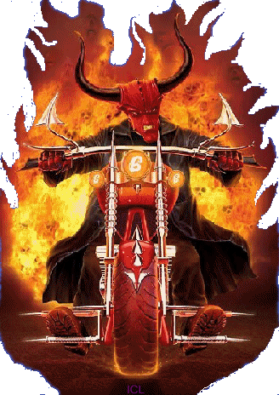
4:1-13
Ghost Rider
Red PJs
Simon Legree
Snidley Whiplash

Slide 6
4:1-13

Slide 7
4:1-13
Since
You are the Son of God
If
“Condition of the 1st class”
The outcome of the possibility is understood

Slide 8
4:1-13
2 Cor. 4:3-4 ~ ³ But even if our gospel is veiled, it is veiled to those who are perishing, ⁴ whose minds the god of this age has blinded, who do not believe, lest the light of the gospel of the glory of Christ, who is the image of God, should shine on them.

Slide 9
4:1-13
1 John 2:16 ~ For all that is in the world – the lust of the flesh, the lust of the eyes, and the pride of life – is not of the Father but is of the world.

Slide 10
4:1-13

Slide 11
4:1-13
lust of the flesh
Gen. 3:6 ~ So when the woman saw that the tree was good for food,

Slide 12
4:1-13

Slide 13
4:1-13
lust of the eyes
lust of the flesh
Gen. 3:6 ~ So when the woman saw that the tree was good for food,
that is was pleasant to the eyes,

Slide 14
4:1-13

Slide 15
4:1-13
lust of the eyes
pride of life
Gen. 3:6 ~ So when the woman saw that the tree was good for food,
that is was pleasant to the eyes,
and a tree desirable to make one wise,

Slide 16
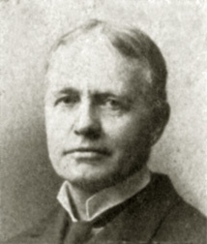
4:1-13
Edward Judson (1844-1914) ~ “If we succeed without suffering, it is because others have suffered before us. If we suffer without succeeding, it is that others may succeed after us.”

Slide 17
4:1-13
Deut. 17:18–20 ~ ¹⁸ “Also it shall be, when he sits on the throne of his kingdom, that he shall write for himself a copy of this law in a book, from the one before the priests, the Levites. ¹⁹ And it shall be with him, and he shall read it all the days of his life, that he may learn to fear the Lord his God and be careful to observe all the words of this law and these statutes, ²⁰ that his heart may not be lifted above
his brethren,

Slide 18
4:1-13
Deut. 17:18–20 ~ that he may not turn aside from the commandment to the right hand or to the left, and that he may prolong his days in his kingdom, he and his children in the midst of Israel.

Slide 19
4:1-13
Zech. 3:2 ~ And the Lord said, “The Lord rebuke you, Satan!”

Slide 20
4:1-13

Slide 21
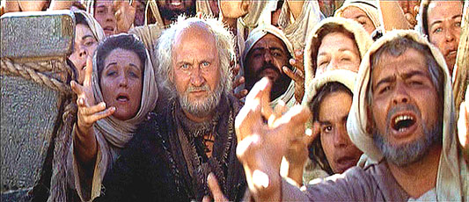
4:1-13

Slide 22
4:1-13
Heb. 4:15 ~ For we do not have a High Priest who cannot sympathize with our weaknesses, but was in all points tempted as we are, yet without sin.

Slide 23
4:1-13

Slide 24
4:1-13
1 Cor. 10:12-13 (NLT) ~ ¹² If you think you are standing strong, be careful not to fall. ¹³ The temptations in your life are no different from what others experience. And God is faithful. He will not allow the temptation to be more than you can stand. When you are tempted, he will show you a way out so that you can endure.

Slide 25
4:1-13

