Slide 1
3:1-38

Slide 2
3:1-38
Luke 2:51-52 ~ ⁵¹ Then He went down with them and came to Nazareth, and was subject to them, but His mother kept all these things in her heart. ⁵² And Jesus increased in wisdom and stature, and in favor with God and men.

Slide 3
3:1-38

Slide 4
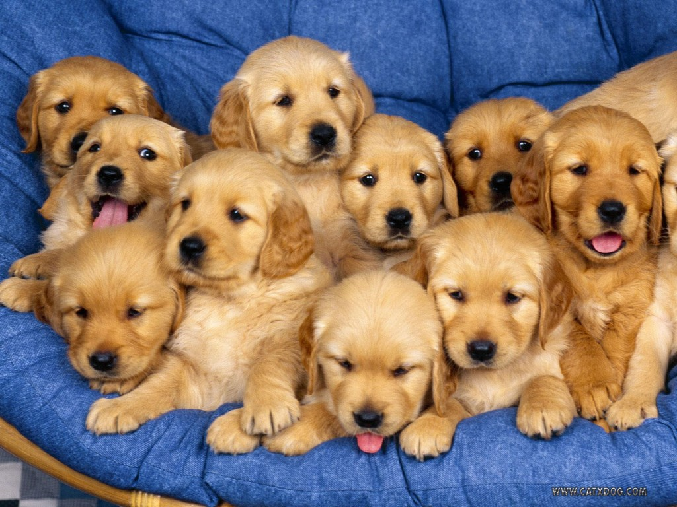
3:1-38
This Photo by Unknown Author is licensed under CC BY-SA-NC

Slide 5
3:1-38

Slide 6
3:1-38
Here lies the body
of Jonathan Blake
Stepped on the gas
Instead of the brake.
Sir John Strange
Here lies an honest lawyer,
And that is Strange.
Owen Moore
Gone away
Owin' more
Than he could pay.

Slide 7
3:1-38
Harry Edsel Smith
Born 1903—Died 1942
Looked up the elevator shaft to see if
The car was on the way down.
It was.
Under the sod and under the trees
Lies the body of Jonathan Pease.
He is not here, there’s only the pod:
Pease shelled out and went to God.

Slide 8
3:1-38
Remember man, as you walk by,
As you are now, so once was I,
As I am now, so shall you be,
Remember this and follow me.
To follow you I’ll not consent,
Until I know which way you went.

Slide 9
3:1-38

Slide 10
3:1-38
Herod the Great
Archelaus
Herod Antipas
Herod Philip
Decapolis

Slide 11
3:1-38

Slide 12
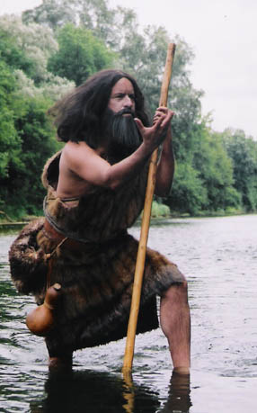
3:1-38

Slide 13
3:1-38
Luke 7:28 ~ For I say to you, among those born of women there is not a greater prophet than John the Baptist; but he who is least in the kingdom of God is greater than he.
John 10:41 ~ Then many came to Him and said, “John performed no sign, but all the things that John spoke about this Man were true.”

Slide 14
3:1-38

Slide 15
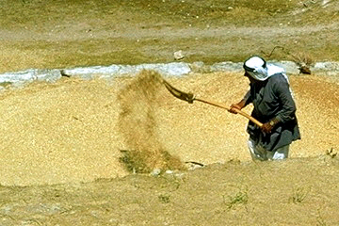
3:1-38
Winnowing fan

Slide 16
3:1-38

Slide 17
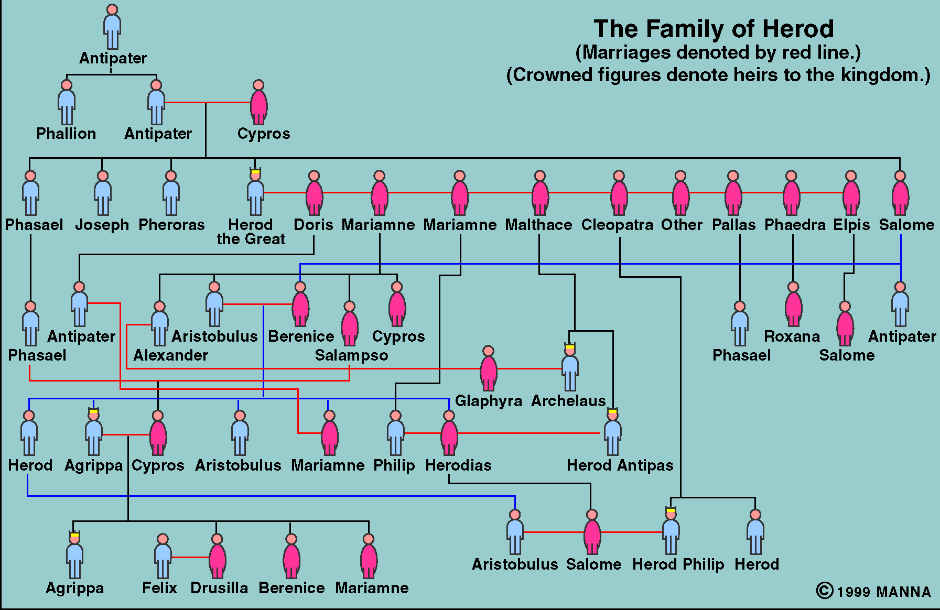
3:1-38
Caesar Augustus ~ “It is better to be Herod’s pig (hus) than his son (huios).”
HEROD the GREAT
King of Judea
B e c a u s e I a m M e
Herod the Great
Marries Mariamne II
They have a son, Philip
He has another wife, Malthace
They have a son, Antipas
Herod’s sister, Salome, has a daughter, Berenice
Berenice has a daughter, Herodias
She marries her 2nd cousin, Philip
They have a daughter, Salome
Herodias leaves Philip for Antipas
Salome dances for Antipas

Slide 18
3:1-38

Slide 19
3:1-38
Matt. 3:15 ~ But Jesus answered and said to him, “Permit it to be so now, for thus it is fitting for us to fulfill all righteousness.” Then he allowed Him.
1) It identified Him with sinful man
2) It prefigured His later “baptism” on the Cross

Slide 20
3:1-38

Slide 21
3:1-38
Comparing Matt. 1:1-17 with Luke 3:23-38
Matthew
Luke
Joseph’s line
Mary’s line
Through David’s son, Solomon
Through David’s son, Nathan
From Abraham to Jesus
From Jesus back to Adam
Legal right to the throne
Blood right to the throne

Slide 22
3:1-38
Jer. 22:30 ~ Thus says the LORD: “Write this man down as childless,
A man who shall not prosper in his days;
For none of his descendants shall prosper,
Sitting on the throne of David,
And ruling anymore in Judah.”

Slide 23
3:1-38
Matthew includes a genealogy to show that Jesus is a fulfillment of God’s promise to Abraham through David
Matthew ~ Jesus is the Messiah
Mark ~ Jesus is the Servant
Mark doesn’t include a genealogy because slaves didn’t have a pedigree
Luke ~ Jesus is the Son of Man
Luke includes a genealogy to show that Jesus is a Son of Adam
John ~ Jesus is the Son of Gon
John doesn’t include a genealogy because God doesn’t have a pedigree

Slide 24
3:1-38

